Slide 1
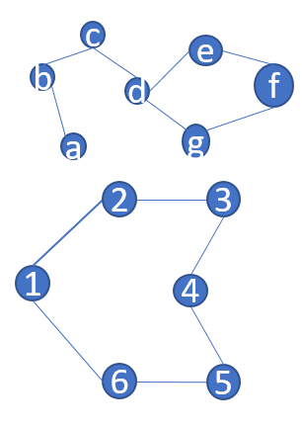
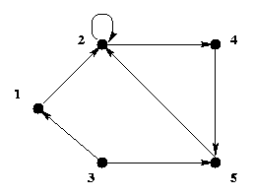
c
e
b
d
f
a
g
2
3
1
4
6
5
Path: d-e-f-g-d-c-b-a-2-3-4-5-6-1-2
Circuit: 2-3-4-5-6-1-2-a-b-c-d-e-f-g-d-2

Slide 2
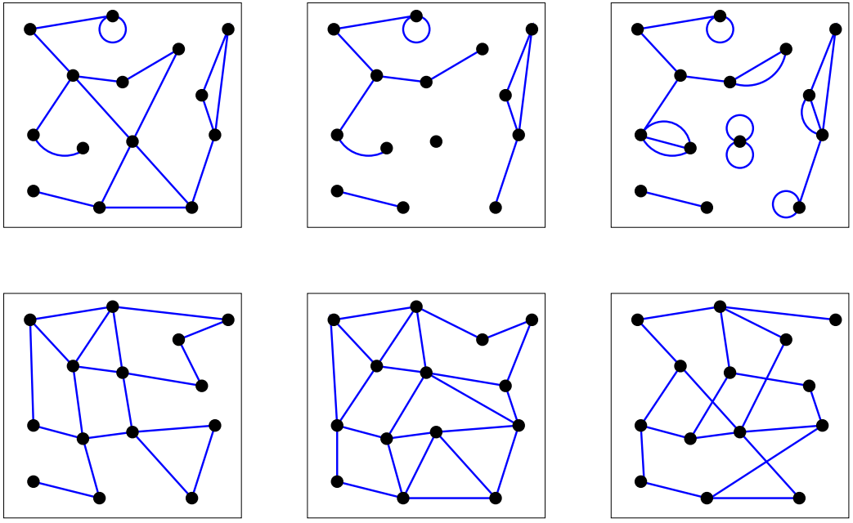

Slide 3
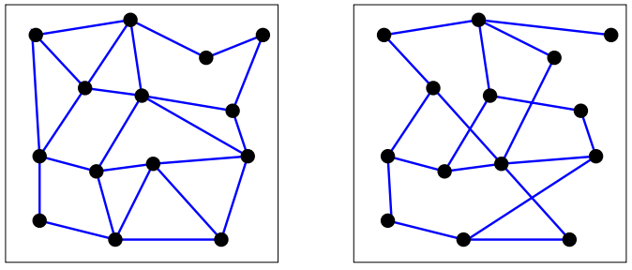

Slide 4
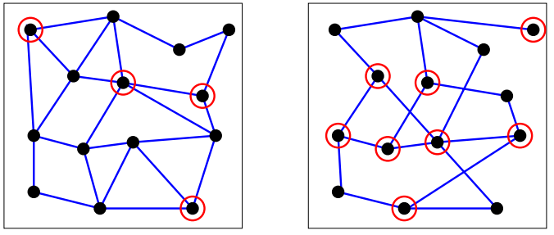

Slide 5
