Slide 1
Introduction to Large Language Models (LLMs)
LLMs are advanced AI models trained on massive text datasets

Slide 2
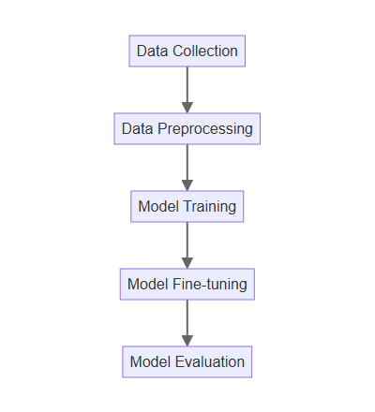
LLM Training Process
Data collection involves gathering diverse text from various sources
Preprocessing cleans and prepares the data for model training
The model learns patterns and relationships within the text data
Fine-tuning adapts the model to specific tasks and domains
Evaluation assesses performance using metrics like perplexity and BLEU score

Slide 3

Key LLM Architectures
Transformer networks are the foundation of most modern LLMs
Attention mechanisms allow models to focus on relevant parts of the input
Encoder-decoder models are used for tasks like machine translation
Decoder-only models are employed for text generation and completion

Slide 4

Applications of LLMs
Chatbots provide automated customer service and support
Content creation generates articles, blog posts, and marketing copy
Code generation assists developers by automating coding tasks
Translation services enable communication across different languages
Sentiment analysis helps understand public opinion and customer feedback

Slide 5
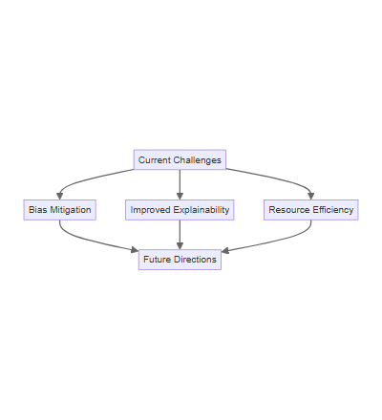
Challenges and Future Directions
Bias in training data can lead to unfair or discriminatory outputs
Explainability and interpretability of LLM decisions remain a challenge
Computational resources required for training are substantial
Research focuses on improving efficiency and reducing bias
Ethical considerations are crucial for responsible LLM development and deployment

