Slide 1
Project Management Process Overview
A structured approach to managing projects from initiation to closure.

Slide 2
Project Initiation & Planning
**Initiation:** Defining project scope, objectives, and stakeholders. Securing necessary approvals and resources.
**Planning:** Developing a detailed project plan, including timelines, budgets, and resource allocation. Identifying potential risks and developing mitigation strategies. Establishing communication and reporting procedures.

Slide 3
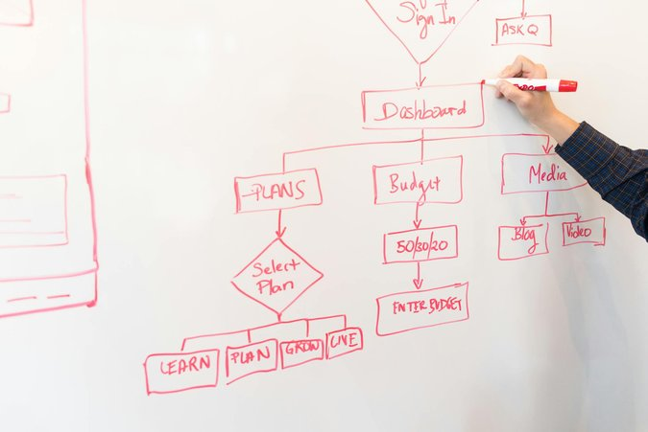
Project Execution & Monitoring
**Execution:** Carrying out the project plan, managing tasks, and coordinating team efforts. Regular progress updates and communication with stakeholders.
**Monitoring & Controlling:** Tracking progress against the plan, identifying deviations, and taking corrective actions. Managing risks and issues as they arise. Performance reporting and change management.

Slide 4
Project Closure & Review
**Closure:** Formally closing the project upon completion. Finalizing deliverables, documentation, and financial reporting. Conducting post-project reviews to identify lessons learned and best practices.
**Benefits of Effective Closure:** Improved project outcomes, enhanced team performance, and valuable insights for future projects. Formal handover to operations and client sign-off.

