Slide 1
What is Machine Learning?
Machine learning allows computers to learn from data without explicit programming.

Slide 2

Types of Machine Learning
Supervised learning uses labeled data to train models for prediction.
Unsupervised learning finds patterns in unlabeled data for insights.
Reinforcement learning trains agents to make optimal decisions in an environment.
Each type has unique strengths and applications in different domains.

Slide 3
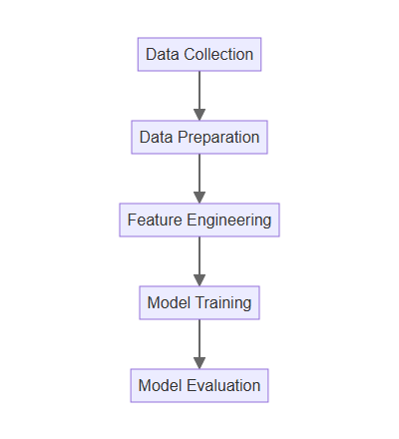
How Machine Learning Works
Data collection and preparation are crucial initial steps.
Features are extracted and selected to represent the data effectively.
A model is trained using algorithms to learn patterns from the data.
The trained model is evaluated and refined for optimal performance.

Slide 4

Applications of Machine Learning
Image recognition enables computers to identify objects and faces.
Natural language processing allows machines to understand and generate text.
Medical diagnosis can be improved through ML-powered analysis.
Self-driving cars rely heavily on machine learning algorithms.

Slide 5

Future of Machine Learning
Continued advancements in algorithms and computing power.
Growing adoption across industries and integration into everyday life.
Ethical considerations and responsible development are crucial.
Machine learning will play a transformative role in shaping the future.

