Slide 1
Introduction to Process Workflow
A process workflow is a series of steps or actions that are followed in order to complete a specific task or achieve a particular goal.

Slide 2
Key Components of a Workflow
**Activities:** Individual tasks or steps within the workflow.
**Actors:** Individuals or systems responsible for executing activities.
**Transitions:** Connections between activities, defining the flow of work.
**Decisions:** Points where the workflow branches based on conditions.
**Data:** Information required or produced during the workflow execution.

Slide 3

Benefits of Implementing Workflows
**Increased Efficiency:** Streamlined processes reduce time and effort.
**Improved Quality:** Standardized steps ensure consistent results.
**Enhanced Collaboration:** Clear roles and responsibilities facilitate teamwork.
**Better Tracking and Monitoring:** Workflow management systems provide visibility into progress.
**Reduced Errors:** Automated steps minimize manual intervention and human error.

Slide 4
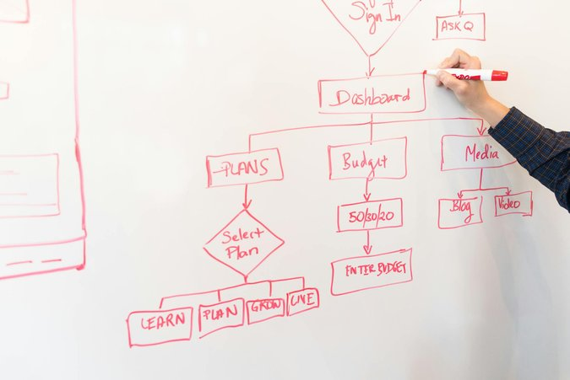
Workflow Design and Management
**Define Objectives:** Clearly state the goals and desired outcomes of the workflow.
**Document the Process:** Map out the steps involved in detail.
**Choose the Right Tools:** Select appropriate software or platforms for workflow automation.
**Monitor and Optimize:** Regularly review and refine the workflow for continuous improvement.
**Training and Communication:** Ensure all stakeholders understand the workflow and their roles.

Slide 5
title

