Slide 1
Understanding the Production Cycle
The production cycle encompasses all stages from raw materials to finished goods

Slide 2

Raw Material Procurement
Sourcing high-quality materials at competitive prices is key
Supplier relationships and efficient inventory management are vital
Just-in-time inventory systems minimize storage costs and waste
Forecasting demand accurately ensures uninterrupted production

Slide 3
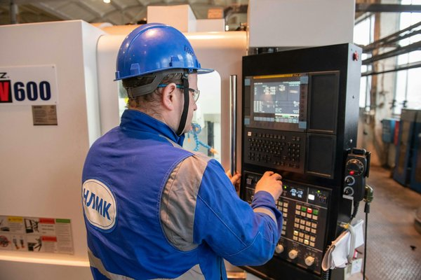
Processing and Transformation
This stage involves converting raw materials into usable components
Machinery, technology, and skilled labor are critical factors
Process optimization improves efficiency and reduces production time
Quality control checks at each step maintain product integrity

Slide 4
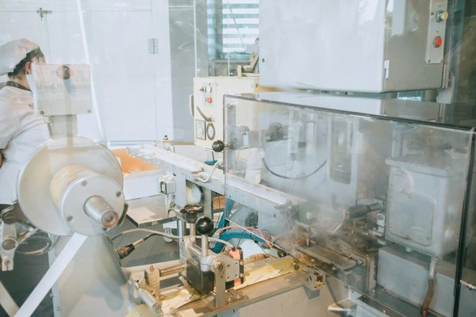
Assembly and Manufacturing
Components are assembled to create the final product
Automation and robotics enhance speed and precision
Lean manufacturing principles minimize waste and improve workflow
Stringent quality checks ensure product meets specifications

Slide 5

Quality Control and Testing
Rigorous testing ensures product quality and reliability
Automated testing and manual inspections are employed
Defect tracking and analysis identify areas for improvement
Compliance with industry standards and regulations is mandatory

Slide 6
Packaging and Distribution
Packaging protects the product during transportation and storage
Efficient logistics ensures timely delivery to customers
Inventory management systems track stock levels and optimize distribution
Customer feedback informs packaging and delivery improvements

