Slide 1
Urgent Bath Time!
Cleanliness is crucial!

Slide 2

Gather Your Supplies
Soap/body wash is essential.
Shampoo for hair cleansing.
Towels for drying off.
Washcloth/loofah optional.

Slide 3

Water Temperature Check
Test water, avoid scalding.
Aim for comfortably warm.
Adjust as needed.

Slide 4
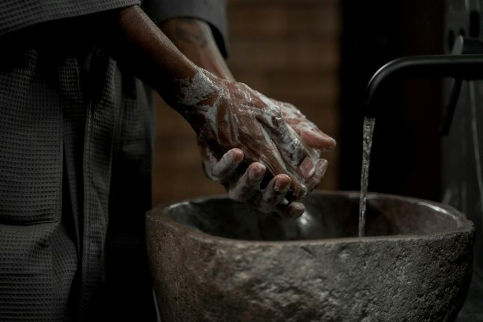
Lather Up and Rinse
Apply soap/body wash.
Scrub thoroughly all over.
Rinse completely.
Shampoo and condition hair.

Slide 5

Drying Off
Pat skin dry with towel.
Avoid harsh rubbing.
Apply moisturizer if desired.

Slide 6
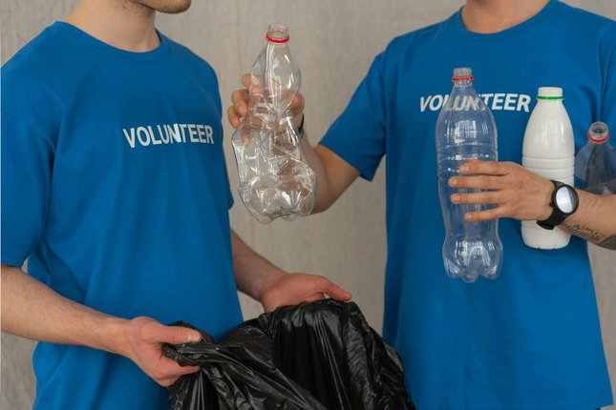
You're Done!
Enjoy the clean feeling!
Bathe regularly for hygiene.
Stay healthy and refreshed.

