Slide 1
Unleash Your Potential with Brother Technology
Brother: A Legacy of Innovation and Empowerment

Slide 2

Printing Reimagined: Brother's Innovative Printers
High-quality printing for all your academic needs
From compact home printers to robust business solutions
Explore wireless printing, mobile connectivity, and eco-friendly options
Unleash your creativity with vibrant color and sharp detail

Slide 3
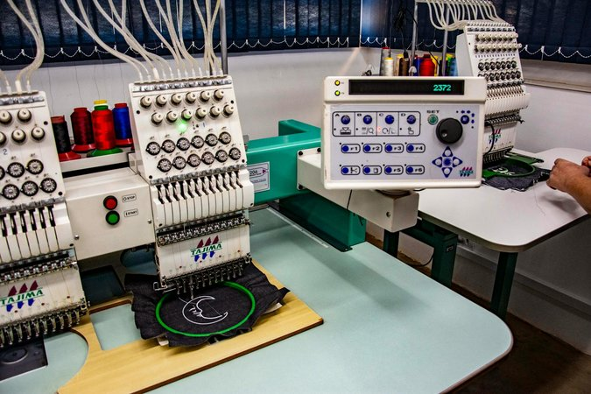
Beyond Printing: Explore Brother's Diverse Solutions
Sewing and embroidery machines for fashion design and crafting
Labeling and scanning solutions for organization and efficiency
Industrial equipment for professional applications
Discover a world of possibilities beyond traditional printing

Slide 4

Empowering Creativity and Productivity
Streamline your workflow with Brother's connected solutions
Enhance your projects with professional-grade results
From classroom assignments to entrepreneurial ventures, Brother has you covered
Embrace technology that empowers you to achieve more

Slide 5

Your Future with Brother: Innovation and Beyond
Explore career opportunities in technology and design
Discover how Brother is shaping the future of innovation
Join a community of creators and professionals
Let Brother inspire your journey towards success

