Slide 1
Getting Ready
Gather towels and clothes.

Slide 2
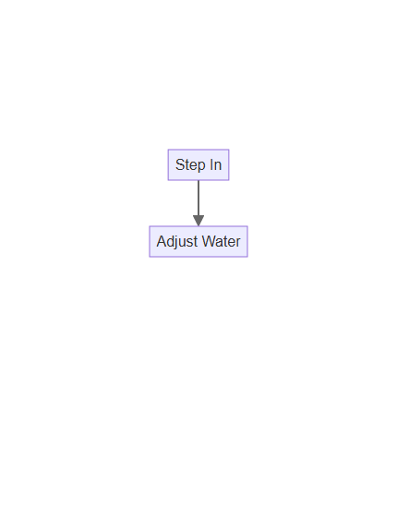
Into the Tub/Shower
Step in carefully.
Adjust water if needed.

Slide 3
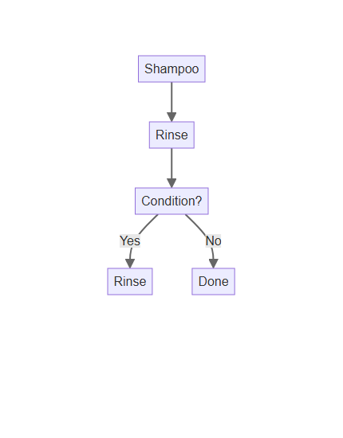
Wash Your Hair
Apply shampoo.
Rinse thoroughly.
Condition (optional).

Slide 4
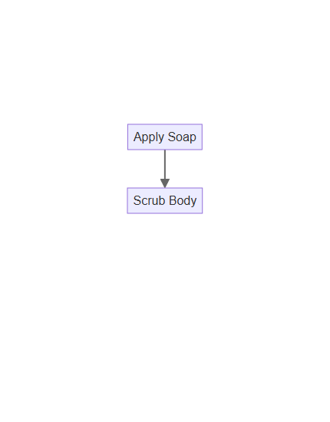
Wash Your Body
Use soap or body wash.
Scrub gently all over.

Slide 5
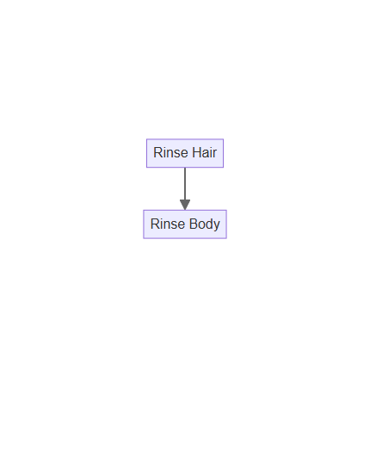
Rinse Off
Ensure all soap is gone.
Enjoy the warm water.

Slide 6
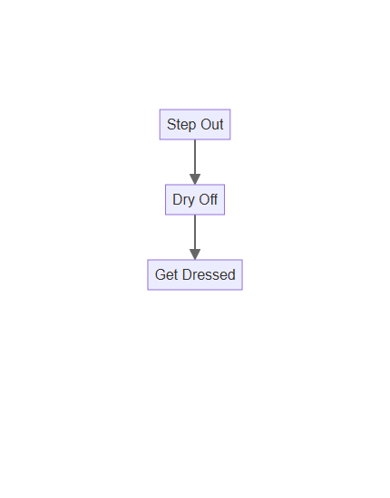
Dry Off and Dress
Step out carefully.
Dry with a towel.
Get dressed.

