Slide 1
Introduction to Python
Python is a high-level, general-purpose programming language known for its readability and versatility.

Slide 2

Variables and Data Types
Variables store data values and are assigned using the `=` operator.
Common data types include:
Integers (int): whole numbers (e.g., 10, -5, 0)
Floats (float): decimal numbers (e.g., 3.14, -2.5)
Strings (str): text enclosed in quotes (e.g., "Hello", 'Python')
Booleans (bool): True or False values
...

Slide 3
Operators
Arithmetic operators: `+`, `-`, `*`, `/`, `//` (floor division), `%` (modulo), `**` (exponentiation)
Comparison operators: `==` (equal to), `!=` (not equal to), `>`, `<`, `>=`, `<=`
Logical operators: `and`, `or`, `not`
Assignment operators: `=`, `+=`, `-=`, `*=`, `/=`, etc.

Slide 4
Control Flow
`if`, `elif`, and `else` statements allow conditional execution of code blocks.
`for` loops iterate over a sequence (e.g., list, string, range).
`while` loops repeat a block of code as long as a condition is true.
Indentation is crucial for defining the scope of code blocks within control flow structures.

Slide 5
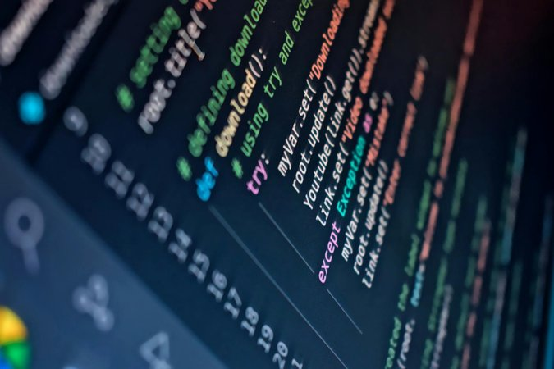
Functions
Functions are reusable blocks of code that perform specific tasks.
Defined using the `def` keyword followed by the function name and parentheses.
Parameters can be passed to functions to customize their behavior.
The `return` statement sends a value back from the function.

