Slide 1
Introduction to Machine Learning
Machine learning allows computers to learn from data without explicit programming.

Slide 2
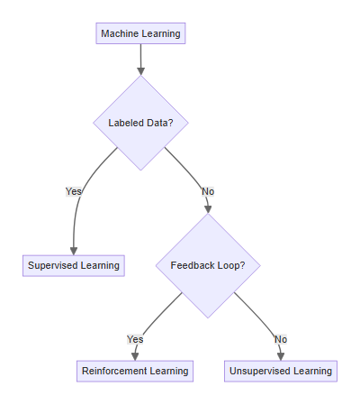
Types of Machine Learning
Supervised learning uses labeled data to train models for prediction.
Unsupervised learning finds patterns in unlabeled data for insights.
Reinforcement learning trains agents to make optimal decisions in an environment.
Each type addresses different problems and requires specific techniques.

Slide 3

The Machine Learning Workflow
Data collection and preparation are crucial initial steps.
Feature engineering and selection impact model performance.
Model training involves choosing and optimizing algorithms.
Evaluation and deployment ensure real-world effectiveness.

Slide 4

Machine Learning in Environmental Science
Predicting climate change impacts using weather data analysis.
Optimizing resource allocation for sustainable practices.
Monitoring pollution levels and identifying sources.
Protecting endangered species through habitat modeling.

Slide 5

Challenges and Future Directions
Data bias and interpretability require careful consideration.
Computational resources and scalability can be limiting factors.
Ethical implications and responsible AI development are crucial.
Continued research and development promise further advancements.

