Slide 1
LED Board Technical Specifications - Overview
Conforms to IS16103 (Part 1 & 2): 2012

Slide 2
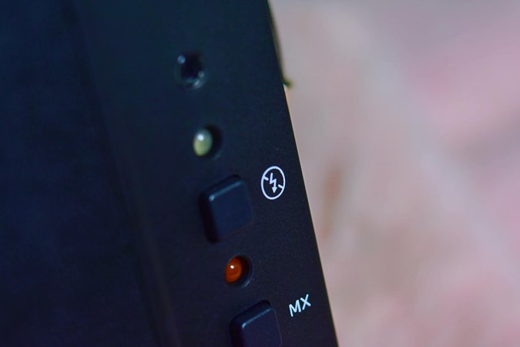
Board Specifications
Input Voltage: 12V/24VDC/110AC
Reflective Panel Thickness: 9mm
Operating Temperature: 50°C to 60°C
LED Density: 220 LEDs per meter

Slide 3

Frame Specifications
Material: Aluminium - IS 5082
Protection: Anodization, IP 20
Available Colors: Silver/Black

Slide 4
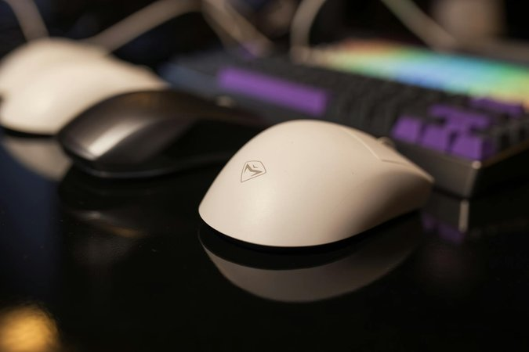
LED Specifications
Color: Cool white
Average Lifespan: 30,000 hrs
Temperature Range: -50°C to 60°C
Rated Current: 5 amps to 16 amps

Slide 5
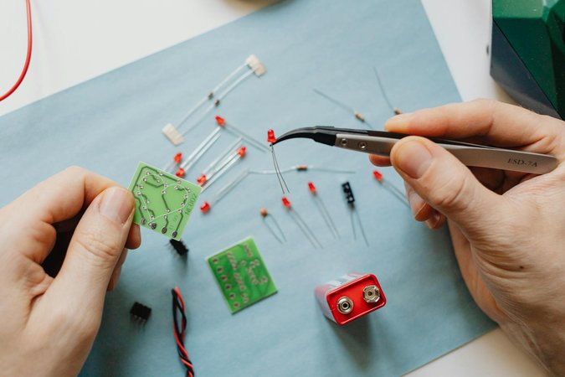
LED Specifications (cont.)
Power Consumption: 20W/minute
Luminous Efficiency: 6-7 lm/LED
Wiring: Direct connection to power supply for each light box (no series wiring)

Slide 6
Installation Locations and Sizes
Coaching Depot Hyderabad: 4ft x 6ft (2 units, 48 sqft)
IOH Shed: 2ft x 6ft (1 unit, 12 sqft)
Layout: 4ft x 6ft (1 unit, 24 sqft)
Coach Care Center (SP-1): 2ft x 6ft (1 unit, 12 sqft)
Bio Lab: 2ft x 2ft (1 unit, 4 sqft)

Slide 7

Sign-off and Verification
Digitally signed by Sureddy Srinivas
Date: 2025.03.05
Reason: IREPS-CRIS
Location: New Delhi

Slide 8
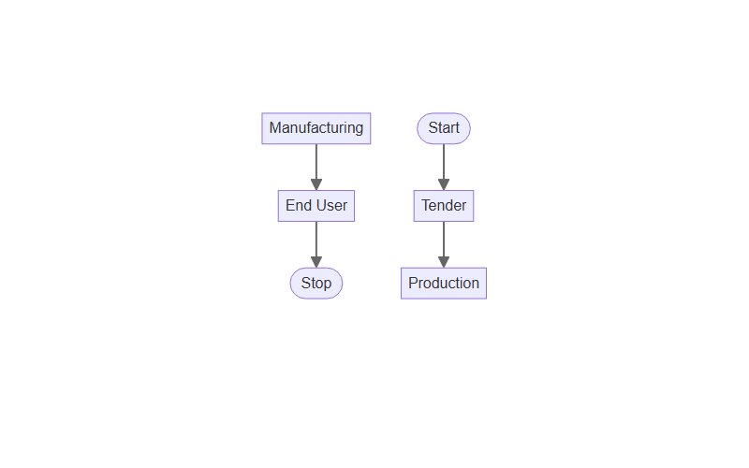
Process Involved

