Slide 1
What is Machine Learning?
Machine learning allows computers to learn from data without explicit programming.

Slide 2

Types of Machine Learning
Supervised learning uses labeled data to train models for prediction.
Unsupervised learning finds patterns in unlabeled data for insights.
Reinforcement learning trains agents to make optimal decisions in an environment.
Each type has unique strengths and applications in different domains.

Slide 3
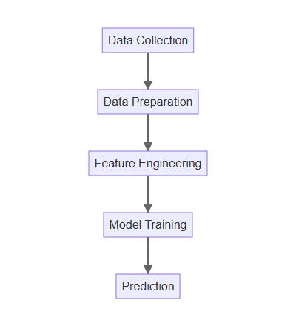
How Machine Learning Works
Data collection and preparation are crucial initial steps.
Features are extracted and selected to represent the data effectively.
A model is trained using algorithms to learn patterns from the data.
The trained model is then used to make predictions on new data.

Slide 4

Machine Learning Applications
Image recognition identifies objects and patterns in images.
Natural language processing enables computers to understand and generate text.
Speech recognition converts spoken language into text for various applications.
These applications are transforming industries and our daily lives.

Slide 5

The Future of Machine Learning
Advancements in algorithms and hardware are driving rapid progress.
Ethical considerations and responsible AI development are crucial.
Machine learning will continue to transform industries and society.
Understanding its potential and limitations is essential for everyone.

