Slide 1
Introduction to Machine Learning
Machine learning allows computers to learn from data without explicit programming.

Slide 2
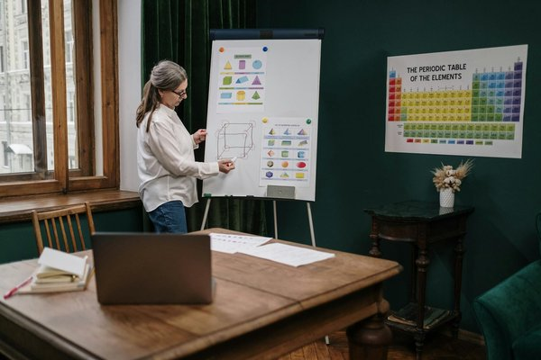
Supervised Learning
Supervised learning uses labeled data to train models.
Algorithms learn the relationship between input features and output labels.
Examples include linear regression, logistic regression, and support vector machines.
Predictive modeling for tasks like classification and regression.

Slide 3
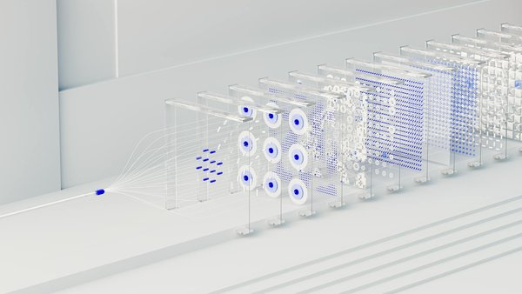
Unsupervised Learning
Unsupervised learning explores unlabeled data to discover hidden patterns.
Algorithms identify clusters, reduce dimensionality, and detect anomalies.
Examples include k-means clustering, principal component analysis, and association rule mining.
Useful for exploratory data analysis and feature engineering.

Slide 4
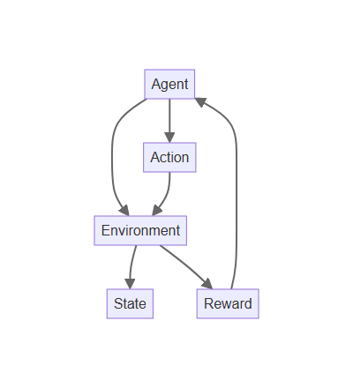
Reinforcement Learning
Reinforcement learning trains agents to make optimal decisions in an environment.
Agents learn through trial and error, receiving rewards for desired actions.
Applications include robotics, game playing, and resource management.
Driving advancements in autonomous systems and adaptive control.

Slide 5

Deep Learning
Deep learning uses artificial neural networks with multiple layers.
Learns complex representations from vast amounts of data.
Powers applications like image recognition, natural language processing, and speech recognition.
Driving breakthroughs in artificial intelligence and machine learning.

