Slide 1
Project Initiation: Defining Success
Clear objectives & scope

Slide 2
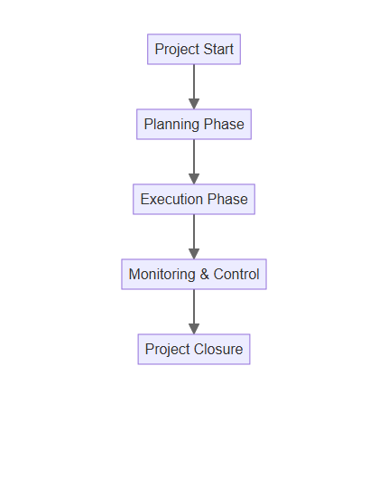
Effective Planning & Execution
Detailed project plan
Risk management strategy
Regular progress tracking
Communication protocols

Slide 3

Communication & Collaboration
Transparent communication
Regular stakeholder updates
Collaborative tools & platforms
Open feedback channels

Slide 4

Continuous Improvement & Closure
Post-project review
Document lessons learned
Process optimization
Celebrate successes

