Slide 1
What is Machine Learning?
Machine learning allows computers to learn from data without explicit programming.

Slide 2
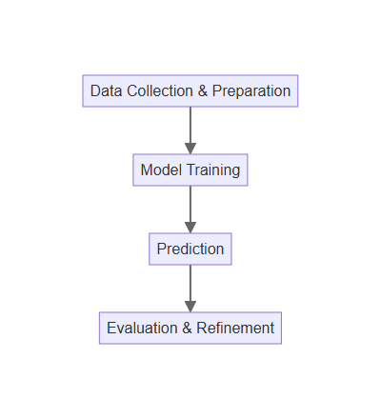
How Machine Learning Works
Data is collected and prepared to train the machine learning model.
The model learns patterns and relationships within the data.
Predictions are made on new, unseen data based on the learned patterns.
The model's performance is evaluated and refined through iterations.

Slide 3
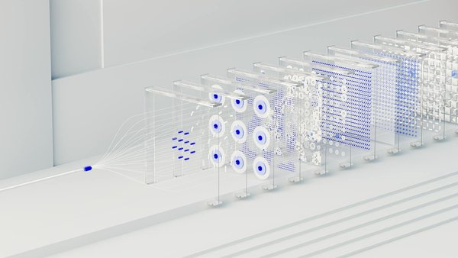
Types of Machine Learning
Supervised learning uses labeled data to train models for prediction.
Unsupervised learning finds patterns in unlabeled data for insights.
Reinforcement learning trains agents to make optimal decisions in an environment.
Each type has unique applications and algorithms.

Slide 4
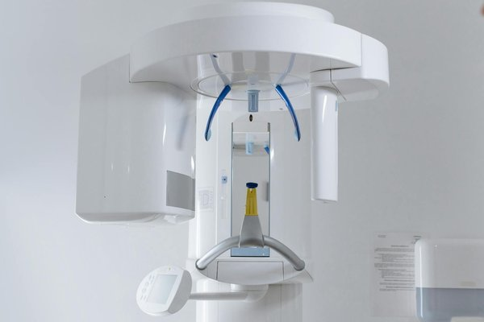
Machine Learning in Action
Self-driving cars use ML to navigate and make decisions in real-time.
Medical imaging analysis uses ML for faster and more accurate diagnoses.
Personalized recommendations on streaming platforms are powered by ML.
These are just a few examples of ML's impact across industries.

Slide 5

The Future of Machine Learning
Advancements in ML are driving innovation in various fields.
Ethical considerations and responsible AI development are crucial.
The demand for ML expertise continues to grow rapidly.
Understanding ML is essential for navigating the future of technology.

