Slide 1
Understanding Shame
Shame is a painful emotion characterized by a sense of worthlessness, defect, and powerlessness.

Slide 2

The Roots of Shame
Early childhood experiences, such as criticism, neglect, or abuse, can contribute to the development of shame.
Trauma and significant life stressors can also trigger feelings of shame.
Societal and cultural messages about worthiness and acceptability play a role.

Slide 3

The Impact of Shame
Shame can lead to social isolation, withdrawal, and difficulty forming close relationships.
It can contribute to mental health issues like depression, anxiety, and addiction.
Shame can manifest physically through symptoms like chronic pain, fatigue, and digestive problems.

Slide 4

Recognizing Shame Triggers
Identifying personal shame triggers is crucial for managing shame.
Common triggers include criticism, rejection, failure, and public humiliation.
Keeping a journal can help track shame-inducing situations and emotional responses.

Slide 5

Challenging Shameful Thoughts
Shame often involves distorted and negative self-perceptions.
Challenging these thoughts with evidence and self-compassion is essential.
Reframing negative self-talk into more positive and realistic statements can help.

Slide 6

Practicing Self-Compassion
Self-compassion involves treating oneself with kindness, understanding, and acceptance.
Recognizing that everyone makes mistakes and experiences difficult emotions is key.
Engaging in self-care activities can foster self-compassion.

Slide 7

Building Healthy Boundaries
Setting healthy boundaries protects against shame-inducing situations.
Learning to say "no" and prioritizing one's needs are important aspects of boundary setting.
Communicating boundaries assertively can help maintain healthy relationships.

Slide 8

Seeking Support
Talking to a trusted friend, family member, or therapist can be helpful in managing shame.
Support groups can provide a safe space to share experiences and connect with others.
Professional guidance can offer tools and strategies for overcoming shame.

Slide 9

The Path to Healing
Healing from shame is a process that takes time and effort.
It involves self-reflection, challenging negative thoughts, and building self-compassion.
Embracing vulnerability and authenticity can lead to greater self-acceptance.

Slide 10

Embracing Imperfection
Recognizing that imperfection is a part of the human experience is crucial for overcoming shame.
Letting go of the need to be perfect can free individuals from the burden of shame.
Embracing imperfections can lead to greater self-acceptance and overall well-being.

Slide 11
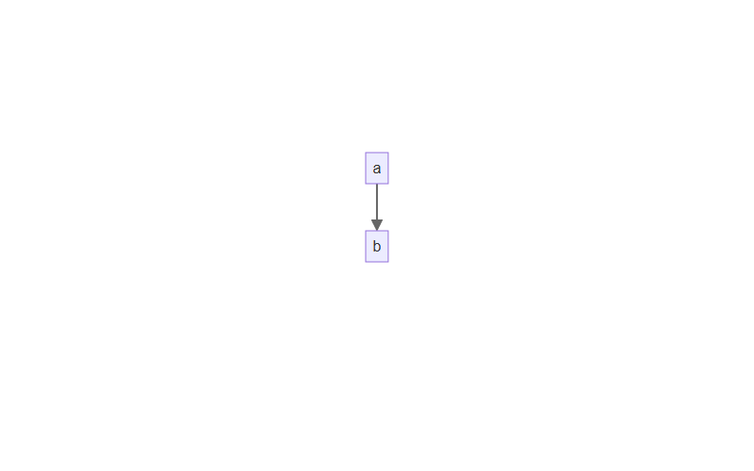
Process Flow 1

Slide 12
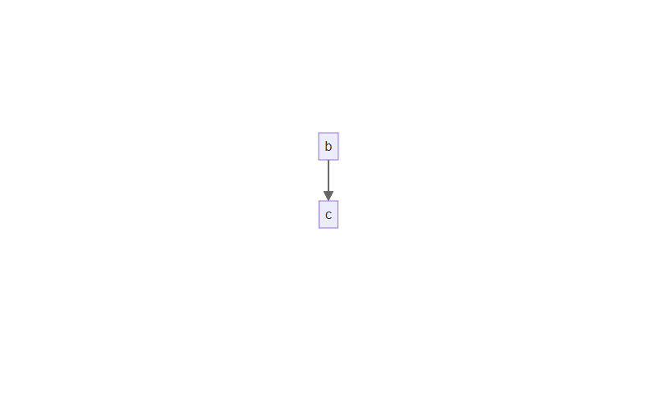
Process Flow 2

Slide 13
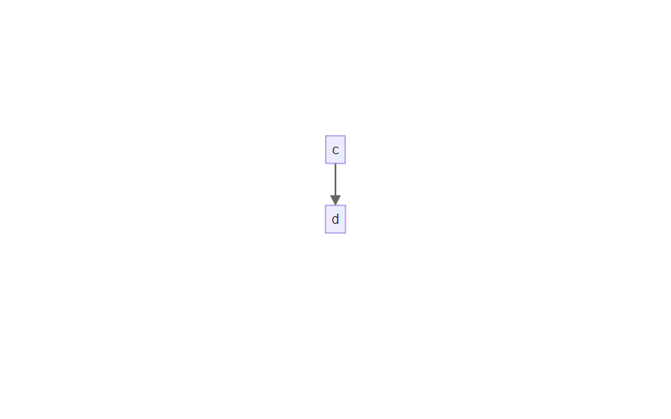
Process Flow 3

