Slide 1
What is Machine Learning?
Machine learning allows computers to learn from data without explicit programming.

Slide 2

Types of Machine Learning
Supervised learning uses labeled data to train algorithms for prediction.
Unsupervised learning finds patterns in unlabeled data for insights and grouping.
Reinforcement learning trains agents to make optimal decisions in an environment.
Each type addresses different problems and requires specific data and algorithms.

Slide 3
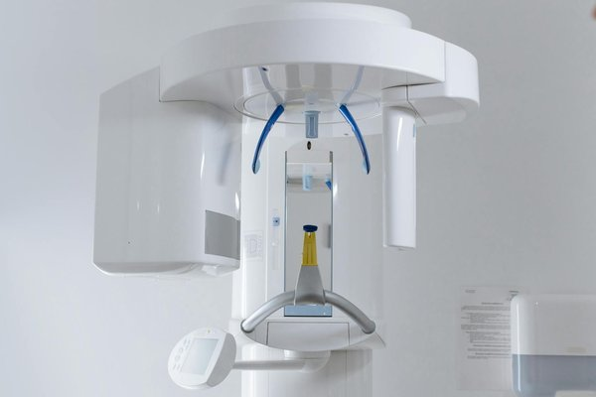
Machine Learning in Healthcare
Early disease detection through image analysis and predictive modeling.
Personalized treatment plans based on individual patient data and genetics.
Drug discovery and development accelerated by ML algorithms.
Improved patient care through automated diagnosis and treatment recommendations.

Slide 4
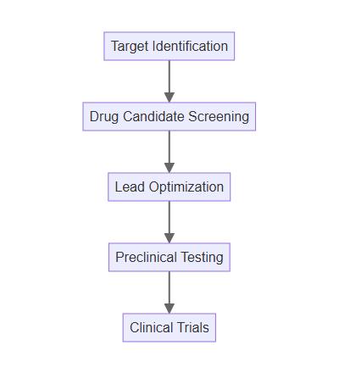
Machine Learning and Drug Discovery
ML accelerates the identification of potential drug candidates.
Predictive models analyze molecular properties and interactions.
This reduces the time and cost associated with traditional drug development.
It also increases the likelihood of discovering effective treatments.

Slide 5

Challenges of Machine Learning in Health
Data privacy and security are crucial concerns in healthcare applications.
Bias in data can lead to inaccurate or unfair predictions.
Explainability and interpretability of ML models are essential for trust.
Regulatory approval and validation are necessary for widespread adoption.

Slide 6

Future of Machine Learning in Health
ML will play an increasingly important role in personalized medicine.
Integration with wearable devices and IoT will enhance data collection.
AI-powered diagnostics and treatment recommendations will become more common.
Continued research and development will lead to further advancements in healthcare.

