Slide 1
Brother Industries: A Global Overview
Founded in 1908 in Nagoya, Japan, as a sewing machine repair shop.

Slide 2
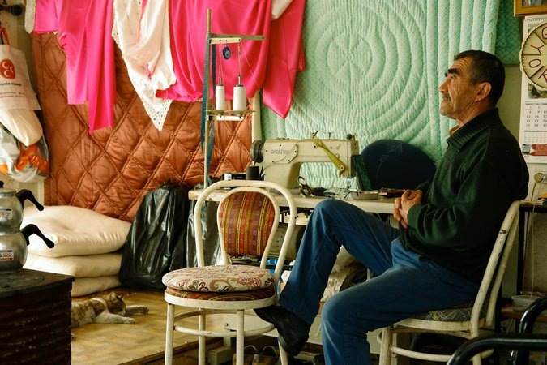
Core Product Categories
Printing Solutions: Inkjet printers, laser printers, all-in-one printers, mobile printers, and related consumables. ...
Sewing & Embroidery Machines: Machines for hobbyists and professionals, offering a wide range of features and capabi...
Labeling & Mobile Solutions: Label makers, mobile scanners, and portable printers for various industries, including r...
Industrial Equipment: Cutting machines, machine tools, and industrial sewing machines for manufacturing and productio...

Slide 3
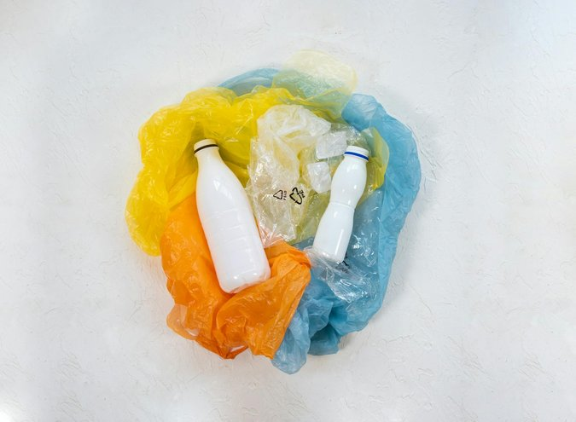
Commitment to Sustainability
Focus on reducing environmental impact through product design and manufacturing processes.
Initiatives include energy-efficient products, reduced packaging, and responsible recycling programs.
Active participation in environmental conservation projects and community engagement.
Striving for a sustainable future through innovation and responsible business practices.

Slide 4

Brother's Innovation and Technology
Continuous investment in research and development to drive innovation across product lines.
Focus on developing user-friendly technology with enhanced features and functionality.
Patented technologies in printing, scanning, and sewing contribute to improved performance and efficiency.
Commitment to providing cutting-edge solutions that meet evolving customer needs.

Slide 5

Brother's Global Reach and Local Impact
Extensive global network provides localized support and service to customers worldwide.
Partnerships with local businesses and communities contribute to economic growth and development.
Focus on creating shared value by addressing social and environmental challenges.
Dedicated to building long-term relationships with customers and stakeholders around the world.

