Slide 1
What is Machine Learning?
Machine learning is a subfield of artificial intelligence (AI) that focuses on enabling computers to learn from data without explicit programming.

Slide 2
Types of Machine Learning
**Supervised Learning:** The algorithm learns from labeled data (input-output pairs) to predict outcomes for new, unseen data. Examples include classification (e.g., spam detection) and regression (e.g., predicting house prices).
**Unsupervised Learning:** The algorithm learns from unlabeled data to discover hidden patterns, relationships, and structures. Examples include clustering (e.g., customer segmentation) and dimensionality reduction.
**Reinforcement Learning:** The algorithm learns through trial and error by interacting with an environment. It receives rewards or penalties for its actions, aiming to maximize cumulative rewards over time. Examples include game playing and robotics.

Slide 3
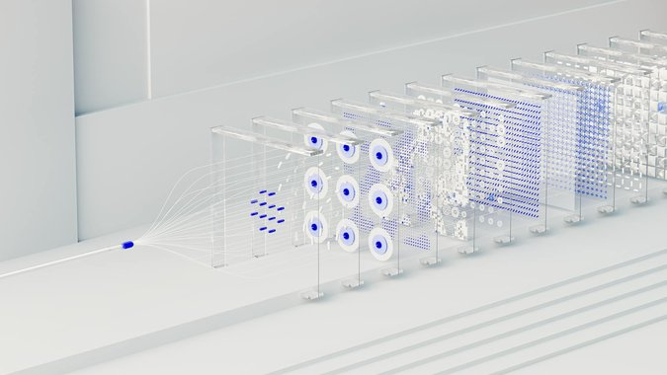
Applications of Machine Learning
**Healthcare:** Diagnosing diseases, personalized medicine, drug discovery.
**Finance:** Fraud detection, risk assessment, algorithmic trading.
**Marketing:** Customer segmentation, targeted advertising, recommendation systems.
**Self-Driving Cars:** Object detection, path planning, navigation.
**Natural Language Processing:** Chatbots, language translation, sentiment analysis.

