Slide 1
AI-Powered Medical Diagnosis
Image recognition for X-rays and MRIs

Slide 2

Benefits of AI in Healthcare
Improved diagnostic accuracy
Faster medical information processing
Personalized treatment plans
Reduced human error and improved efficiency

Slide 3

Challenges and Considerations for AI Adoption
Data privacy and security concerns
Regulatory compliance and legal frameworks
Integration with existing healthcare systems
Training and education for healthcare professionals

Slide 4
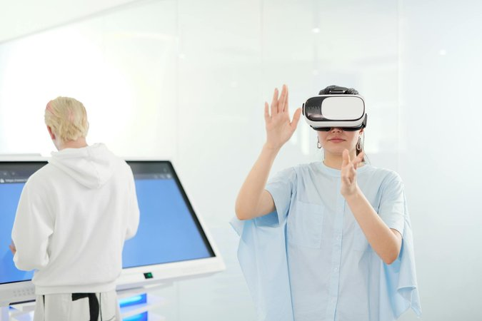
Future of AI in Healthcare
Expansion of telemedicine and remote care
AI-driven drug discovery and development
Remote patient monitoring and personalized interventions
Advancements in precision medicine and targeted therapies

