Slide 1
Discover Your Potential with Brother
Unleash your creativity with innovative technology.

Slide 2

Printing Reimagined
High-quality printing for all your projects.
Wireless connectivity for seamless integration.
Eco-friendly options for a sustainable future.
Compact designs to fit any workspace.

Slide 3
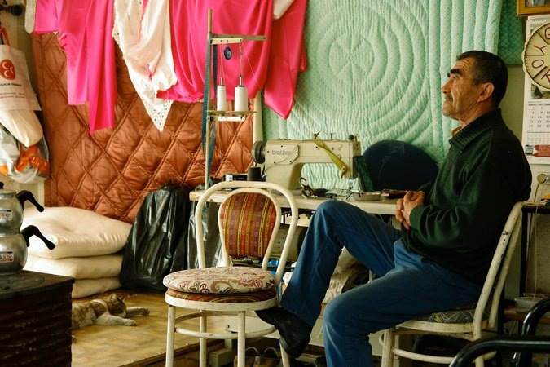
Beyond Printing: Explore the Brother Ecosystem
Sewing and embroidery machines for personalized creations.
Labeling solutions for organization and efficiency.
Scanners and all-in-one printers for streamlined workflows.

Slide 4
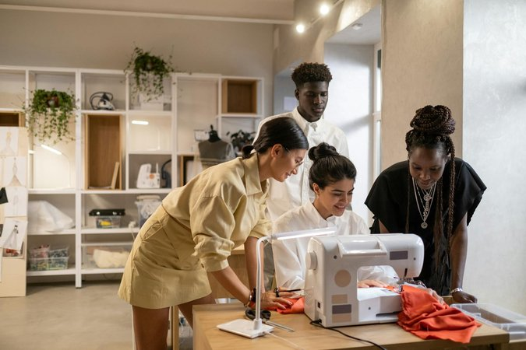
Crafting Your Future: Sewing & Embroidery
From beginner to advanced, Brother has a machine for you.
Express your unique style through custom designs.
Explore a world of fabrics and techniques.

Slide 5
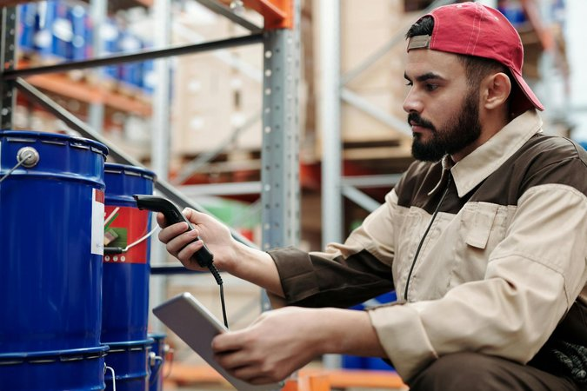
Organize and Conquer: Labeling Solutions
Label makers for home, school, and beyond.
Customizable labels for every need.
Improve efficiency and productivity with clear organization.

Slide 6

Grow with Brother: Internships and Opportunities
Explore career paths in technology and innovation.
Gain valuable experience through internships.
Connect with a global network of professionals.

