Slide 1
What is Business Process Management (BPM)?
A disciplined approach to identifying, designing, executing, documenting, measuring, monitoring, and controlling both automated and non-automated business processes to achieve consistent, targeted results aligned with an organization's strategic goals.

Slide 2
The BPM Lifecycle
**Design:** Mapping and analyzing existing processes, identifying areas for improvement, and designing new or optimized processes.
**Modeling:** Creating visual representations of the processes to facilitate understanding and communication.
**Execution:** Implementing the designed processes, often involving automation and integration with IT systems.
**Monitoring:** Tracking key performance indicators (KPIs) to measure process effectiveness and identify areas for further optimization.
**Optimization:** Continuously refining and improving processes based on monitoring data and feedback.

Slide 3
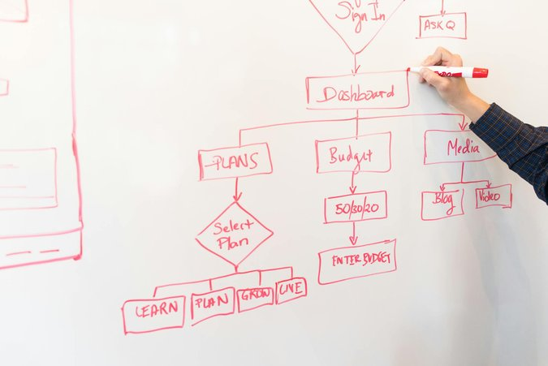
BPM Benefits for Executives
**Increased Efficiency:** Streamlined processes reduce operational costs and improve resource utilization.
**Enhanced Agility:** BPM enables organizations to adapt quickly to changing market conditions and customer demands.
**Improved Visibility:** Real-time monitoring provides insights into process performance and identifies bottlenecks.
**Better Decision-Making:** Data-driven insights support informed decision-making and strategic planning.
**Stronger Compliance:** BPM helps organizations adhere to regulatory requirements and industry best practices.

Slide 4
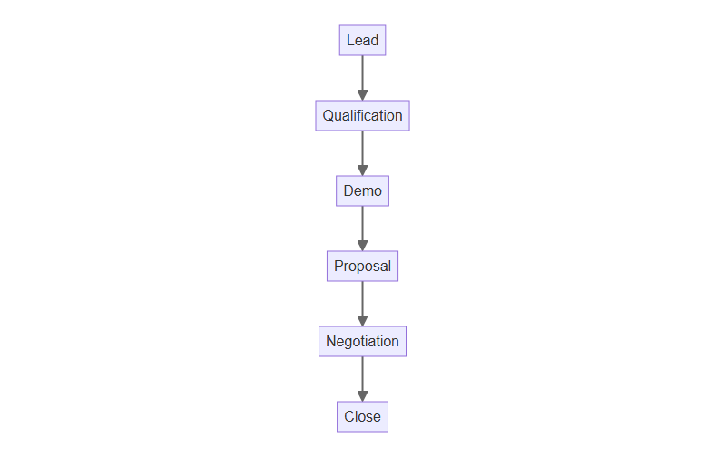
Sales Process Flow

Slide 5
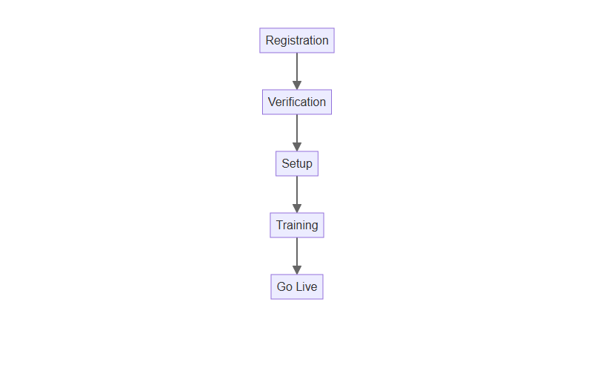
Customer Onboarding

Slide 6
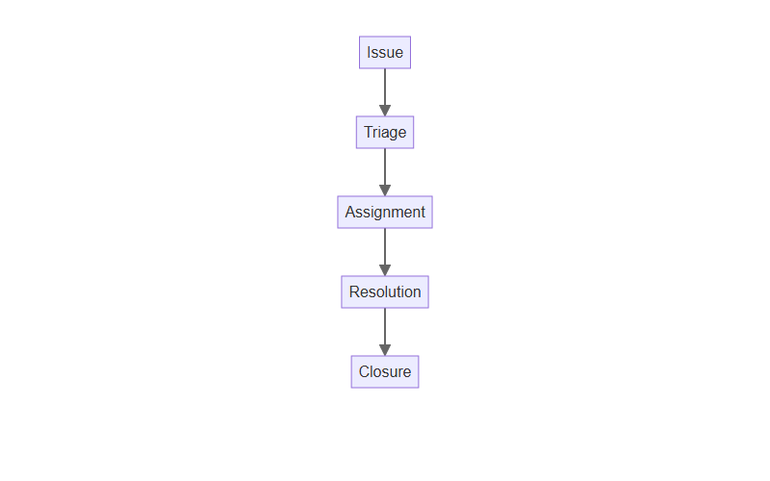
Support Workflow

