Slide 1
What is Machine Learning?
Machine learning allows computers to learn from data without explicit programming.

Slide 2
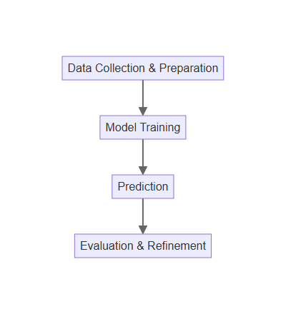
How Machines Learn
Data is collected and prepared to train the machine learning model.
The model learns patterns and relationships within the data.
Predictions are made based on the learned patterns.
The model's performance is evaluated and refined through feedback.

Slide 3

Types of Machine Learning
Supervised learning uses labeled data to train models for prediction.
Unsupervised learning finds patterns in unlabeled data for insights.
Reinforcement learning trains agents to make optimal decisions in an environment.
Each type has unique applications in various fields.

Slide 4

Machine Learning in Healthcare
Early disease detection through image analysis and predictive modeling.
Personalized treatment plans based on individual patient data.
Drug discovery and development accelerated by ML algorithms.
Improved patient outcomes and reduced healthcare costs.

Slide 5
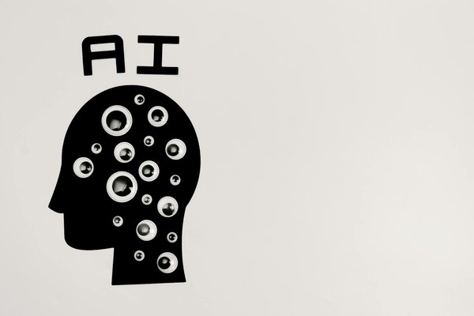
Future of Machine Learning in Health
More accurate and efficient diagnoses with advanced algorithms.
Development of personalized medicine tailored to individual needs.
Increased automation of tasks, freeing up healthcare professionals.
Ethical considerations and responsible AI development are crucial.

