Slide 1
Introduction to Bro: A Network Security Monitor
Bro is a powerful open-source network analysis framework.

Slide 2

How Bro Works: Deep Packet Inspection
Bro performs deep packet inspection (DPI) to examine the contents of network traffic.
It doesn't just look at headers; it analyzes the payload of various protocols (HTTP, DNS, SMTP, etc.).
This allows Bro to identify subtle patterns and anomalies indicative of malicious activity.
Bro uses a scripting language for customization and extending its capabilities.

Slide 3

Bro's Key Features and Capabilities
Comprehensive Logging: Detailed records of network activity for forensic analysis and incident response.
Anomaly Detection: Identifies unusual traffic patterns that deviate from established baselines.
Signature-Based Detection: Uses known patterns to identify malicious activity.
Custom Scripting: Allows users to tailor Bro to their specific needs and environment.
Real-time Alerts: Provides immediate notifications of critical security events.

Slide 4
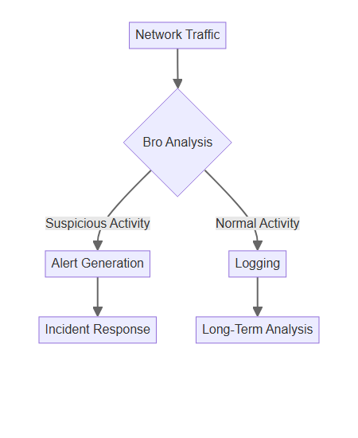
Bro's Applications and Use Cases
Intrusion Detection and Prevention: Identifying and blocking malicious traffic.
Network Forensics: Investigating security incidents and reconstructing events.
Performance Monitoring: Analyzing network traffic to identify bottlenecks and optimize performance.
Policy Compliance: Ensuring adherence to network security policies.
Threat Hunting: Proactively searching for evidence of malicious activity.

Slide 5

Getting Started with Bro
Bro is freely available for download and can be deployed on various operating systems.
The Bro community provides extensive documentation and support resources.
Commercial vendors offer enterprise-grade Bro solutions with enhanced features and support.
Consider virtualized deployments for testing and experimentation.
Requires some technical expertise for configuration and management.

