Slide 1
Introduction to Flowcharts
Visual representation of a process or workflow

Slide 2

Basic Flowchart Symbols
Oval: Represents the start or end of a process
Rectangle: Represents a process or action step
Diamond: Represents a decision point with multiple paths
Arrow: Indicates the flow of the process
Parallelogram: Represents input or output

Slide 3
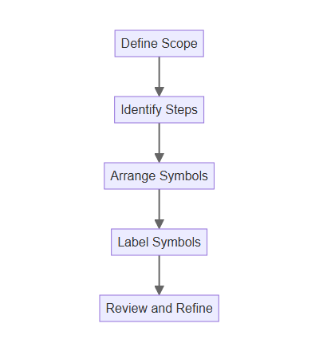
Creating a Flowchart
Define the scope and purpose of the flowchart
Identify the key steps and decision points involved
Arrange the symbols logically to represent the flow
Use clear and concise labels for each symbol
Review and refine the flowchart for clarity and accuracy

Slide 4
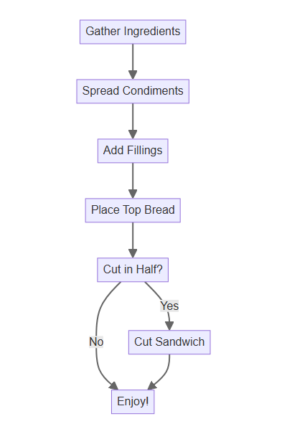
Example: Making a Sandwich
Start by gathering ingredients: bread, fillings, condiments
Spread condiments on the bread slices
Add desired fillings to one slice of bread
Place the other slice of bread on top
Cut the sandwich in half (optional)
Enjoy your delicious sandwich!

Slide 5

Benefits of Using Flowcharts
Improved communication and understanding of processes
Identification of bottlenecks and inefficiencies
Facilitates problem-solving and process optimization
Useful for training and documentation purposes
Aids in project planning and management

Slide 6

Flowchart Software and Tools
Microsoft Visio: Industry-standard diagramming software
Draw.io: Free online flowchart maker
Lucidchart: Collaborative diagramming platform
Google Drawings: Simple and accessible drawing tool
Many other specialized and general-purpose tools available

