Slide 1
What is Machine Learning?
Machine learning teaches computers to learn from data without explicit programming.

Slide 2
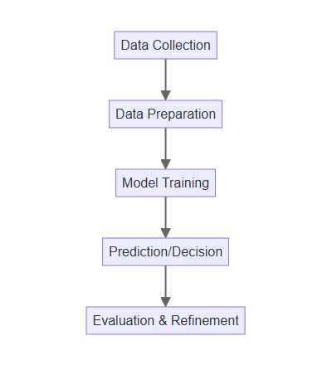
How Does it Work?
Data is collected and prepared to train the machine learning model.
Algorithms identify patterns and relationships within the data.
The model learns to make predictions or decisions based on these patterns.
Performance is evaluated and refined through continuous learning.

Slide 3
Types of Machine Learning
Supervised learning uses labeled data to train models for prediction.
Unsupervised learning finds patterns in unlabeled data for insights.
Reinforcement learning trains agents to make optimal decisions in an environment.
Each type has unique applications and benefits.

Slide 4
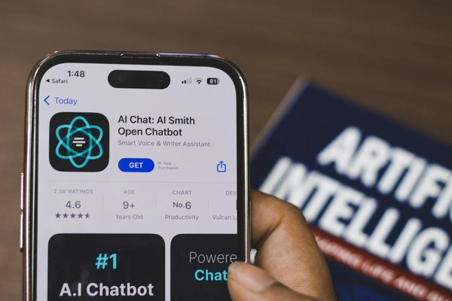
Real-World Applications
Image recognition helps identify objects and faces in photos.
Natural language processing enables chatbots and language translation.
Predictive analytics forecasts future trends and behaviors.
Self-driving cars use machine learning for navigation and decision-making.

Slide 5

The Future of Machine Learning
Continued advancements are expected in areas like personalized medicine.
AI-powered automation will transform industries and job markets.
Ethical considerations around bias and fairness will be crucial.
Machine learning will play an increasingly important role in shaping our future.

