Slide 1
LED Board Technical Specifications Overview
Conforms to IS16103 (Part 1 & 2): 2012

Slide 2
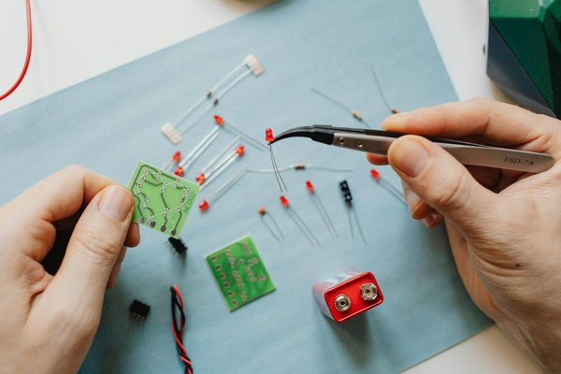
LED Board Electrical Specifications
Input Voltage: 12V/24VDC/110AC
Operating Temperature: 50°C to 60°C
Units per meter: 220 LEDs
Wiring: Direct connection to power supply for each light box (no series wiring)

Slide 3
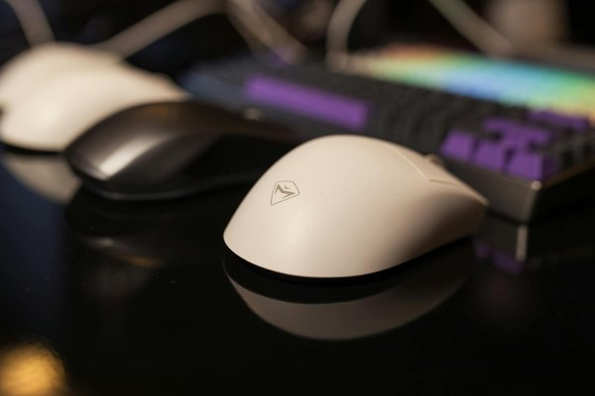
LED Specifications
Color: Cool white
Average Lifespan: 30,000 hrs
Temperature Range: -50°C to 60°C
Rated Current: 5 amps to 16 amps
Power Consumption: 20W/minute

Slide 4
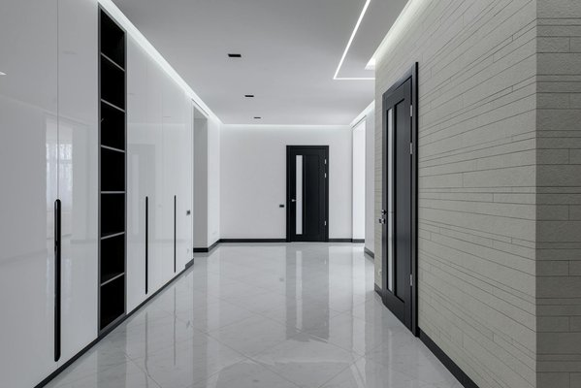
LED Performance Metrics
Luminous Efficiency: 6-7 lm/LED
Total LED count varies based on board size
Targeted for outdoor visibility in railway environments

Slide 5
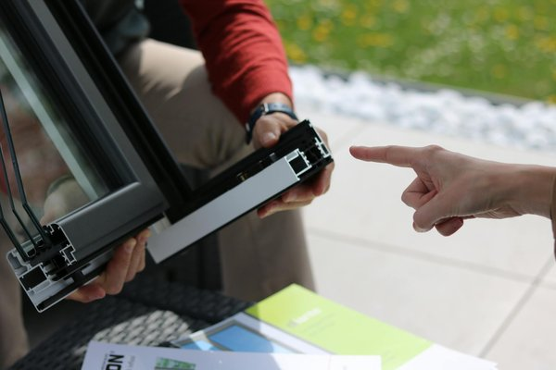
Frame and Panel Specifications
Frame Material: Anodized Aluminium (IS 5082)
Frame Color: Silver/Black
Frame Protection: IP 20
Reflective Panel Thickness: 9mm

Slide 6
Deployment Locations and Sizes
Coaching Depot Hyderabad: 4ft x 6ft (2 units, 48 sq ft)
IOH Shed: 2ft x 6ft (1 unit, 12 sq ft)
Layout: 4ft x 6ft (1 unit, 24 sq ft)
Coach Care Center (SP-1): 2ft x 6ft (1 unit, 12 sq ft)
Bio Lab: 2ft x 2ft (1 unit, 4 sq ft)

Slide 7
Project Summary and Approval
Total Project Area: 100 sq ft
Technical specifications detailed for LED board and installation
Prepared by: SSE/C&W/HYB
Digitally signed and verified

