Slide 1
Introduction to Large Language Models (LLMs)
LLMs are advanced AI models trained on massive text datasets

Slide 2

How LLMs Work
LLMs use transformer networks to process and understand text
These networks rely on self-attention mechanisms to weigh the importance of different words
Training involves predicting the next word in a sequence, given the preceding words
This process allows LLMs to learn complex patterns and relationships in language

Slide 3

Applications of LLMs
Chatbots and conversational AI for enhanced customer service
Content generation for articles, blog posts, and creative writing
Code generation and software development assistance
Machine translation and language understanding

Slide 4
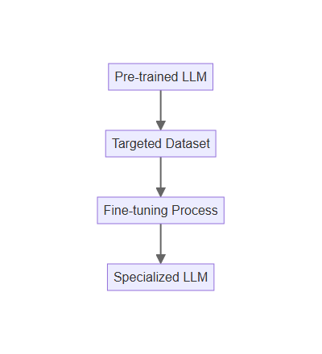
Fine-tuning LLMs
Fine-tuning adapts pre-trained LLMs to specific tasks or domains
This involves training the model on a smaller, targeted dataset
Fine-tuning improves performance and reduces computational costs
It allows for customization and specialization of LLMs

Slide 5

Challenges and Limitations
Bias in training data can lead to biased outputs
LLMs can sometimes generate nonsensical or factually incorrect text
Computational resources required for training and deployment can be substantial
Ethical concerns regarding misuse and potential societal impact

Slide 6
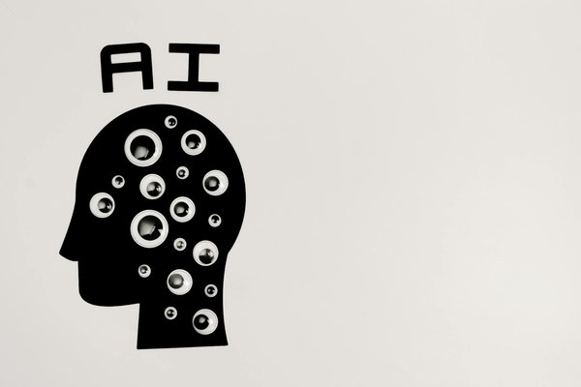
Future of LLMs
Continued advancements in model architecture and training techniques
Development of more efficient and accessible LLMs
Integration of LLMs into various applications and industries
Addressing ethical concerns and promoting responsible AI development

Slide 7
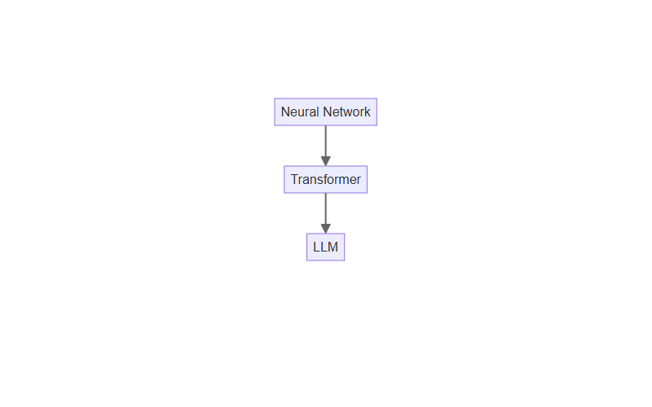
Formation

