Slide 1
The Power of a Hug
Hugs are a fundamental form of human connection.

Slide 2

The Biology of a Hug
Hugging releases oxytocin, often called the "love hormone."
Oxytocin promotes feelings of trust, bonding, and connection.
Hugging also lowers cortisol levels, reducing stress and anxiety.
Physical touch stimulates pressure receptors, sending calming signals to the brain.

Slide 3

Hugs and Emotional Well-being
Hugs provide comfort and support during challenging times.
They can boost self-esteem and reduce feelings of loneliness.
Hugs foster a sense of belonging and strengthen relationships.
Non-verbal communication through hugs can be incredibly powerful.

Slide 4
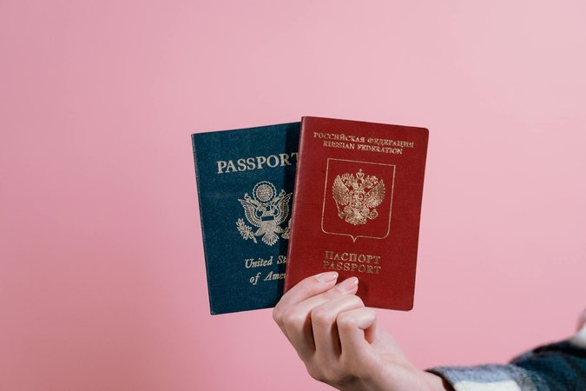
Hugs in Different Cultures
Hugging customs vary across cultures and social contexts.
Some cultures embrace frequent hugging, while others are more reserved.
Understanding these differences promotes respectful interactions.
It's important to be mindful of personal space and individual preferences.

Slide 5
The Importance of Consensual Touch
Always ensure hugs are consensual and welcomed.
Respect personal boundaries and individual comfort levels.
Communicate clearly and ask before initiating a hug.
A genuine, consensual hug can create a positive and meaningful connection.

