Slide 1
Preparing for Your Bath
Gather your supplies: towels, soap/body wash, shampoo/conditioner, washcloth/loofah (optional).

Slide 2
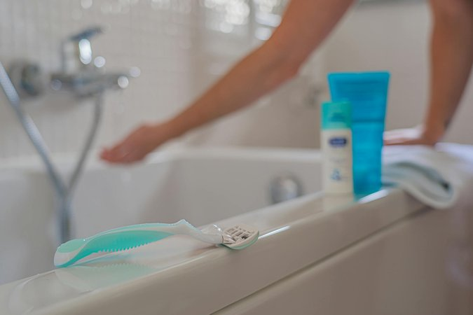
Cleansing Your Body
Step into the bath carefully.
Use a washcloth, loofah, or your hands to apply soap or body wash.
Gently cleanse your entire body, paying attention to areas prone to perspiration.
Rinse thoroughly to remove all soap residue.

Slide 3
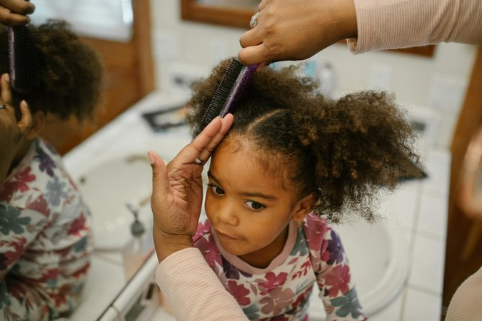
Hair Care in the Bath
Wet your hair completely.
Apply shampoo to your scalp and massage gently to create a lather.
Rinse thoroughly.
Apply conditioner to the ends of your hair, avoiding the scalp.
Leave conditioner in for the recommended time, then rinse thoroughly.

Slide 4
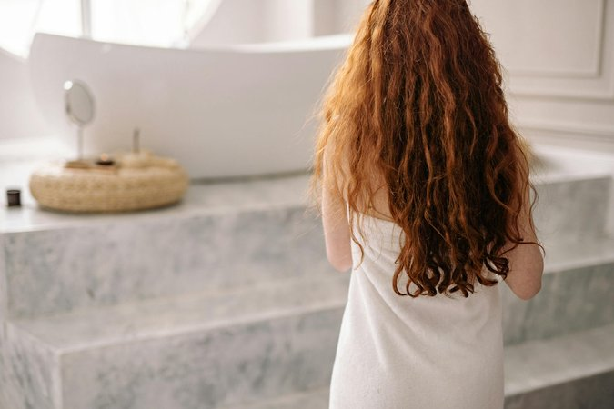
Finishing Up
Drain the bathtub.
Step out of the bath carefully and dry yourself thoroughly with a towel.
Apply moisturizer to your skin while it's still damp.
Comb or brush your hair.
Put on clean clothes.

