Slide 1
**

Slide 2
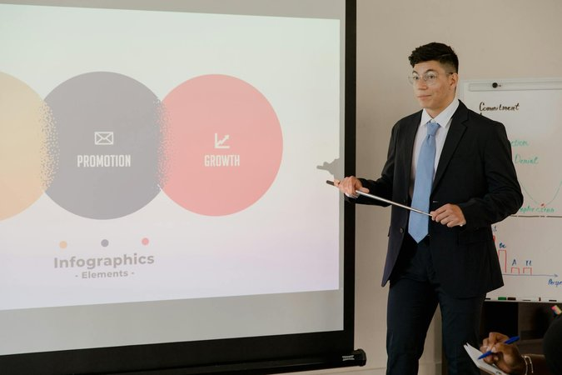
Introduction to Simple Test Presentations**
Purpose: Demonstrate a basic presentation structure.
Key Features: Clear titles, concise bullet points, and relevant visuals.
Benefits: Easy to create, understand, and adapt for various topics.
Target Audience: Suitable for a general audience with varying levels of familiarity with the subject matter.

Slide 3
Key Components of a Test Presentation**
Content: Focus on delivering a clear message with supporting evidence.
Structure: Organize information logically using headings, subheadings, and bullet points.
Visuals: Use images, charts, and graphs to enhance understanding and engagement.
Delivery: Practice a confident and engaging presentation style.

Slide 4

Best Practices for Effective Presentations**
Keep it Simple: Avoid overwhelming the audience with too much information.
Use Visuals Wisely: Select visuals that support the message and enhance clarity.
Practice Makes Perfect: Rehearse the presentation to ensure smooth delivery.
Engage the Audience: Maintain eye contact and encourage interaction.

Slide 5
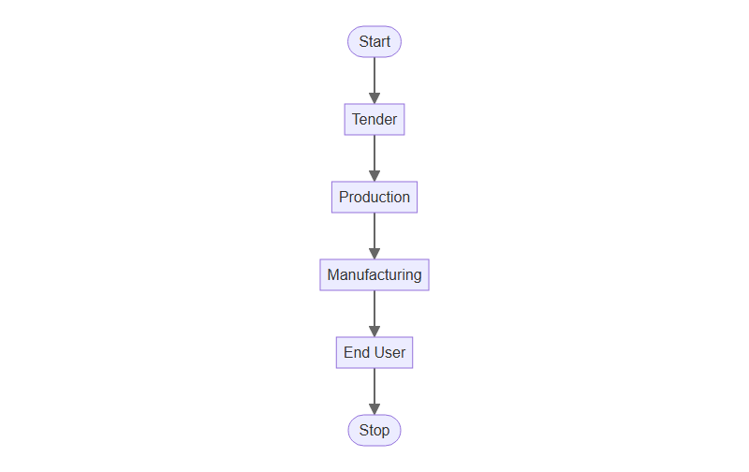
Business Process Flow

