Slide 1
Introduction to the Software Development Lifecycle (SDLC)
SDLC is a structured process for planning, creating, testing, and deploying software systems.

Slide 2

Common SDLC Models
Waterfall: A linear, sequential approach with distinct phases. Suitable for projects with stable requirements.
Agile: An iterative and incremental approach emphasizing flexibility and collaboration. Ideal for projects with evolving requirements.
DevOps: Integrates development and operations, focusing on automation and continuous delivery. Promotes faster releases and improved collaboration.
Spiral: Combines elements of Waterfall and iterative models, incorporating risk assessment at each stage. Suitable for complex projects with high risk.

Slide 3
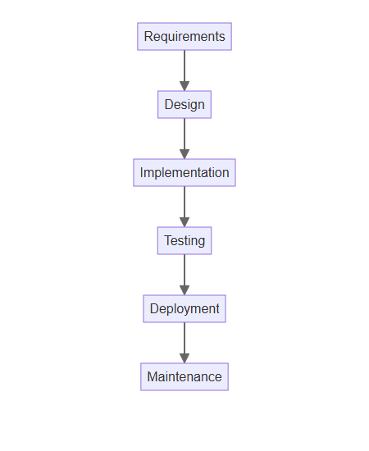
The Waterfall Model
Requirements: Gathering and documenting all project requirements.
Design: Defining the software architecture, user interface, and database design.
Implementation: Writing the code and building the software.
Testing: Verifying the software functionality and identifying defects.
Deployment: Releasing the software to end-users.
Maintenance: Providing ongoing support and updates.

Slide 4
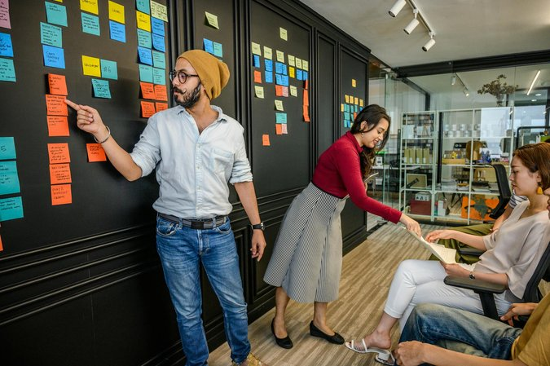
The Agile Model
Sprints: Short, time-boxed iterations focused on delivering specific features.
Continuous Integration: Regularly integrating code changes and performing automated tests.
Collaboration: Emphasizes close collaboration between developers, testers, and stakeholders.
Flexibility: Adapts to changing requirements throughout the development process.
Feedback: Regularly gathers feedback from stakeholders to ensure alignment with project goals.

Slide 5
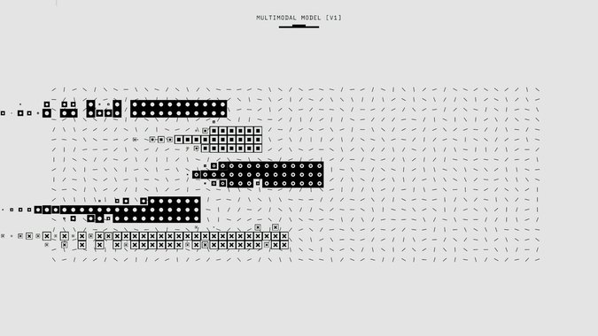
Choosing the Right SDLC Model
Project Size and Complexity: Waterfall suits simpler, well-defined projects; Agile suits complex, evolving projects.
Team Experience and Skills: Agile requires experienced, self-organizing teams.
Client Involvement: Agile encourages active client participation throughout the process.
Time and Budget Constraints: Waterfall provides more predictable timelines and budgets, but can be less flexible.
Risk Tolerance: Spiral model is best suited for high-risk projects.

