Slide 1
Identifying Depression Through Speech
A Comparative Analysis of Acoustic Features in Read and Spontaneous Speech
Nile
University of Glasgow · School of Computing Science · Level 4 Dissertation
1

Slide 2
Why This Matters
The Problem
The Opportunity
280+ million people affected globally
1 in 6 UK adults experience it weekly
Diagnosis relies on subjective self-report
Inter-rater reliability as low as 0.28 κ
Significant access barriers to specialist care
🔊 Speech Analysis
Non-invasive
Can be collected remotely
No specialist equipment needed
Objective and repeatable
2

Slide 3
The Research Gap
What exists
What's missing
Deep learning models achieving 80%+ accuracy
Which features actually indicate depression?
Does speech task type change what we find?
"Black Box" — High accuracy, no explanation
Research Question
Which acoustic features are most predictive of depression, and how do they differ between read and spontaneous speech?
3

Slide 4
Approach Overview
Data
Features
Models
ANDROIDS Corpus
eGeMAPS Feature Set
SVM + Random Forest
118 Italian speakers
Clinical psychiatric diagnoses
Same participants, both tasks
Reading + Interview
88 acoustic features
Standardised & interpretable
Prosody, spectral, timing
Each feature has meaning
Interpretable by design
Feature importance rankings
Not deep learning
Understanding over accuracy
→
→
4

Slide 5
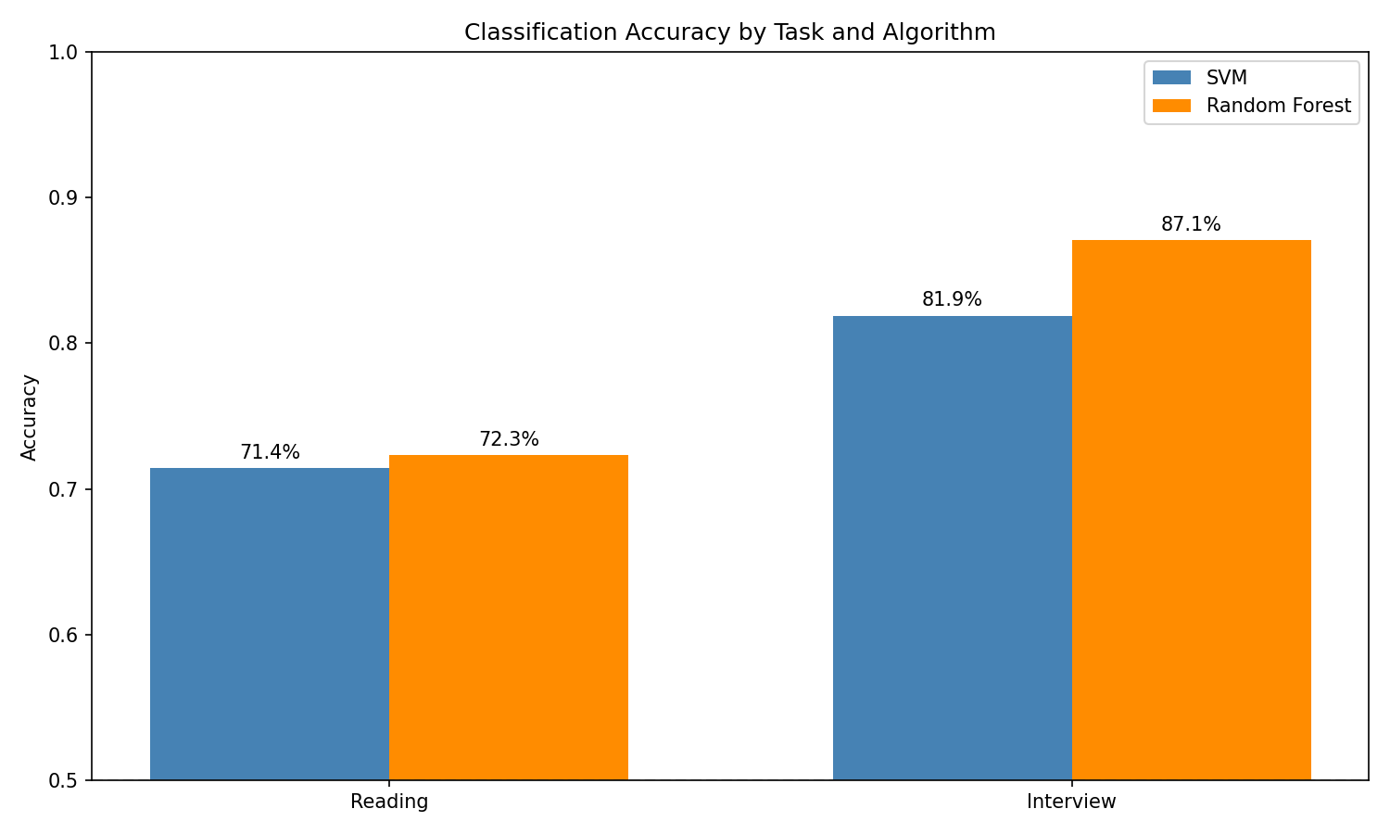
The Headline Result
Interview speech significantly outperforms reading
Reading
72.3%
Interview
87.1%
↑ +15 percentage points
📊 p = 0.0055 (statistically significant)
🏆 Beats prior deep learning (81.6%)
5

Slide 6
Different Tasks, Different Features
Of the top 10 features for each task, only 1 appears in both lists
Reading Task
Interview Task
Spectral slopes, MFCCs
Static voice properties
What the voice sounds like
Variability measures, temporal dynamics
Dynamic voice properties
How the voice changes over time
These tasks don't give stronger or weaker versions of the same signal — they provide access to qualitatively different information about depression.
6

Slide 7
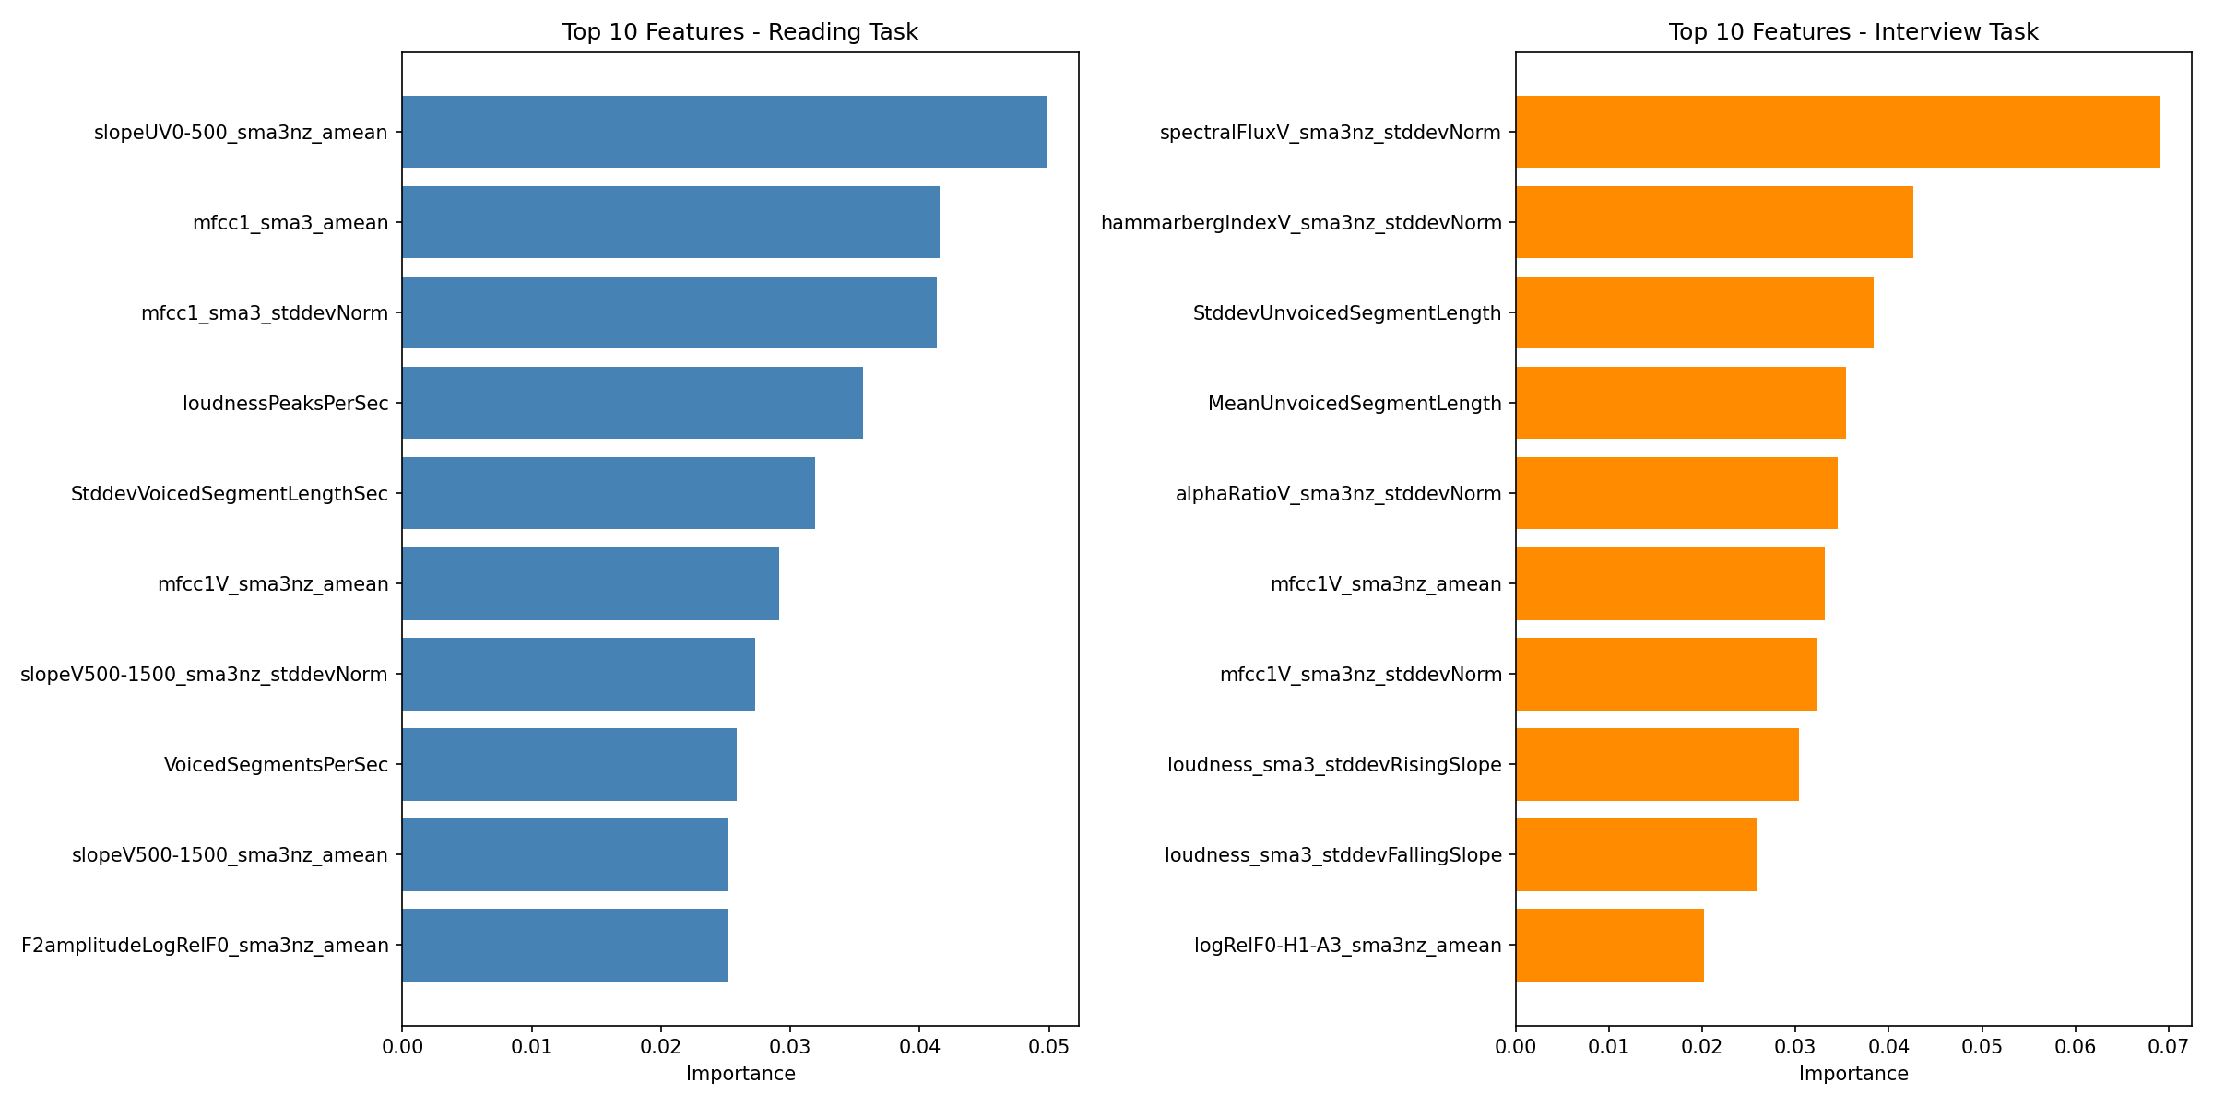
The Variability Finding
Interview: 7/10 are variability
① Spectral flux variability
② Hammarberg index variability
③ Pause duration variability
Reading: Only 2/10 are variability
Key Insight
Depression compresses dynamic range. "Flat affect" = reduced modulation across multiple voice dimensions.
7

Slide 8
Why Interview Works Better
Three mechanisms from clinical literature
🧠
❤️
🎵
Cognitive Load
Emotional Engagement
Prosodic Freedom
Spontaneous speech requires planning, retrieval, and monitoring
Interview topics engage affect — mood, relationships, daily life
Conversation allows full control over intonation and rhythm
Depression impairs executive function → pauses, hesitations
Depression alters expression → only visible when emotions are relevant
Reading follows punctuation → suppresses natural modulation
Interview captures all three channels. Reading suppresses them.
8

Slide 9
Implications
🩺
🔬
⚙️
Clinical Practice
Research
System Design
Task selection > algorithm choice
Use spontaneous speech for screening
Measure variability, not just averages
Single-task studies miss markers
Feature importance is task-contingent
Don't generalise across tasks
Elicit spontaneous speech
Use open-ended questions
Prioritise temporal dynamics
9

Slide 10
Limitations
Most Serious
Moderate
Italian speech only
Binary labels only
Features may not transfer to English or other languages — prosodic patterns can be language-dependent
No severity information — depressed or not, nothing in between
Modest sample size
Gender imbalance (72% female)
118 speakers — though results were stable across all 5 CV folds
Women misclassified slightly more often
→ Cross-corpus validation across languages and populations is essential before clinical deployment
10

Slide 11
Conclusion
"Spontaneous speech captures depression markers that reading misses — specifically, the reduced dynamic modulation that clinicians call 'flat affect'."
Contributions
01
02
03
04
Task Effect
Task-Specific Features
Interpretable ≥ Deep Learning
Variability is Key
+15 points, p = 0.0055
Only 1/10 overlap
87.1% vs 81.6%
7/10 top interview features
11

Slide 12
Thank You
Questions?
Nile
University of Glasgow · School of Computing Science
87.1% interview vs 72.3% reading · p = 0.0055 1/10 feature overlap · 7/10 interview features are variability
12

