Slide 1
Data Privacy Services
PRIVACY CONSOLE · v0.2.0
One Privacy Engine, three entry points, two outcomes, measured privacy. No LLM ever sees a raw value.
Built from the rehearsal of 15 October 2026: the scripted demo ran end to end in 3:25.
Data Privacy Services · Privacy Console · rehearsal 2026-10-15 18:28 UTC · commit 37ec781
1 / 12
Notes:
Data Privacy Services: one Privacy Engine, three entry points, two outcomes, and privacy we measure rather than claim.
Everything you will see runs on a local stack with synthetic seed data. The numbers on these slides were measured, by the rehearsal named in the footer and, for throughput, by the bench runs, not taken from a brochure.

Slide 2
Customer data keeps reaching places it should not
WHY DPS
Test, UAT, analytics, vendors and LLM pipelines all want realistic data. DPS hands them a protected copy instead, through whichever door the data already uses.
L1 · API
JSON, text and documents
One HTTPS call de-identifies a payload, redacts a scanned PDF or mints test fixtures.
L2 · CONNECTORS
Oracle, PostgreSQL, MongoDB
Batch jobs: discover, review, run, evidence. Masked or synthetic UAT copies, consistent across systems.
L3 · UI SCANNER
Web front ends
What each screen collects, and a parallel view filled with safe data. Nothing is ever submitted.
Obfuscated format kept, reversible only with the key the caller holds
Synthetic realistic and consistent, with no path back to the original
Three entry points, two outcomes, one policy model, one detector stack, one transformation engine.
Data Privacy Services · Privacy Console · rehearsal 2026-10-15 18:28 UTC · commit 37ec781
2 / 12
Notes:
Test, UAT, analytics, vendors and now LLM pipelines all want realistic data, and too often they get production data.
DPS gives them a protected copy through the door the data already uses: an API call, a database job or a web front end.
Two outcomes: obfuscated data the owner can reverse with their own key, or synthetic data with no path back to a real person.

Slide 3
Three promises, built to be proved
PRINCIPLES
Each promise has a mechanism in the code and a measurement in the evidence.
P1
The LLM never sees raw PII
Detection and transformation run locally. The gateway receives typed placeholders only, a verifier checks every call, and a per-tenant counter of raw values sent must read zero.
Proved by: the counter on Overview, in Reports and in every API report block
D2
The caller holds the key
The data key is returned in the response, optionally wrapped with the caller's public key. DPS stores no key; reveal works only with the key the caller passes back.
Proved by: the key card in the Playground; every evidence pack records key custody
P6
Evidence, not claims
Every job seals an evidence pack: findings, methods, verification, fidelity and privacy measurements, and the hash of the configuration it ran with.
Proved by: the evidence pack and its PDF, for every job and every scan
Data Privacy Services · Privacy Console · rehearsal 2026-10-15 18:28 UTC · commit 37ec781
3 / 12
Notes:
Three promises, each with a mechanism and a measurement.
No LLM ever sees a raw value: the engine works locally, the gateway receives typed placeholders only, and a counter per tenant proves zero.
The caller holds the key: DPS returns it and keeps nothing, so nobody can reverse a token without it, including us.
Evidence, not claims: every job leaves an evidence pack you can hand to an auditor.

Slide 4
One engine, four roles, one metadata database
ARCHITECTURE
One container image runs every role. The metadata database holds jobs, hashed keys, evidence and the audit log, never a customer value.
DATA PRIVACY SERVICES · ONE IMAGE
LLM gateway
typed placeholders only
Apps and pipelines
JSON, text, documents
app
API and console; L1 needs no database
Privacy Engine
detect
classify
OCR gateway
scanned pages and images
Data owners
owner, table, selection
plan
transform
worker
L2 jobs: partitions, checkpoints
verify
report
Oracle · PostgreSQL · MongoDB
sources and masked targets
QA and privacy teams
a front-end URL
browser-worker
L3 scans in Chromium
migrate
DDL as the owner role, one-shot
S3 or PVC exports
files write mode
Bank tokenization service
external_tokenize adapter
Metadata PostgreSQL
job queue, hashed keys, checkpoints, evidence, audit
Data Privacy Services · Privacy Console · rehearsal 2026-10-15 18:28 UTC · commit 37ec781
4 / 12
Notes:
One container image runs four roles: the app serves the API and this console, the worker runs database jobs, the browser worker runs scans, and migrate owns the schema.
The metadata database holds jobs, hashed API keys, evidence and the audit log, never a customer value.
The only line to an LLM is the dashed one: placeholders only. The whole thing deploys to OpenShift with kustomize.

Slide 5
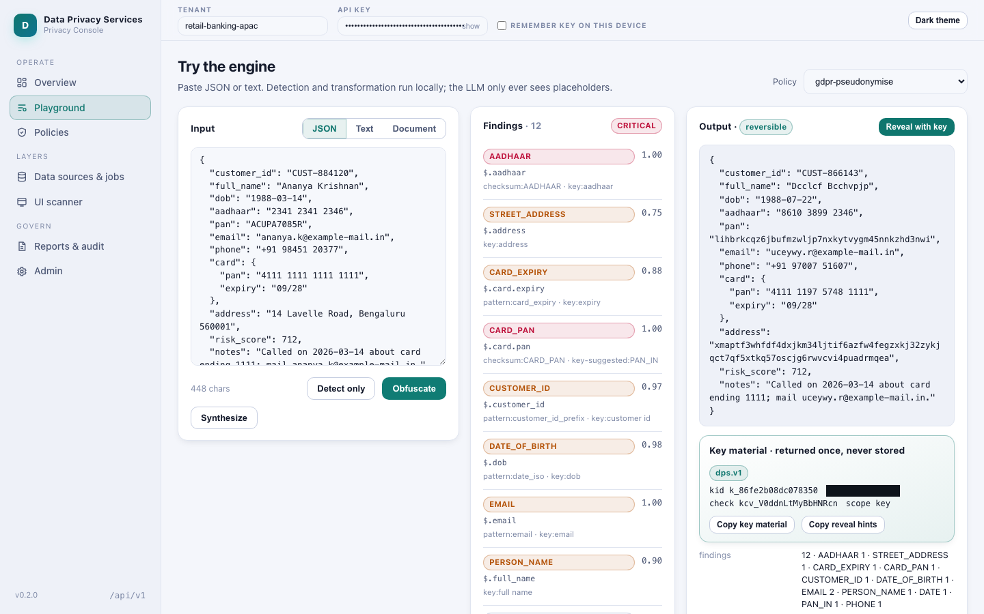
The Playground: findings, tokens and the key
L1 · PLAYGROUND
Paste a KYC record: every finding names its detector and score; obfuscation keeps formats; the key goes back to the caller.
Findings in the sample KYC record
12
Entity types found
AADHAAR
CARD_EXPIRY
CARD_PAN
CUSTOMER_ID
DATE
DATE_OF_BIRTH
EMAIL
PAN_IN
PERSON_NAME
PHONE
STREET_ADDRESS
Reveal with the caller's key: identical input
Raw values sent to an LLM: 0
Data Privacy Services · Privacy Console · rehearsal 2026-10-15 18:28 UTC · commit 37ec781
5 / 12
Notes:
A KYC record goes in; every finding names its detector, its score and the rule that decided its treatment.
Obfuscation keeps formats, so downstream systems keep working: an identifier still looks like that identifier, an e-mail keeps its domain.
The key card belongs to the bank: DPS stored nothing, and reveal with that key gave back exactly the input.
The counter of raw values sent to an LLM read zero for this call.

Slide 6
Documents: true redaction, not a box over text
L1 · DOCUMENTS
Pages are rebuilt from images with the findings burned out, so no text layer survives; an OCR re-read of every page checks that no original is still readable.
Scanned KYC page
OCR reads the page
Findings per page
Redacted PDF
OCR pages read
2
pages the OCR contract read
Findings redacted
14
sensitive values found on the pages
Characters left to extract
0
a text extractor on the redacted PDF
Originals still readable
0
an OCR re-read of the redacted pages
The obfuscated text and the findings come back with the key, so the caller can still reveal the text output; the redacted PDF is irreversible by design.
Data Privacy Services · Privacy Console · rehearsal 2026-10-15 18:28 UTC · commit 37ec781
6 / 12
Notes:
A scanned KYC page: OCR reads it, the engine finds the sensitive values, and the pages are rebuilt as images with those values burned out.
Nothing survives in a text layer, so nothing hidden can be copied out; an OCR re-read of every page checks that no original is still readable.
The text output still comes back with the key, so the owner can reveal it; the redacted PDF is irreversible by design.

Slide 7
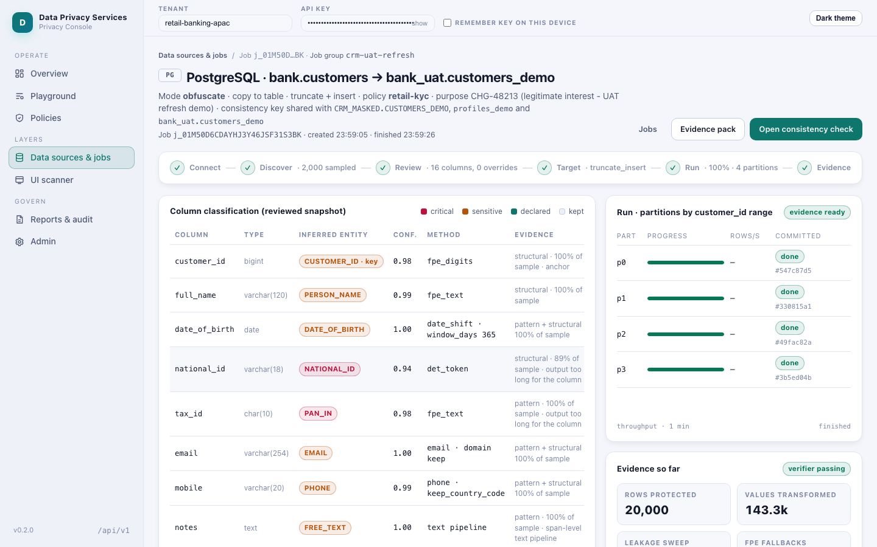
Databases: masked copies at scale, with evidence
L2 · CONNECTORS
Discover, review the heat-map, run: partitions with checkpoints, a verification sweep and a sealed evidence pack for every job.
Measured throughput, rows per second
tools/bench_connector.py on one host with 18 CPUs
PostgreSQL obfuscate into files · 1 worker · parallelism 4
2,911.7
PostgreSQL obfuscate into in place · 1 worker · parallelism 4
3,195.7
PostgreSQL obfuscate into table · 1 worker · parallelism 4
2,474.0
PostgreSQL obfuscate into table · 3 workers · parallelism 4
4,127.6
PostgreSQL obfuscate into table · 3 workers · parallelism 12
4,828.4
PostgreSQL synthesize into table · 1 worker · parallelism 4
2,021.1
Oracle obfuscate into table · 1 worker · parallelism 4
PostgreSQL
20,000 rows · 4 partitions
930.9 rows/s · verified
MongoDB
20,000 rows · 4 partitions
353.8 rows/s · verified
Oracle
20,000 rows · 4 partitions
246.3 rows/s · verified
941.6
MongoDB obfuscate into table · 1 worker · parallelism 4
860.3
Data Privacy Services · Privacy Console · rehearsal 2026-10-15 18:28 UTC · commit 37ec781
7 / 12
Notes:
Layer 2 works on whole schemas: discover the columns, review the heat-map, run in partitions with checkpoints, then a verification sweep and a sealed evidence pack.
These are this rehearsal's jobs on Oracle, MongoDB and PostgreSQL, and the throughput we measured with the bench tool on one machine; production scales out with more workers.

Slide 8
One key, three systems, the same tokens
L2 · JOB GROUPS
A job group shares one key across Oracle, MongoDB and PostgreSQL: the same customer id becomes the same token everywhere, so joins still work, with no lookup table.
PostgreSQL
bank customers
Customer ids sampled
500
Found in every system of the group
500
Consistency check passed
500 of 500 matched
500 of 500 matched
Oracle
CRM customers
MongoDB
customer profiles
500 of 500 matched
Data Privacy Services · Privacy Console · rehearsal 2026-10-15 18:28 UTC · commit 37ec781
8 / 12
Notes:
A job group gives Oracle, MongoDB and PostgreSQL one key, so the same customer id becomes the same token in every system.
The consistency check samples customer ids and joins the masked copies: every pair matched, with no lookup table anywhere.

Slide 9
Synthetic data: measured, not claimed anonymous
L2 · SYNTHETIC
The copula engine is fitted, previewed and measured on the rows the job will write, before anything is written; a real row is rejected in flight.
Fidelity score
0.96
shape of the real columns and their correlations
Exact-row matches
0
synthetic rows identical to a real row
Nearest-neighbour distance ratio
1.50
target at least 0.95; higher is safer
Membership inference (MIA) AUC
0.50
target at most 0.60; a coin toss scores about half
Utility, synthetic vs real
0.97
train on synthetic, test on real (accuracy)
How it was measured
On a deterministic preview of the rows this job writes, before writing; exact copies of real rows are rejected in flight.
Rows written: 20,000
Label: synthetic — measured, not claimed anonymous
Data Privacy Services · Privacy Console · rehearsal 2026-10-15 18:28 UTC · commit 37ec781
9 / 12
Notes:
For synthetic copies the copula engine is fitted, previewed and measured before a single row is written.
Fidelity says the shape survived; exact-row matches must be zero, and a real row is rejected in flight.
The nearest-neighbour distance ratio and the membership-inference test say how far the synthetic rows sit from real people; utility says a model trained on synthetic data still works on real data.
That is why the label reads: synthetic, measured, not claimed anonymous.

Slide 10
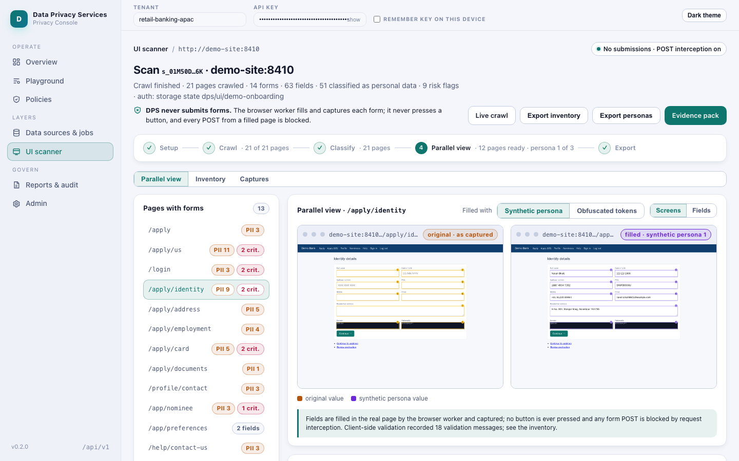
UI scanner: every screen filled, nothing submitted
L3 · UI SCANNER
The scanner maps the onboarding journey, classifies every field and shows each screen beside a copy filled with synthetic or obfuscated data.
Non-GET requests received by the site
0
counted by the demo site, which served the scan 175 GETs; the browser blocked 60 sends
Pages crawled 21
Fields classified 63
Personas filled in 3
Data Privacy Services · Privacy Console · rehearsal 2026-10-15 18:28 UTC · commit 37ec781
10 / 12
Notes:
The scanner walked the onboarding journey, classified every field and filled each screen with a synthetic persona and, flipped, with obfuscated tokens.
The demo site counts every POST, every other non-GET request and every form sent by GET: zero, although it served every page of the scan. DPS has no submit path, and the browser blocked every send from a filled page.

Slide 11
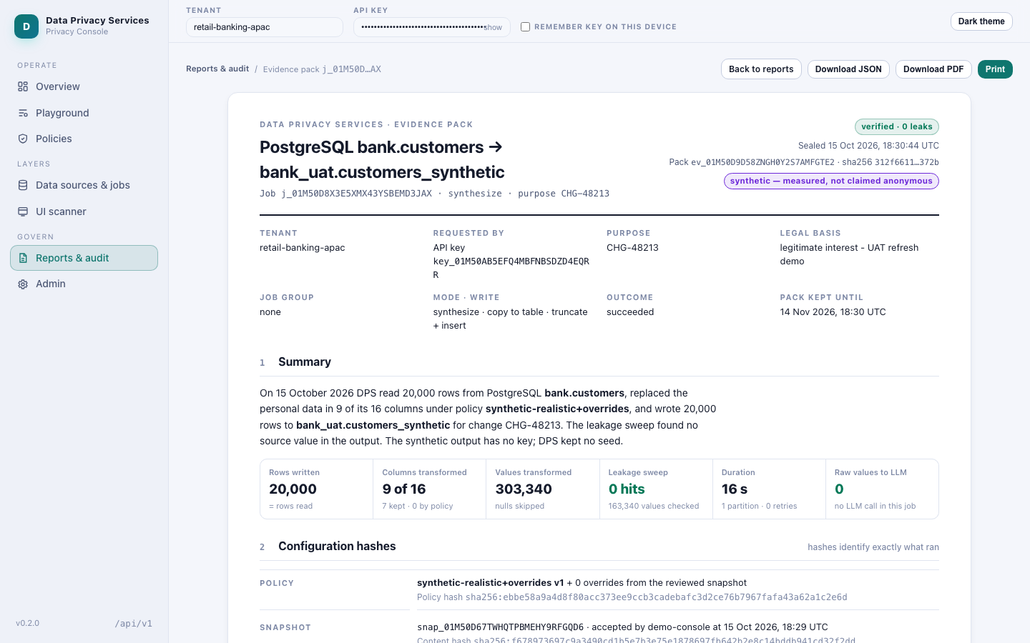
Evidence for every job, posture at every boot
EVIDENCE · POSTURE
Packs name the policy hash, the methods and the verification; staging and production refuse to boot when a posture check enforced at boot fails.
Posture checks
5 of 11 passed
local stack, evaluated as if production; staging and production refuse to boot when a check enforced at boot fails
Values of raw PII sent to an LLM
0
tenant retail-banking-apac, from the reports summary
Evidence packs listed: 5
Audit rows for the demo jobs: 32
Evidence PDF rendered
A rotated key is refused: HTTP 401
Retention run (dry run): succeeded
Data Privacy Services · Privacy Console · rehearsal 2026-10-15 18:28 UTC · commit 37ec781
11 / 12
Notes:
Evidence packs name the policy hash, the methods, the verification and the measurements, and print as a PDF.
In staging and production the service will not start when a posture check enforced at boot fails; this local stack evaluates the same checks as if it were production and only reports them, so the production-only ones fail here by design.
The rehearsal also proved that a rotated key stops working and that retention runs.
And the counter that matters most: raw PII sent to an LLM, zero, for this tenant.

Slide 12
Decisions taken, and what comes next
DECISIONS
The owner decided D1 to D4; D5 to D13 stand at the defaults of the design record; D14 is still open.
D1
Repository · Decided
own git repo, nested in document_intelligence
D8
Reversible tokens · Default
AES-SIV by default; FF1 after a licence review
Next steps
• Set the scale targets together (D14): they size batches, caps and the benchmark goals.
• Run the FF1 licence review before format-preserving encryption is switched on (D8).
• Connect the bank's tokenization service through the external_tokenize adapter.
• Front the console with the bank's SSO and agree the quota day boundary (UTC today).
D2
Key custody · Decided
stateless: the key is returned, DPS stores none
D9
Deployment · Default
compose locally; OpenShift through kustomize
D3
Write modes · Decided
in place, append, table, files; confirmed writes
D10
Documents · Default
obfuscated text and findings; true redacted PDF
D4
UI scanner · Decided
inventory and parallel view; no submissions at all
D11
Retention · Default
job metadata and evidence per tenant; raw values never kept
D5
Jurisdictions · Default
US, CA, MX, IN, UK and EU; NER in EN and ES
D12
Tenancy · Default
X-API-KEY with tenant grants and scopes; SSO later
D6
LLM path · Default
Stellar with COIN OAuth2; Vertex on laptops; stub in CI
D13
Naming · Default
Data Privacy Services, Privacy Console, Vault
D7
Synthesis · Default
surrogates and the built-in copula; MOSTLY AI optional
D14
Scale targets · Open
payload size, rows per job, concurrent jobs, docs per day
Data Privacy Services · Privacy Console · rehearsal 2026-10-15 18:28 UTC · commit 37ec781
12 / 12
Notes:
The owner took the four decisions that shape the platform: where it lives, who holds the key, how jobs write, and that the scanner never submits.
The rest stand at the design defaults, and one is still open: the scale targets, which we set together next.
Next steps: scale targets, the FF1 licence review, the bank's tokenization service, and single sign-on for the console.

