Slide 1
DOCUMENT INTELLIGENCE
Turning KYC documents into a queryable, per-client knowledge platform
Architecture & System Design Executive Briefing · June 2026
Notes:
One-line: we turn a client's raw KYC documents into structured, searchable knowledge that downstream systems can query by client. Agenda: problem, the platform, how each stage works, security, roadmap.

Slide 2
The problem: KYC knowledge is locked away
1
2
3
Trapped in documents
Downstream can't query it
Slow, manual, and risky
Identity, address, ownership and income data arrive as PDFs, scans and images. The knowledge is there, but not usable.
Risk, onboarding and review systems need to ask questions about a client. Today they re-read raw files by hand.
Manual extraction is costly and error-prone, and sending sensitive documents to AI raises real compliance concerns.
Document Intelligence · Confidential
2
Notes:
Set up the pain: the bank already has the documents; the value is locked. Three angles — trapped data, no machine access, manual + compliance risk.

Slide 3
The solution: one platform, document in → knowledge out
Every document is OCR'd, classified safely, extracted, organized into a per-client knowledge tree, and served to downstream systems through one API — with full provenance on every fact.
Document Intelligence · Confidential
3
Notes:
Elevator pitch with the value chain. Emphasize 'one API' and 'provenance'. Everything that follows is how each stage works.

Slide 4
What it delivers
0
Millions
US·CA·MX
100%
sensitive IDs sent to AI
of clients, isolated
EN + ES
facts carry provenance
Passports, SSNs and CURPs are extracted locally and never leave the boundary.
Each client's data is partitioned and access-controlled in the database.
North-American KYC documents across two languages, out of the box.
Every extracted value links to its source page and verification status.
Document Intelligence · Confidential
4
Notes:
Headline outcomes management cares about: compliance (0 IDs to AI), scale, coverage, auditability. These map to the security and architecture slides.

Slide 5
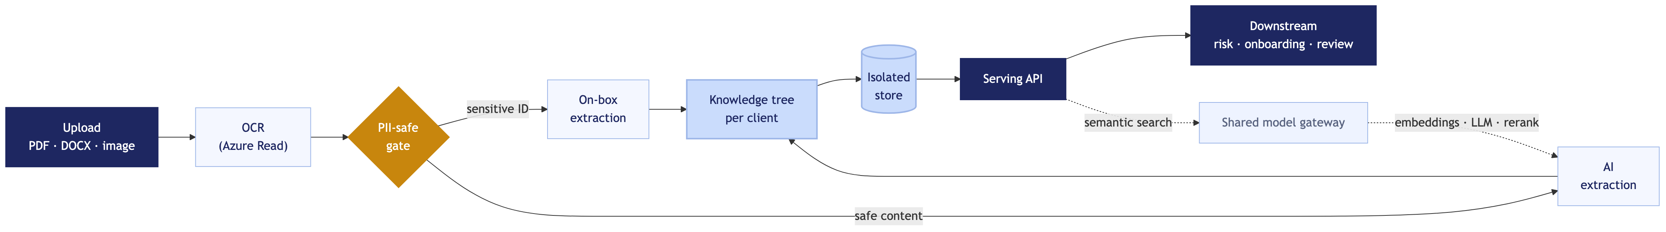
System architecture
Upload → OCR → PII-safe gate → extraction → knowledge tree → isolated store → serving API.
The gate decides what is safe for AI; sensitive IDs are extracted on-box and never leave the boundary.
Model access (embeddings, LLM, rerank) is delegated to a shared gateway — no AI credentials live in this platform.
Document Intelligence · Confidential
5
Notes:
Walk left to right. Stress the gate in the middle: it decides what is safe to send to AI. Storage is isolated per client. Downstream consumers only touch the serving API.

Slide 6
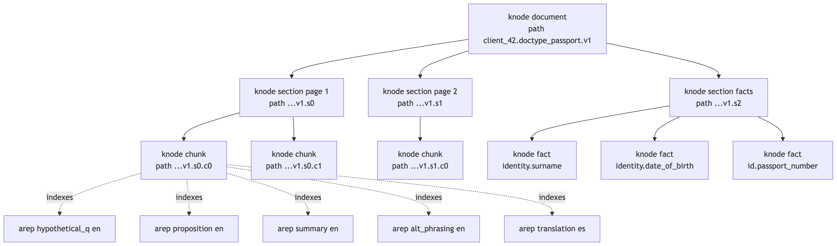
The differentiator: the knowledge subtree
One structure per document — classification, extracted facts, and searchable representations.
Organized per client: document type → version → facts, built to be traversed by any downstream service or agent.
Every node is semantic, linked, and carries its source.
Document Intelligence · Confidential
6
Notes:
This is the novel part and the moat. A document becomes a small tree of knowledge that is both human- and machine-navigable, with provenance on every leaf.

Slide 7
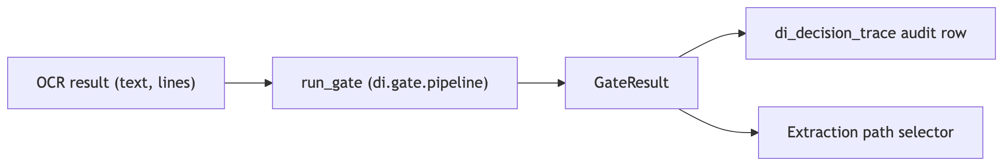
PII-safe by design
Documents are classified locally before any AI sees them — a policy gate decides: extract on-box, or allow to the AI model.
Sensitive IDs (passport, SSN, CURP) stay fully local. Fails safe: when unsure, it keeps data in-house.
Document Intelligence · Confidential
7
Notes:
Compliance is the headline. The gate is the control that lets the bank use AI without exposing regulated PII. Default-deny posture.

Slide 8
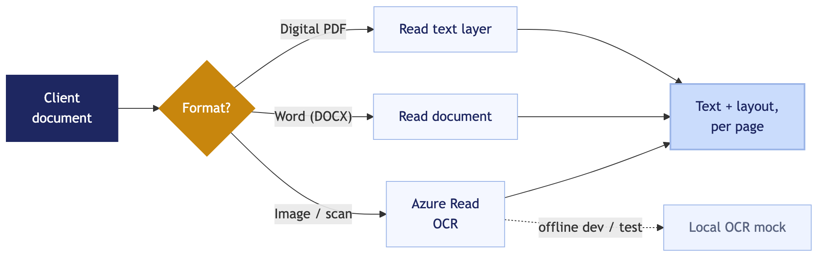
Any document, any format
PDF, Word, PNG and JPEG — all supported.
Production OCR uses Azure Computer Vision Read.
A drop-in local mock lets us run and test fully offline.
Never fails hard — always degrades gracefully.
Document Intelligence · Confidential
8
Notes:
Operationally important: onboard whatever format clients send. The same code talks to real Azure or a local stand-in, so development and testing are not blocked on credentials.

Slide 9
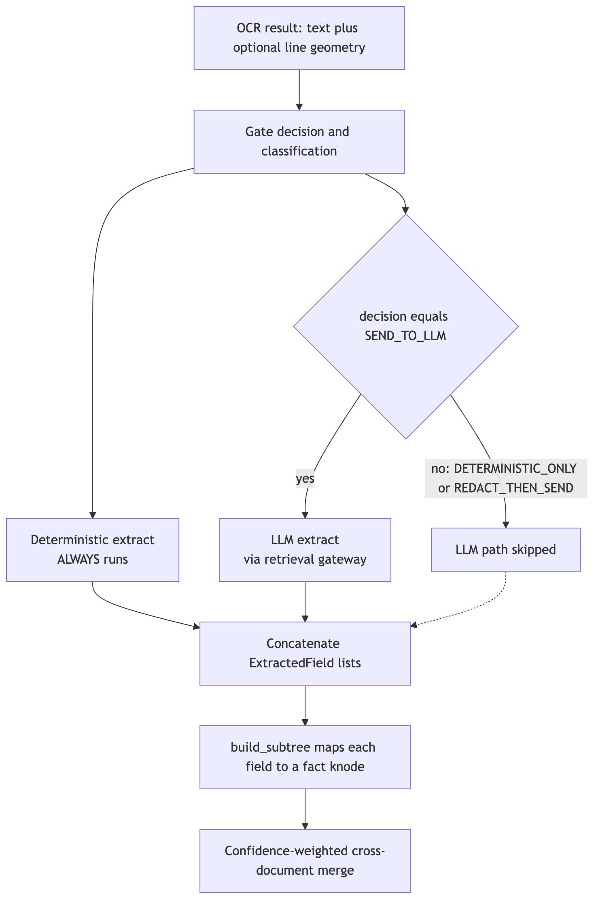
Extraction: deterministic + AI
Fixed-format IDs are parsed and checksum-verified — no AI, no errors.
Variable documents use AI for adaptive extraction.
Each fact records how it was verified and how confident we are.
Deterministic always runs; AI only when the gate allows.
Document Intelligence · Confidential
9
Notes:
Two engines. Deterministic gives trustworthy, audited ID fields. AI handles the messy long tail. The combination is both safe and broad.

Slide 10
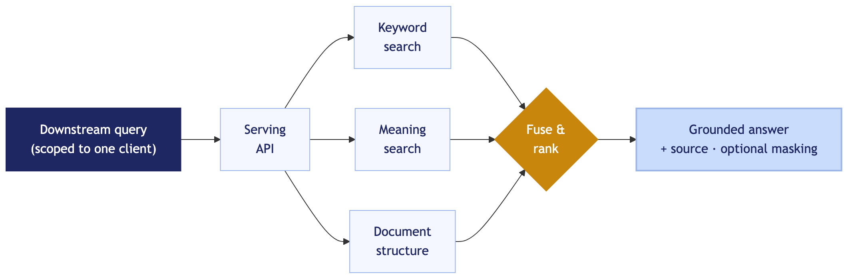
Search & serving
Downstream asks questions scoped to one client.
Hybrid search: keyword + meaning + document structure.
Answers come back grounded in the source document.
Optional masking redacts sensitive values by caller.
Document Intelligence · Confidential
10
Notes:
What downstream teams actually consume: one scoped, grounded, access-aware API. Masking can be toggled per caller clearance.

Slide 11
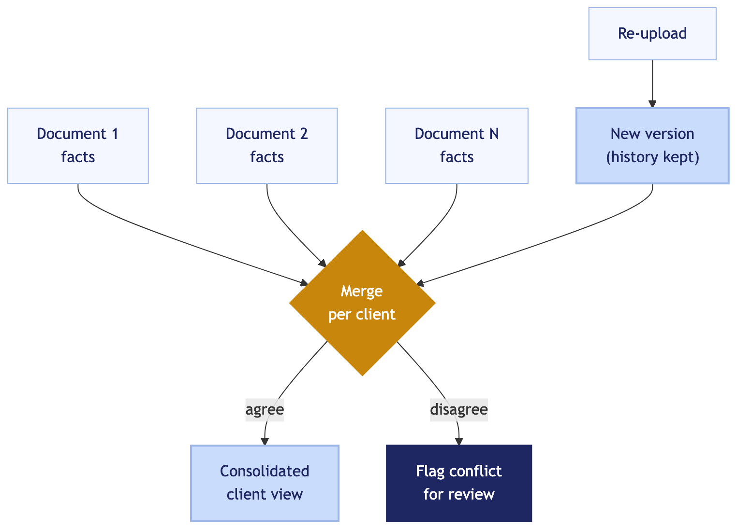
Always current: merge & versioning
Facts from all of a client's documents are consolidated.
Conflicts are flagged for review, not silently overwritten.
Re-uploads create immutable versions; nothing is lost.
A change feed surfaces what is new for periodic review.
Document Intelligence · Confidential
11
Notes:
Re-KYC and periodic review get this for free. The client view stays current across many documents, and history is preserved for audit.

Slide 12
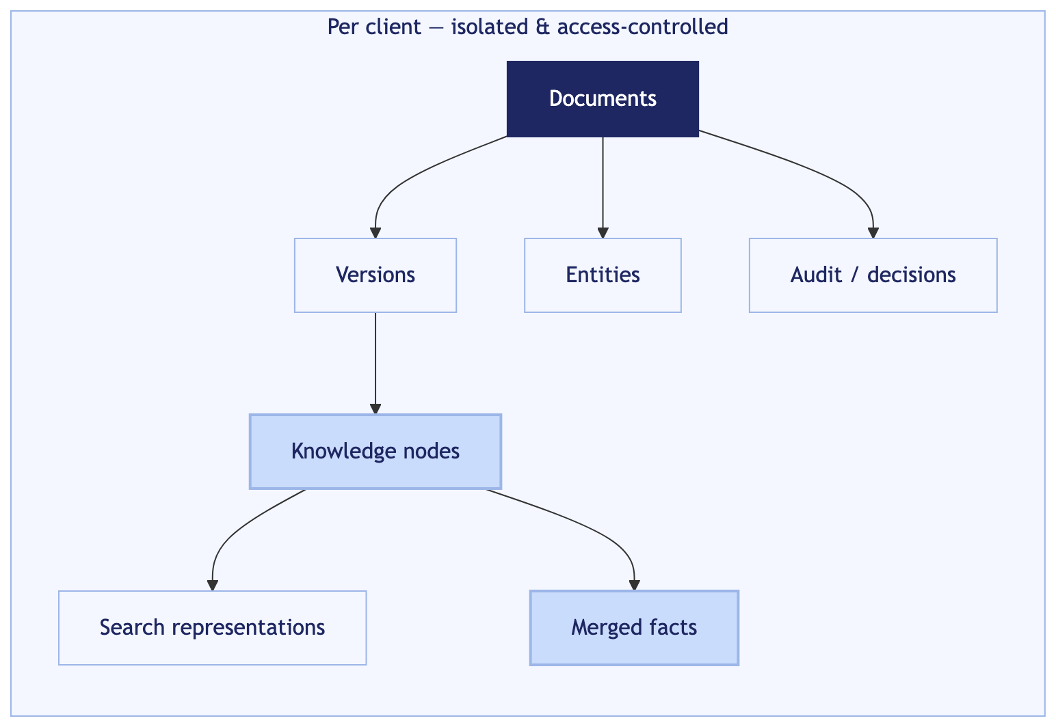
Data model
Seven tables: documents, versions, knowledge nodes, search representations, merged facts, entities, audit.
Isolated and access-controlled per client.
Tuned for fast lookup by client and fast semantic search.
Document Intelligence · Confidential
12
Notes:
Keep this brief for management — it shows the design is real and rigorous. Point at the per-client isolation and the audit table.

Slide 13
Security & compliance, built in
Tenant isolation
PII stays local
Every record is scoped to one client and enforced in the database — a forgotten filter cannot leak another client's data.
Sensitive documents are extracted on-box and never sent to external AI; default-deny when uncertain.
Masking on demand
Provenance & audit
The same data can be served full or redacted, depending on the caller's clearance.
Every fact links to its source; every gate decision is logged for compliance review.
Notes:
For the risk/compliance stakeholders. Four controls: isolation, no-egress for PII, masking, audit. Tie back to the gate slide.

Slide 14
Scale & technology
Designed for millions of clients
Per-client partitioning keeps every lookup fast as the corpus grows.
Semantic search is delegated to a shared, proven model gateway.
Runs as containers; one command brings the whole stack up locally.
Built on
FastAPI
PostgreSQL
pgvector
ltree
Azure Vision Read v3.2
Docker
Python
Document Intelligence · Confidential
14
Notes:
Reassure on scale and that the stack is standard, proven technology — low operational risk.

Slide 15
Status & what's next
Built today
Next
End-to-end pipeline running in containers
Multi-format OCR with local + Azure paths
PII-safe gate + deterministic extraction
Knowledge tree, search, and serving API
Full documentation suite (with diagrams)
Connect the production Azure OCR resource
Deploy the shared model-gateway endpoints
Train the classifier on real document samples
Pilot with a live client document set
Document Intelligence · Confidential
15
Notes:
Honest about built vs pending. 'Next' items are mostly external enablement (credentials, gateway, sample data), not core engineering.

Slide 16
From documents to decisions
A unified, PII-safe document-intelligence platform that makes every client's KYC knowledge instantly queryable — with the provenance and isolation a bank requires.
Notes:
Close on the value: queryable client knowledge + bank-grade safety. Invite questions; point to the roadmap for what unlocks production.

