Slide 1
Stock Price Prediction System using LSTM
Project Proposal
Nilesh Nath
Rajan Shrestha
Nishchal Karki

Slide 2
Table of contents
1
2
3
4
5
6
Introduction
Problem Statement
Objectives
Methodology
Expected Outcomes
References

Slide 3
1
Introduction

Slide 4
Introduction
A stock price predictor is a system that learns about a company's performance and predicts future stock prices.
Our project leverages Long Short-Term Memory (LSTM), a type of Recurrent Neural Network (RNN), to enhance the accuracy of stock price predictions.
LSTM networks are particularly well-suited for time series prediction due to their ability to learn long-term dependencies and retain information over extended periods. This makes them ideal for capturing the complex patterns and trends inherent in stock market data.
The main goal of this project is to develop a robust and reliable prediction model that can analyze historical stock prices and generate accurate forecasts.

Slide 5
2
Problem statement

Slide 6
Problem statement
The stock market, known for its volatility and complex dynamics, presents a significant challenge for investors aiming to predict future stock prices. With the advent of advanced machine learning techniques, particularly Long Short-Term Memory (LSTM) networks, there is potential to improve the accuracy of these predictions significantly. LSTM, a type of recurrent neural network (RNN), excels in capturing temporal dependencies and patterns, making it an ideal choice for time-series forecasting tasks such as stock price prediction. This project, titled "Stock Market Prediction Using LSTM," aims to leverage the power of LSTM networks to forecast stock prices more accurately. By developing a model from scratch, this project will provide insights of stock market behavior and offer a robust predictive tool for investors and financial analysts.

Slide 7
3
Objectives

Slide 8
Objectives
Accurate Forecasting
Market Analysis
Predict future stock prices or price movements with high accuracy using historical data, technical indicators.
Analyze market trends and patterns to identify profitable investment opportunities and potential market entry or exit points.
Sentiment Analysis
Risk Management
Incorporate sentiment analysis from news, social media, and other sources to gauge market mood and its impact on stock prices.
Help investors manage risk by providing insights into potential price volatility and market trends, enabling them to make informed decisions.

Slide 9
4
Methodology

Slide 10
4.1 Requirement identification
4.1.1 Literature review
LSTM networks, introduced by Hochreiter and Schmidhuber in 1997, are a type of Recurrent Neural Network (RNN) designed to overcome the limitations of standard RNNs in learning long-term dependencies.
Studies by Fischer and Krauss (2018) and Zheng et al. (2018) show that LSTMs can outperform traditional models like ARIMA and basic neural networks in terms of prediction accuracy.
Almeida, M., & Pereira, F. (2020) - "Enhancing stock price prediction using deep learning: LSTM with attention mechanism"

Slide 11
4.1 Requirement identification
4.1.2 Requirement analysis
Functional requirements
Data Collection
Data Processing
Real-time Prediction
Performance Evaluation

Slide 12
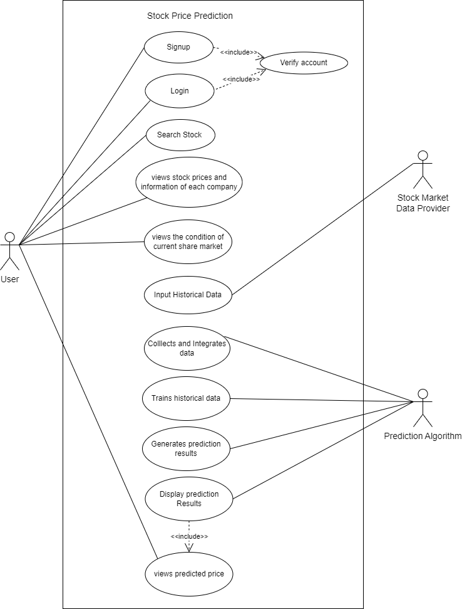
Fig: Use case diagram

Slide 13
4.1 Requirement identification
4.1.2 Requirement analysis
2. Non-Functional requirements
Security
Performance
Maintainability
Usability
Documentation

Slide 14
4.2 Feasibility analysis
Technical feasibility
The project can be managed within an academic environment where team members can collaborate effectively using common tools like Git for version control. The scope of the project is manageable for a student team, allowing them to develop, test, and refine the application within the typical timeframe of an academic semester . We will use Django for Backend api integration and use React/Next for Frontend Development.

Slide 15
4.2 Feasibility analysis
Economical feasibility
Economically, the project is highly feasible. As an academic endeavor, the primary resources required are time and effort from the project team. The reliance on open-source technologies minimizes financial costs, making advanced tools and libraries accessible without monetary investment. This approach ensures that financial barriers do not impede the progress and success of the project.

Slide 16
4.2 Feasibility analysis
3. Operational feasibility
Operationally, the project is well-suited to an academic setting. The scope is designed to be manageable within a typical semester, allowing students to develop, test, and refine their application systematically. Collaboration tools such as Git facilitate effective teamwork. This operational framework supports a cohesive and productive project development cycle. By using LSTM algorithm we have estimated above 90% accuracy for our system.

Slide 17
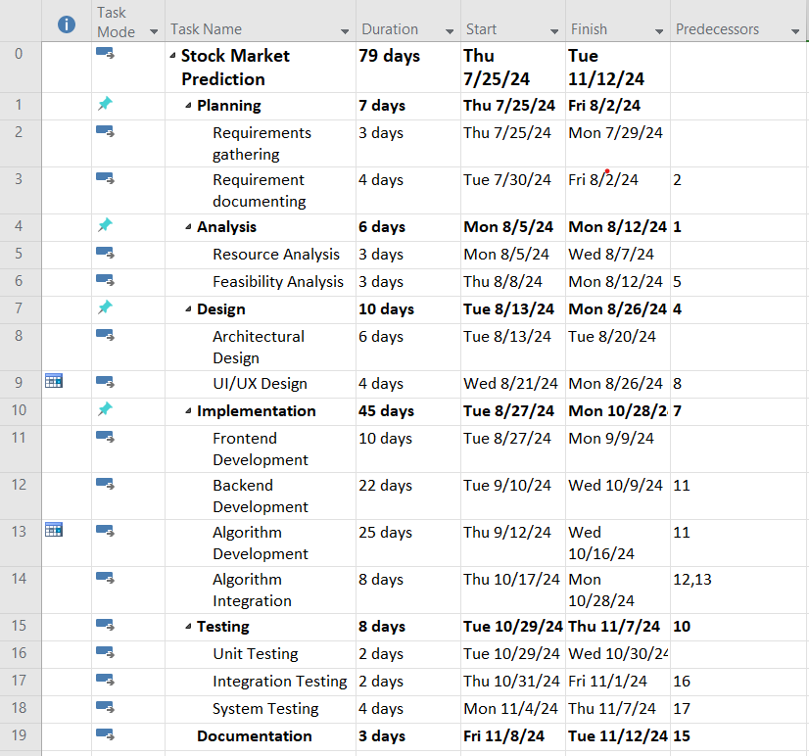
4.2 Feasibility analysis
4. Schedule feasibility
The schedule feasibility is shown as:
a. Work breakdown structure

Slide 18
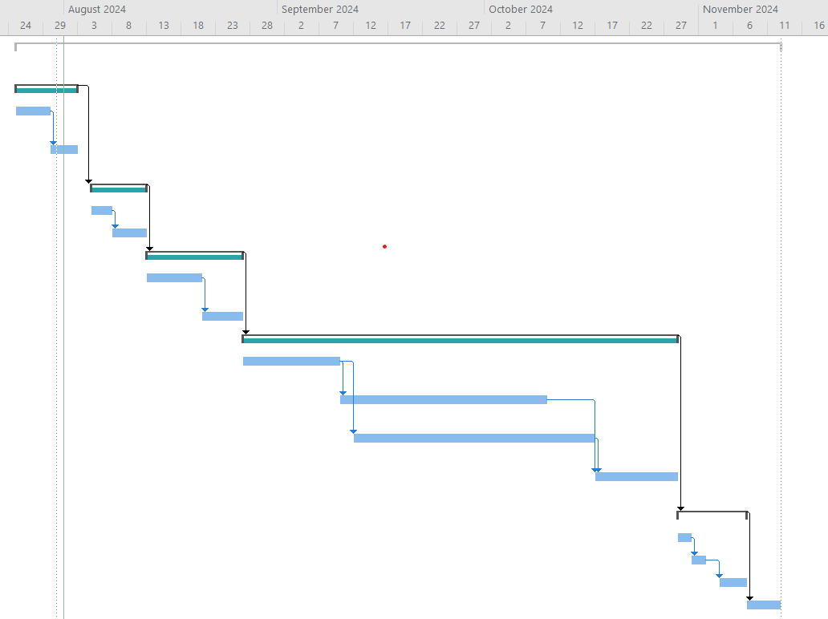
b. Gantt chart

Slide 19
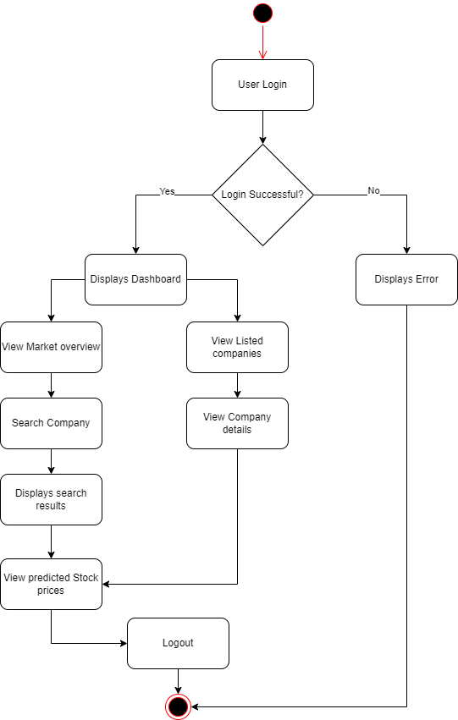
4.3 High level design
Fig: Activity diagram

Slide 20
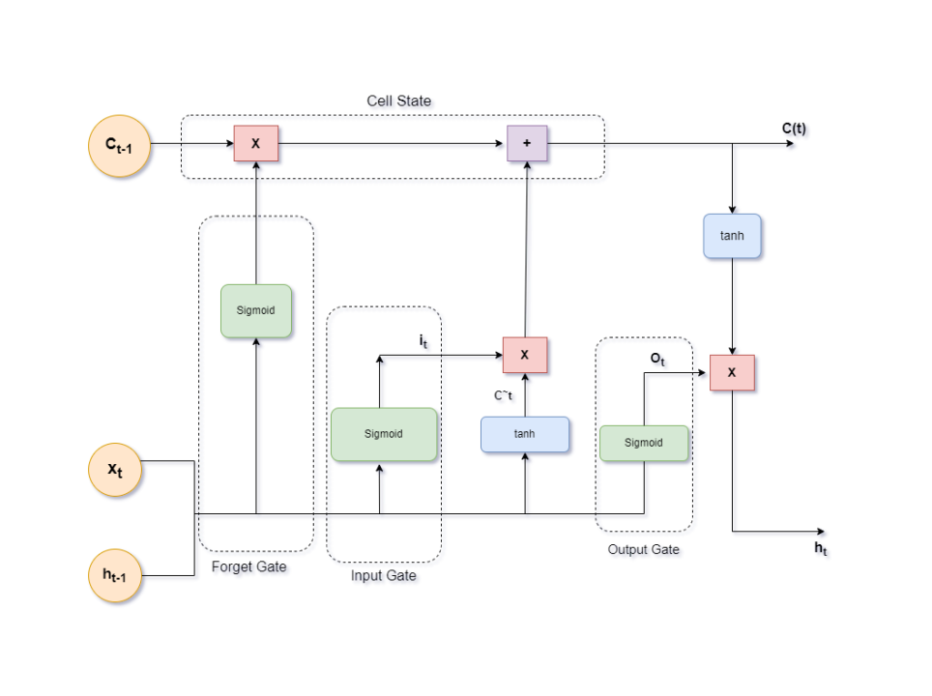
4.3 High level design
Fig: Architecture of LSTM

Slide 21
5
Expected outcomes

Slide 22
Expected Outcomes
Users can view information about each company, analyze its market price, and also see the predicted market price of its stock.
Users can analyze and view the predicted overall market stock price.

Slide 23
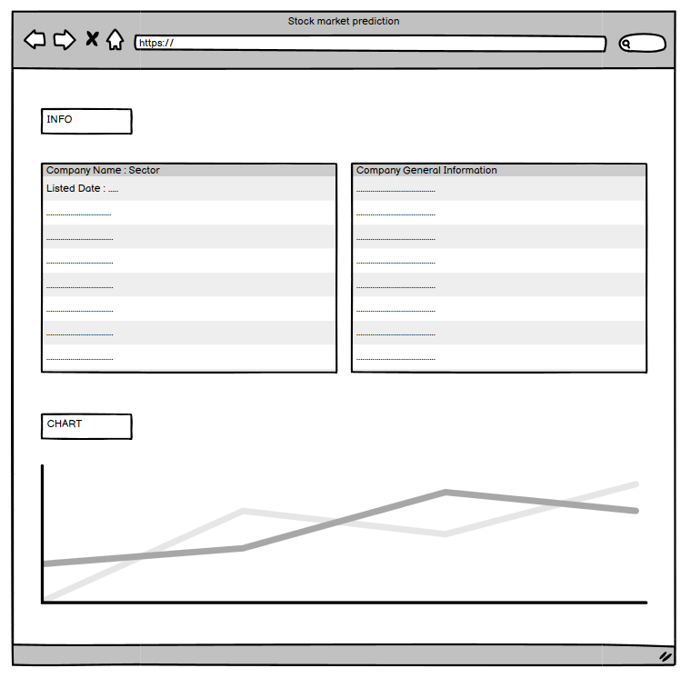

Slide 24
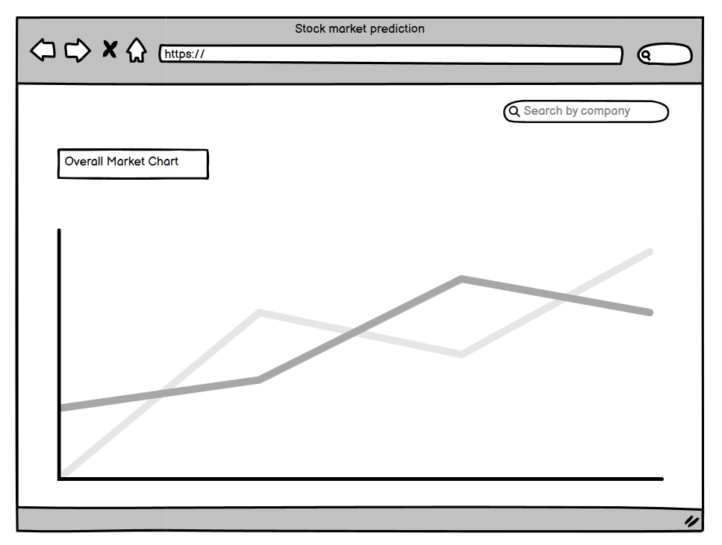

Slide 25
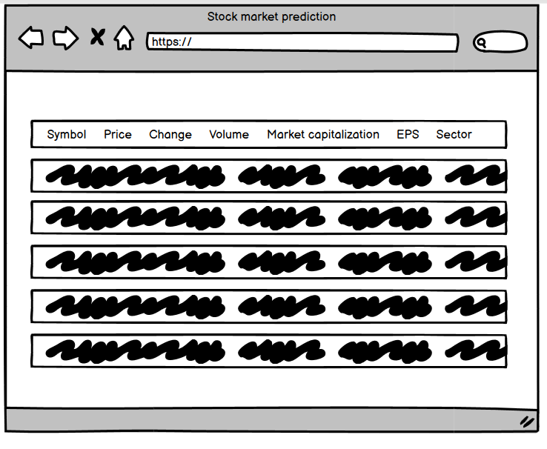

Slide 26
6
References

Slide 27
References
[1]G. Sonkavde, D. S. Dharrao, A. M. Bongale, S. T. Deokate, D. Doreswamy, and S. K. Bhat, “Forecasting Stock Market Prices Using Machine Learning and Deep Learning Models: A Systematic Review, Performance Analysis and Discussion of Implications,” International Journal of Financial Studies, vol. 11, no. 3, p. 94, Sep. 2023, doi: https://doi.org/10.3390/ijfs11030094.
[2]“Papers with Code - Stock Market Prediction,” paperswithcode.com. https://paperswithcode.com/task/stock-market-prediction (accessed Aug. 01, 2024).

Slide 28
References
[3]K. Pawar, R. S. Jalem, and V. Tiwari, “Stock Market Price Prediction Using LSTM RNN,” Advances in Intelligent Systems and Computing, pp. 493–503, Nov. 2018, doi: https://doi.org/10.1007/978-981-13-2285-3_58.
[4]”Stock market analysis + Prediction using LSTM,” kaggle.com. https://www.kaggle.com/code/faressayah/stock-market-analysis-prediction-using-lstm ‌

Slide 29
Thank you!

