Slide 1

Stock Price Prediction Using LSTM
Presented By
Nilesh Nath(26370/077)
Nishchal Karki(26371/077)
Rajan Shrestha(26376/077)
Supervised By
Er. Dhiraj Kumar Jha

Slide 2
INTRODUCTION
Stock price prediction is a popular topic in financial markets because effective forecasting can help investors make informed trading decisions and reduce risk.
However, stock prices are very volatile and impacted by a variety of factors, including market movements, economic indicators, and investor emotions, making forecasting difficult.
LSTM was used to create a Stock Price Prediction System that forecasts future prices by utilizing historical stock price data.
Metrics like Mean Squared Error (MSE), Root Mean Squared Error (RMSE), Mean Absolute Error (MAE), and Mean Absolute Percentage Error (MAPE) are used to evaluate the accuracy and dependability of the LSTM model.

Slide 3
OBJECTIVES
To develop a stock price prediction system using Long Short-Term Memory (LSTM) for accurate forecasting.
To train and evaluate the LSTM model using performance metrics like MSE, RMSE, MAE, and MAPE.
To compare LSTM predictions with actual stock prices and assess model accuracy.

Slide 4
SYSTEM ANALYSIS
Functional Requirement
To allow users to input stock symbols for prediction.
To fetch real-time and historical stock market data from reliable sources.
To use Long Short-Term Memory (LSTM) networks for stock price prediction.
To allow users to compare actual and predicted stock prices.

Slide 5
SYSTEM ANALYSIS
Non-Functional Requirement
Performance
Maintainability
Usability

Slide 6
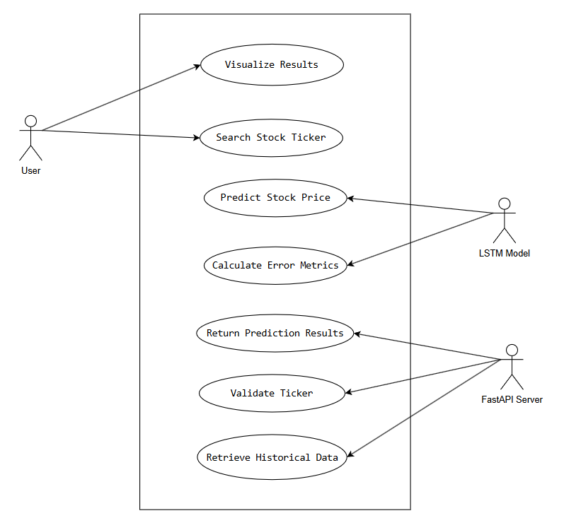
SYSTEM ANALYSIS
Figure: Use Case Diagram

Slide 7
SYSTEM ANALYSIS
Feasibility Analysis
Technical Feasibility:
The Stock Price Prediction System is theoretically possible since it builds the LSTM model with widely used tools and technologies such as Python, Numpy, Pandas.
Data collection and verification proved to be difficult.
Operational Feasibility:
The user-friendly interface ensures that users of all technical levels may easily estimate stock values.
Users can search for equities on NEPSE (Nepal Stock Exchange) and compare anticipated to real prices.

Slide 8
SYSTEM ANALYSIS
3. Schedule Feasibility:
Schedule feasibility is the process of determining if a proposed plan or project can be completed realistically within a given timeframe.
It entails evaluating a variety of factors, including resource availability, time constraints, task dependencies, and potential dangers.

Slide 9
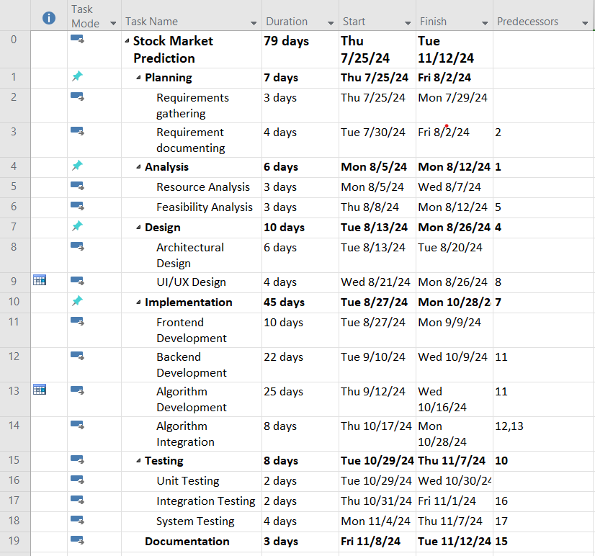
SYSTEM ANALYSIS
Figure: Work Break Structure

Slide 10
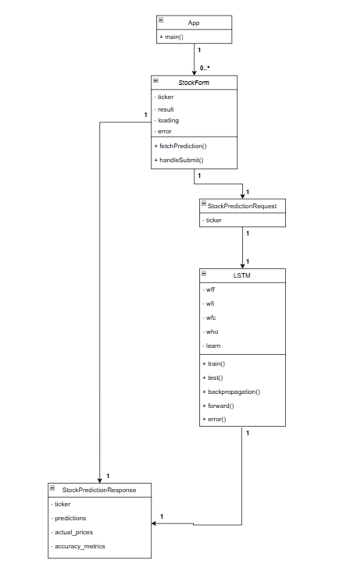
SYSTEM DESIGN
Figure: Class Diagram of the system

Slide 11
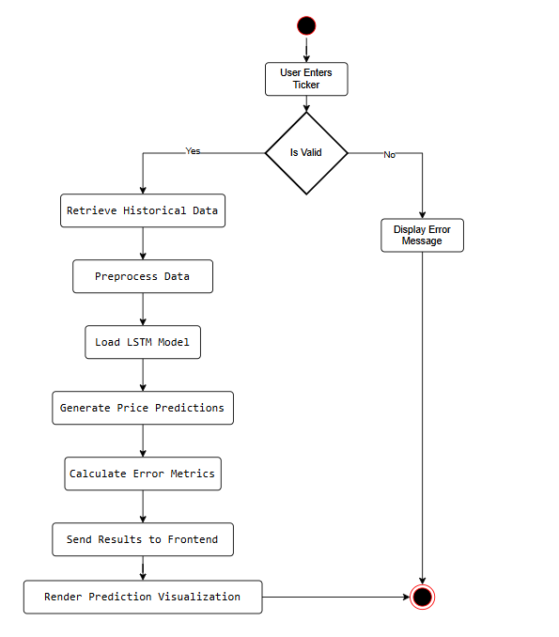
SYSTEM DESIGN
Figure Activity Diagram of the system

Slide 12
SYSTEM DESIGN
Algorithm Details:
Below is a detailed explanation of how LSTM works:
LSTM Architecture
An LSTM is made up of multiple components, the most important of which is the memory cell, which can store information for extended periods of time.
a. Memory Cell:
The memory cell stores information and informs the LSTM model on what to remember and forget at each time step.

Slide 13
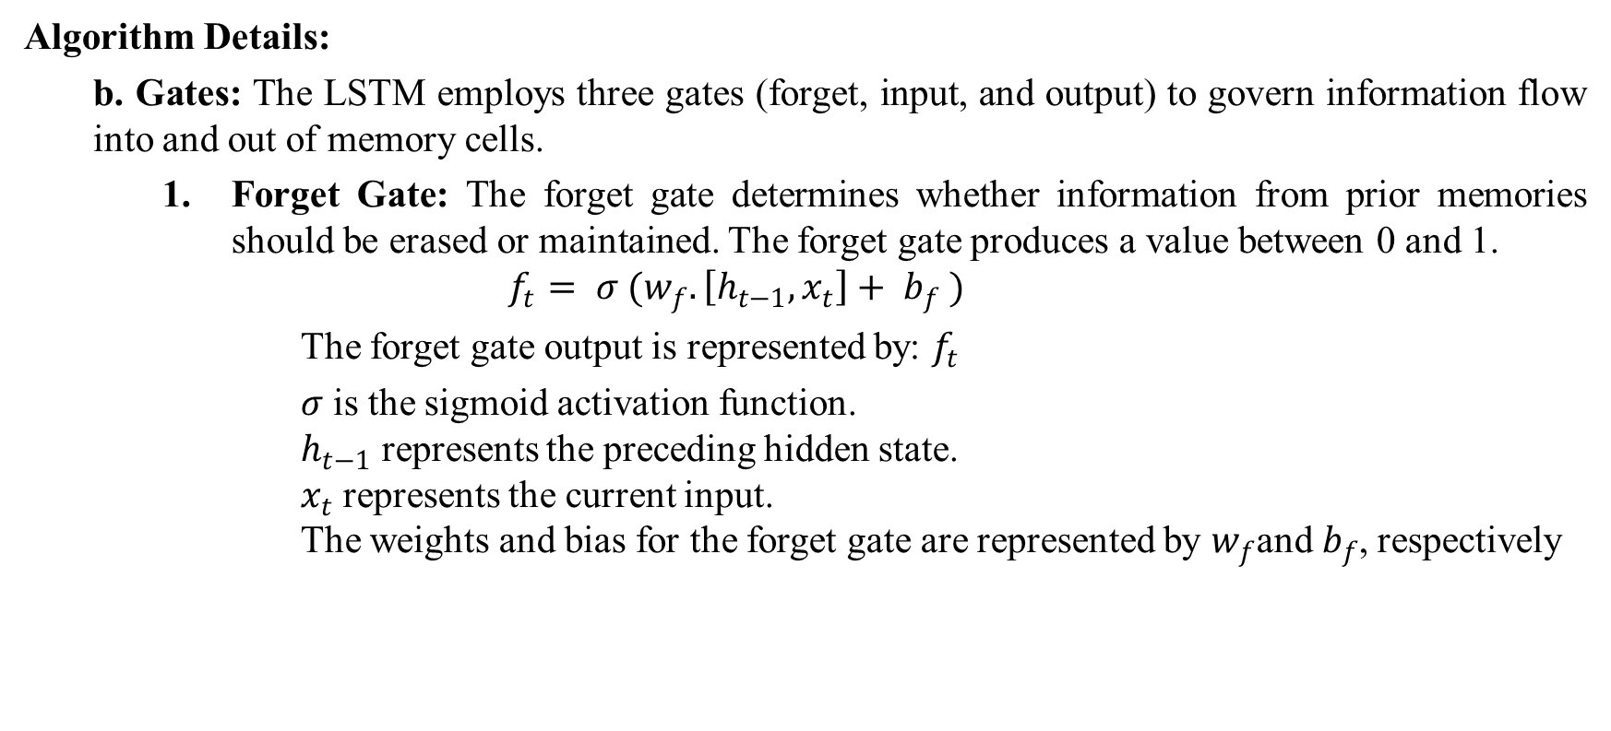
SYSTEM DESIGN
Algorithm Details:
b. Gates: The LSTM employs three gates (forget, input, and output) to govern information flow into and out of memory cells.
Forget Gate: The forget gate determines whether information from prior memories should be erased or maintained. The forget gate produces a value between 0 and 1.
$$f_{t}= σ (w_{f}.\left[h_{t−1},x_{t}\right]+ b_{f} )$$
The forget gate output is represented by: $f_{t}$
𝜎 is the sigmoid activation function. $h_{t−1}$​ represents the preceding hidden state. $x_{t}$ represents the current input. The weights and bias for the forget gate are represented by $w_{f}$and $b_{f}$, respectively

Slide 14
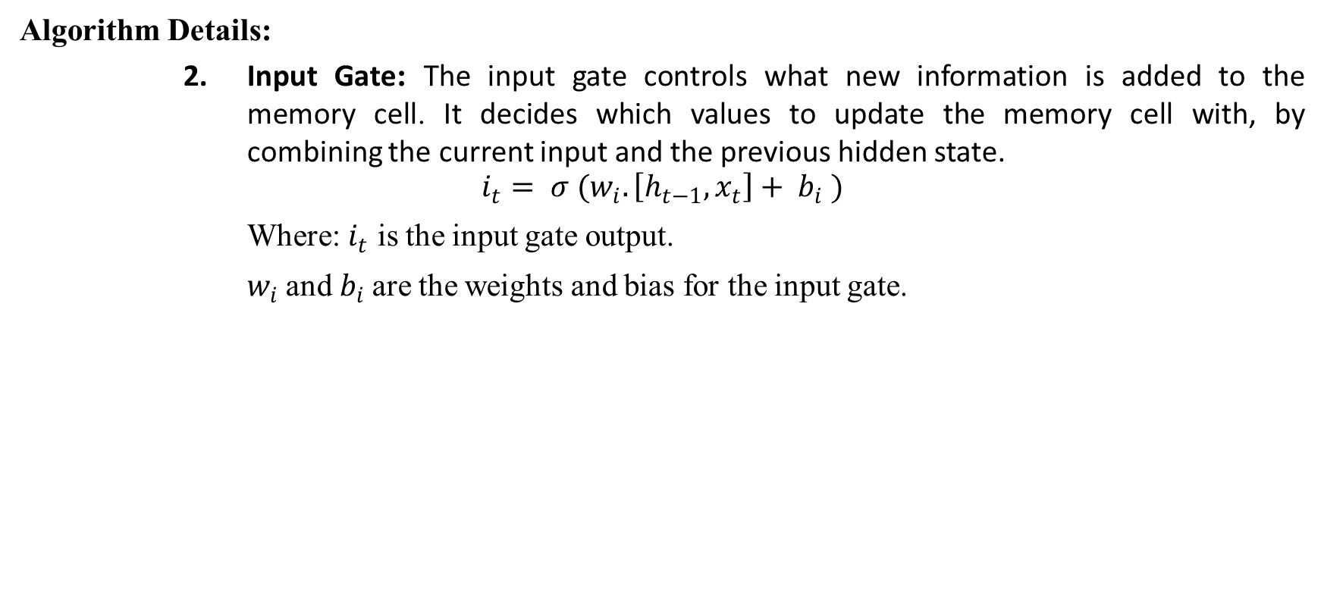
SYSTEM DESIGN
Algorithm Details:
2. Input Gate: The input gate controls what new information is added to the memory cell. It decides which values to update the memory cell with, by combining the current input and the previous hidden state.
$$i_{t}= σ (w_{i}.\left[h_{t−1},x_{t}\right]+ b_{i} )$$
Where: $i_{t}$ is the input gate output.
$w_{i}$and $b_{i}$are the weights and bias for the input gate.

Slide 15

SYSTEM DESIGN
Algorithm Details:
3. Output Gate: The output gate determines what information is output from the memory cell.
$o_{t}= σ (w_{o}.\left[h_{t−1},x_{t}\right]+ b_{o} )$
Where: $o_{t}$ ​is the output gate output. The weights and bias for the output gate are represented by $w_{o}$ and $b_{o}$ respectively.

Slide 16
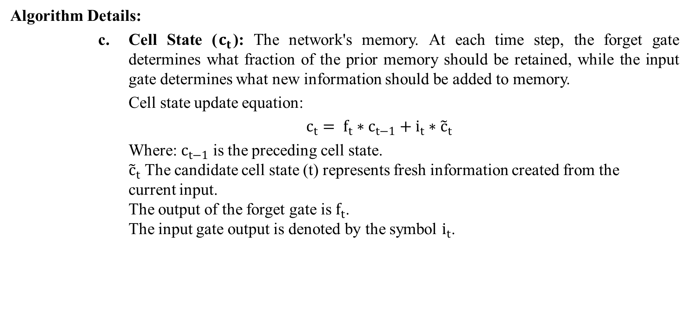
SYSTEM DESIGN
Algorithm Details:
c. Cell State ($c_{t}$): The network's memory. At each time step, the forget gate determines what fraction of the prior memory should be retained, while the input gate determines what new information should be added to memory.
Cell state update equation:
$c_{t}= f_{t}∗c_{t−1}+i_{t}∗{\tilde{c}}_{t}$
Where: $c_{t−1}$​ is the preceding cell state. ${\tilde{c}}_{t}$ The candidate cell state (t) represents fresh information created from the current input. The output of the forget gate is $f_{t}$. The input gate output is denoted by the symbol $i_{t}$.

Slide 17
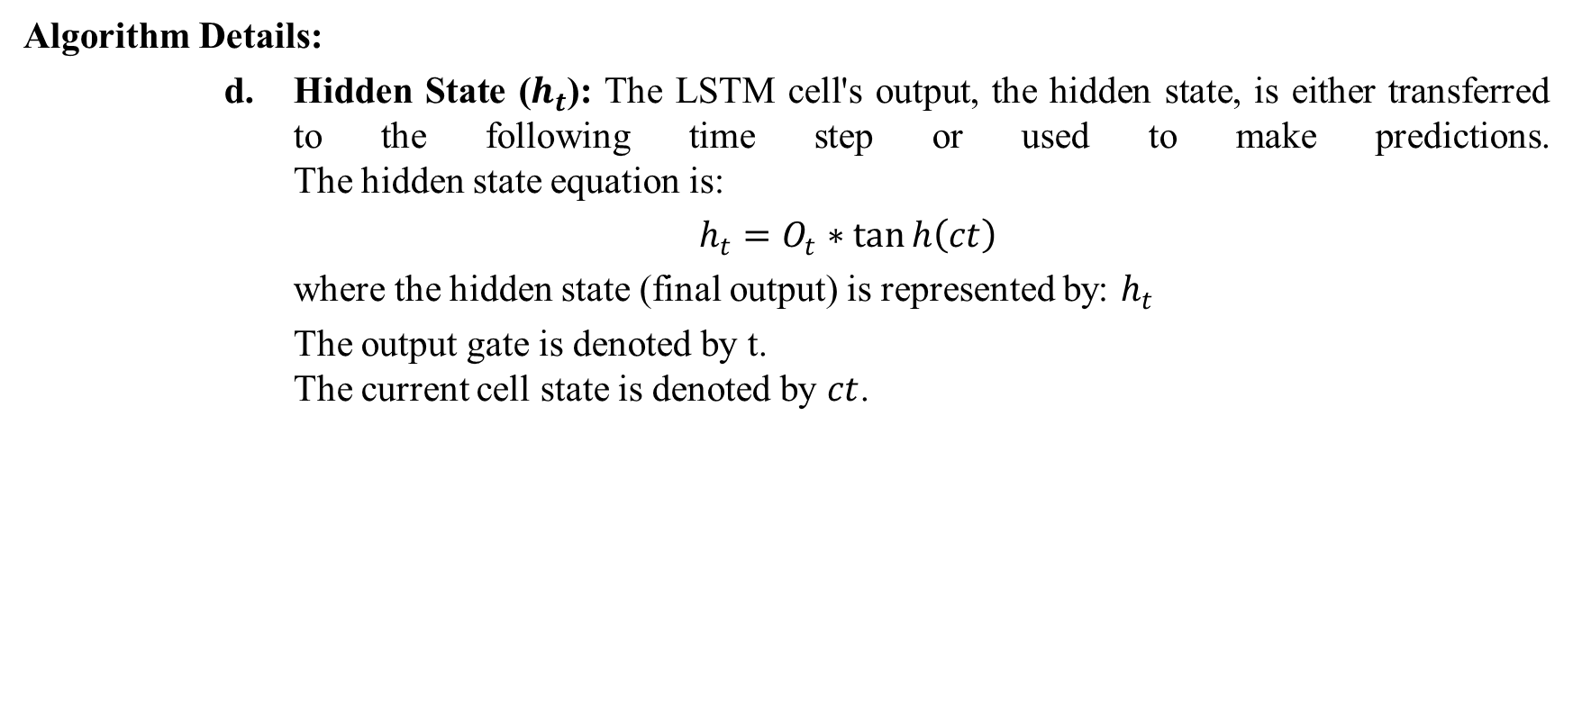
SYSTEM DESIGN
Algorithm Details:
d. Hidden State ($h_{t}$): The LSTM cell's output, the hidden state, is either transferred to the following time step or used to make predictions. The hidden state equation is:
$h_{t}=O_{t}∗\tan{h\left(ct\right)}$
where the hidden state (final output) is represented by: $h_{t}$
The output gate is denoted by t. The current cell state is denoted by $ct$.

Slide 18
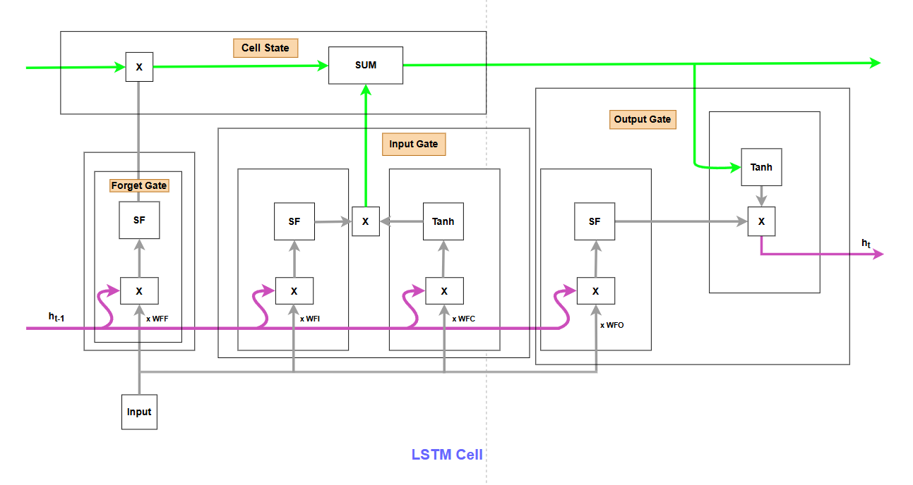
SYSTEM DESIGN
Figure: Architecture of LSTM

Slide 19
IMPLEMENTATION AND TESTING
Implementation
Tools Used:
Front End:
React
CSS
Back End:
Python
FastAPI

Slide 20
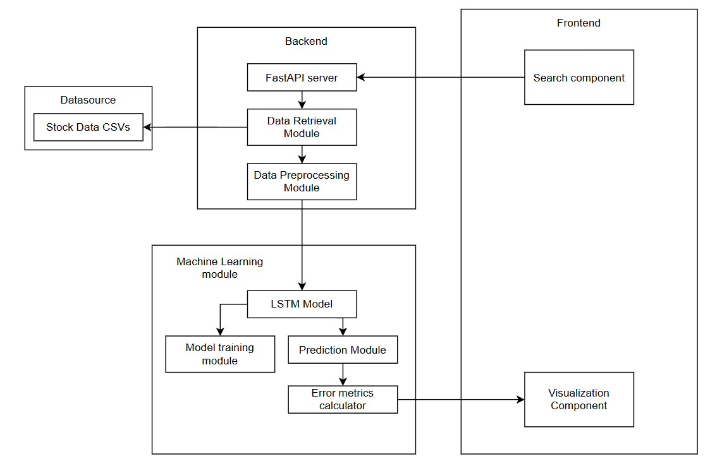
IMPLEMENTATION AND TESTING…
Implementation Detail:
Figure: Algorithm Implementation Procedure

Slide 21
IMPLEMENTATION AND TESTING…
Testing:
Three testing approaches: unit testing, interaction testing, and system testing.
Each step was carefully prepared to test the emergency response system's dependability and performance at various levels of integration.
Based on the testing conducted, the emergency response system achieved an efficiency rate of 88%.
Result Analysis:
Task | Time(Seconds)
Response Time Calculation | 15
Routing Efficiency Analysis | 15
Nearest Location Calculation | 10
Resource Utilization Assessment | 0.5
Total Execution Time | 135

Slide 22
CONCLUSION AND FUTURE RECOMMENDATION
Conclusion
In conclusion, the Stock Price Prediction System using LSTM has successfully demonstrated the potential of machine learning to predict stock prices based on historical data.
Future Recommendation
Implement news sentiment and social media.
integrating real-time data for the most recent forecasts.
Accessibility and dependability would be further enhanced by a more user-friendly interface

Slide 23
DEMONSTRATION

