Slide 1
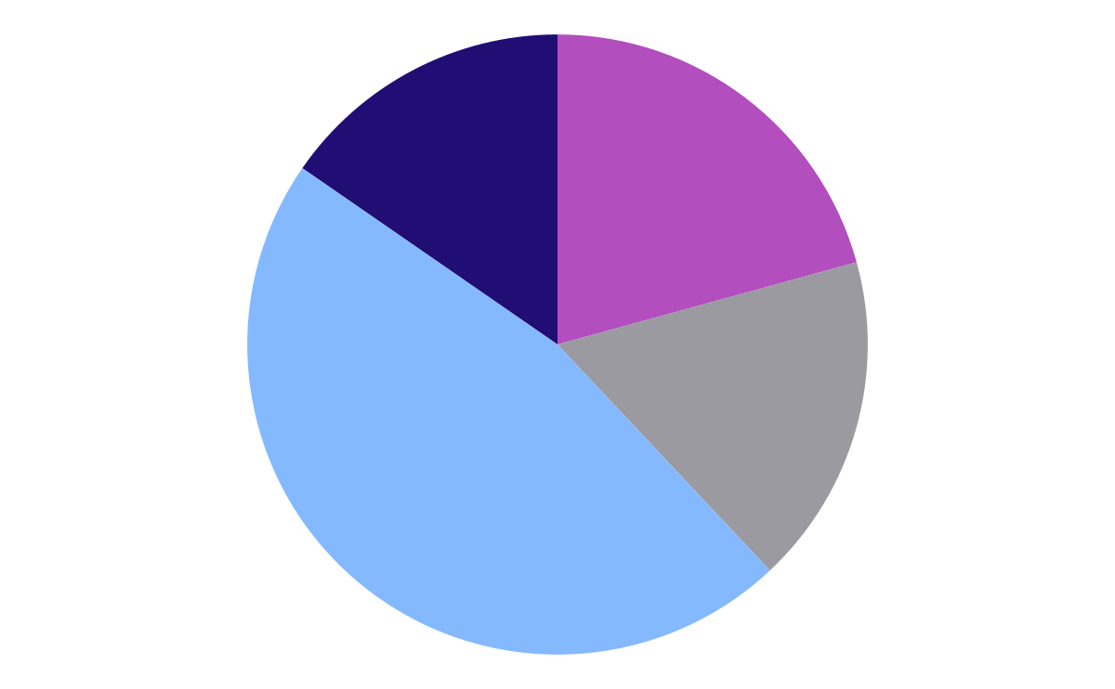
MARKETING DATA ANALYST
JOIN
SUB
PROJECT
PROJECT (MARKETING DATA)

Slide 2

JOIN
JOIN
SUB
01
The main advantage of a join is that it executes faster. The performance increase might not be noticeable by the end user. However, because the columns are specifically named and indexed and optimized by the database engine, the retrieval time almost always will be faster than that of a subquery.

Slide 3
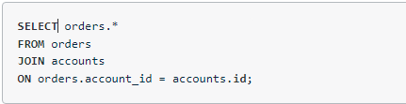
WRITE YOUR FIRST JOIN
JOIN
SUB
As we've learned, the SELECT clause indicates which column(s) of data you'd like to see in the output (For Example, orders.* gives us all the columns in orders table in the output). The FROM clause indicates the first table from which we're pulling data, and the JOIN indicates the second table. The ON clause specifies the column on which you'd like to merge the two tables together. Try running this query yourself below

Slide 4
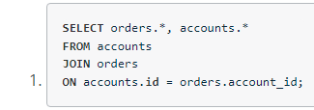
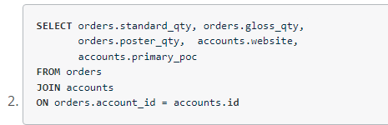
FIRST JOIN - QUIZ
JOIN
SUB
Try pulling all the data from the accounts table, and all the data from the orders table.
Try pulling standard_qty, gloss_qty, and poster_qty from the orders table, and the website and the primary_poc from the accounts table.

Slide 5
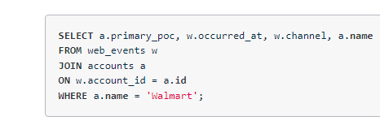
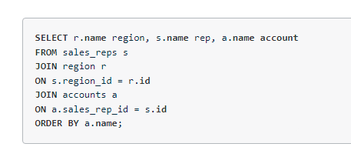
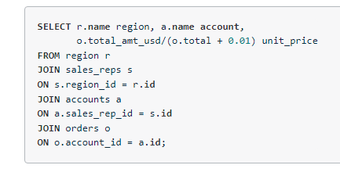
MORE – QUIZ(BASIC)
JOIN
SUB
Provide a table for all web_events associated with account name of Walmart. There should be three columns. Be sure to include the primary_poc, time of the event, and the channel for each event. Additionally, you might choose to add a fourth column to assure only Walmart events were chosen.
Provide a table that provides the region for each sales_rep along with their associated accounts. Your final table should include three columns: the region name, the sales rep name, and the account name. Sort the accounts alphabetically (A-Z) according to account name.
Provide the name for each region for every order, as well as the account name and the unit price they paid (total_amt_usd/total) for the order. Your final table should have 3 columns: region name, account name, and unit price. A few accounts have 0 for total, so I divided by (total + 0.01) to assure not dividing by zero.

Slide 6
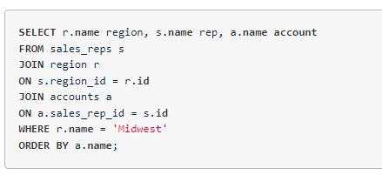
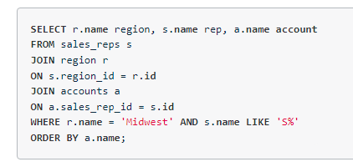
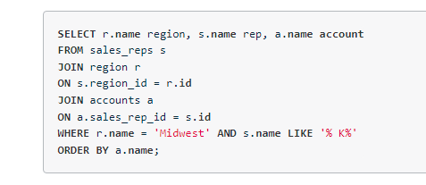
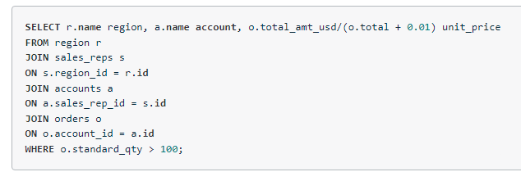
MORE – QUIZ (ADVANCE)
JOIN
SUB
Provide a table that provides the region for each sales_rep along with their associated accounts. This time only for the Midwest region. Your final table should include three columns: the region name, the sales rep name, and the account name. Sort the accounts alphabetically (A-Z) according to account name.
Provide a table that provides the region for each sales_rep along with their associated accounts. This time only for accounts where the sales rep has a first name starting with S and in the Midwest region. Your final table should include three columns: the region name, the sales rep name, and the account name. Sort the accounts alphabetically (A-Z) according to account name.
Provide a table that provides the region for each sales_rep along with their associated accounts. This time only for accounts where the sales rep has a last name starting with K and in the Midwest region. Your final table should include three columns: the region name, the sales rep name, and the account name. Sort the accounts alphabetically (A-Z) according to account name.
Provide the name for each region for every order, as well as the account name and the unit price they paid (total_amt_usd/total) for the order. However, you should only provide the results if the standard order quantity exceeds 100. Your final table should have 3 columns: region name, account name, and unit price. In order to avoid a division by zero error, adding .01 to the denominator here is helpful total_amt_usd/(total+0.01).

Slide 7
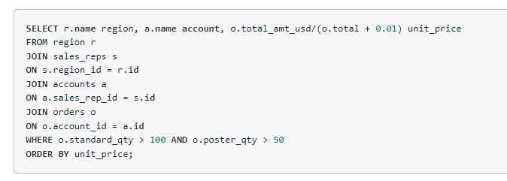
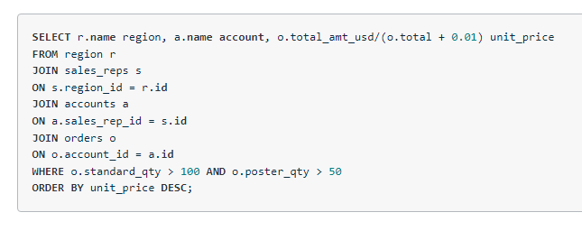
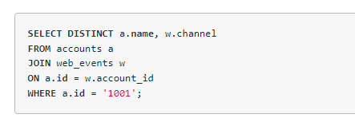
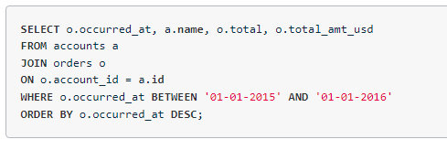
MORE – QUIZ (ADVANCE)
JOIN
SUB
Provide the name for each region for every order, as well as the account name and the unit price they paid (total_amt_usd/total) for the order. However, you should only provide the results if the standard order quantity exceeds 100 and the poster order quantity exceeds 50. Your final table should have 3 columns: region name, account name, and unit price. Sort for the smallest unit price first.
Provide the name for each region for every order, as well as the account name and the unit price they paid (total_amt_usd/total) for the order. However, you should only provide the results if the standard order quantity exceeds 100 and the poster order quantity exceeds 50. Your final table should have 3 columns: region name, account name, and unit price. Sort for the smallest unit price first.
What are the different channels used by account id 1001? Your final table should have only 2 columns: account name and the different channels. You can try SELECT DISTINCT to narrow down the results to only the unique values.
Find all the orders that occurred in 2015. Your final table should have 4 columns: occurred_at, account name, order total, and order total_amt_usd

Slide 8

SUB - QUERIES
JOIN
SUB
02

Slide 9
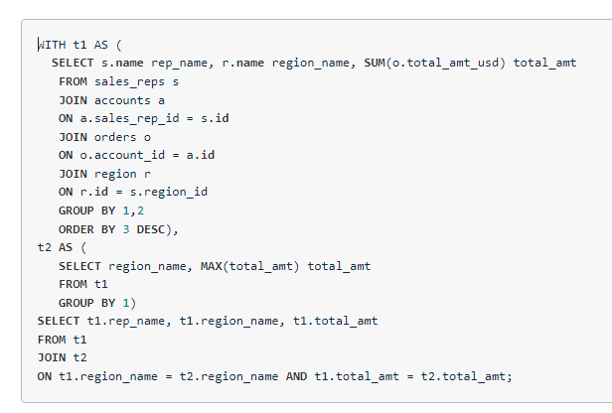
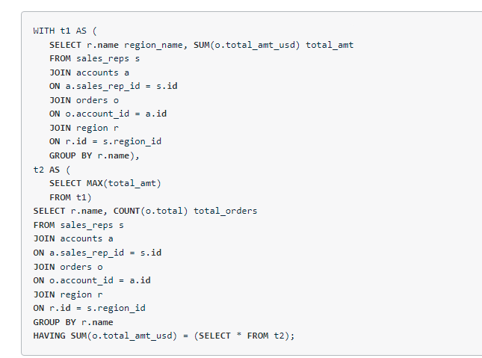
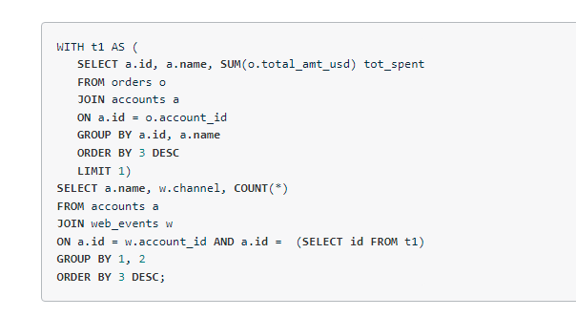
QUIZ (ADVANCE)
JOIN
SUB
Provide the name of the sales_rep in each region with the largest amount of total_amt_usd sales.
For the region with the largest sales total_amt_usd, how many total orders were placed
For the account that purchased the most (in total over their lifetime as a customer) standard_qty paper, how many accounts still had more in total purchases?
For the customer that spent the most (in total over their lifetime as a customer) total_amt_usd, how many web_events did they have for each channel?

Slide 10
THANK YOU

