Slide 1
Analog and
Digital Electronics
(Second Year BTech Computer) (2019-20)
(Faculty: Mr. Y. K. Sharma)
Courtesy: R. P. Jain
(Modern Digital Electronics)

Slide 2
UNIT- 3
Sequential Logic
Courtesy: R. P. Jain & J. S. Katre

Slide 3
Sequential Logic
Flip-flop: SR, JK, D, T; Preset & Clear, Master and Slave Flip Flops, Truth Tables and Excitation tables, Conversion from one type to another type of Flip Flop.
Registers: Buffer register, shift register (SISO, SIPO, PISO & PIPO), Applications of shift registers.

Slide 4
Sequential Logic
Introduction:
Timing parameter comes into picture.
Output depends on present time inputs, the previous output & the sequence in which the inputs are applied.
To store a previous input or output, a memory element is required.
The data stored by the memory element at any given instant of time is called as the present state of the sequential circuit.
Combinational circuit operates on the external inputs and the present
state to produce new outputs. Some of these new outputs are stored in the memory element and called as the next state of the sequential circuit.
Memory element is the most important part of sequential circuits and
is known as flip flop (FF). It is the basic memory element.

Slide 5
Sequential Logic
Clock Signal:
It is timing signal. Every sequential signal will have this timing signal
applied.
It is rectangular signal, with a duty cycle equal to 50%.
Clock signal repeats itself after every T seconds. Hence the clock frequency if f = 1 / T.
High
Low
Time
Leading edge
Falling edge
T
(One cycle time)

Slide 7
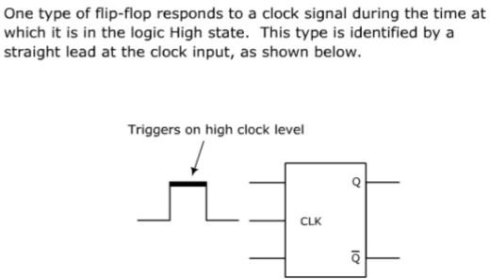
High Level Triggering

Slide 8
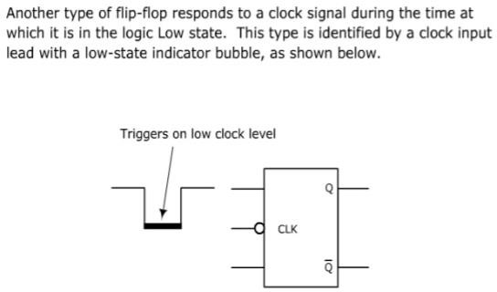
Low Level Triggering

Slide 9
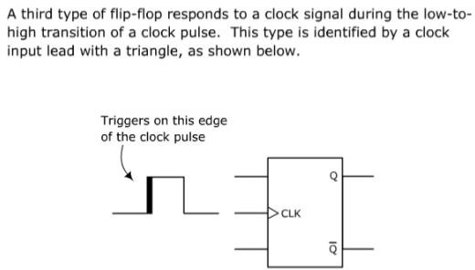
Positive Edge Triggering

Slide 10
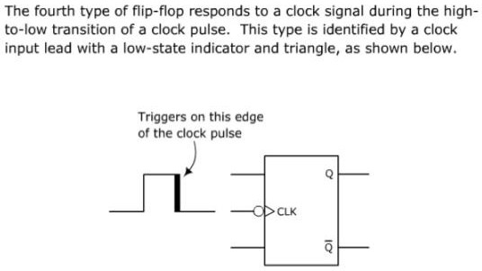
Negative Edge Triggering

Slide 11
Sequential Logic
Clock Skew:
It is defined as the difference in time between the clock edges arriving
at a pair of clock inputs.
In a perfect system, all clock signals arrive at all the various clock input pins of the system at exactly the same time & the skew is zero.
In real time systems, the edges do not arrive at exactly the same time &
there is some skew.
Maximum allowable clock skew for the system is the difference between the shortest and longest path delays.
It is an important design parameter in high-speed clock systems.
It appears due to different delays on different paths from the clock
generator to various circuits. The major reasons for this are:
  Different length of wires
  Gates (buffers) on the paths.
  Flip-flops that clock on different edges
  Gating the clock to control loading of registers

Slide 12
Sequential Logic
Comparison of Combinational & Sequential Circuits:
No. Parameter Combinational Sequential
1. Output depend on | Inputs present at | Present inputs &
 | that instant of time | past inputs/ outputs
2. Memory | Not necessary | Necessary
3. Clock Input | Not necessary | Necessary
4. Examples | Adders, Subtractors, | Flip flops, shift
 | Code converters | registers, counters

Slide 13
Sequential Logic
Sequential circuit consists of combinational circuit along with the memory element.
Memory element will always appear in the feedback path.
Output of sequential circuit depends on the present state as well as the past state.
Present state is stored in the memory elements.
Present states are applied to the combinational circuit along with
the external inputs.
Thus outputs & the next state of the sequential circuit are decided by the external inputs & the present state.
Combinational Circuit
Inputs
Outputs
Memory Elements

Slide 14
Sequential Logic
1-Bit Memory Cell:
Basic digital memory circuit is also known as Flip-flop.
It has two stable states namely logic 1 state and logic 0 state. It can be designed either using NOR gates or NAND gates.
A Flip-flop can be designed using NAND gates 1 and 2, where these two gates G1 & G2 act as inverters. Hence this circuit is called as a cross coupled inverter.
Output of G1 is connected to the input of G2 & output of G2 is connected to input of G1.
Assume Q=1 then input for G2 i.e. B2=1
As B2=1, output of gate-2 ie. G2 i..e Q=0. This makes B1=0.
Hence Q continues to be equal to 1.
Similarly, if we start with Q=0, then we end up obtaining Q=0 and Q=1.

Slide 15
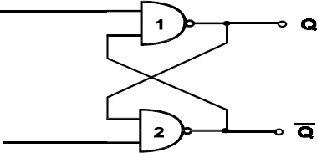
Sequential Logic
Cross Coupled Inverters:
Outputs Q & Q are always complimentary.
The circuit has two stable states, in one stable state Q=1 & Q=0 and it is called as 1 state or set state. Whereas the other Q=0 & Q=1 is called as 0 state or reset state.
If circuit is in 1 reset state, then it will continue to be in the reset state and if it is in the set state then it will continue to remain in the set state.
This property of circuit shows that it can store 1 bit of digital
information and hence known as 1 bit memory cell.
A1
A2
Fig. Cross Coupled inverters as a memory element

Slide 16
Sequential Logic
Latch:
The cross coupled inverter is capable of locking or latching the information, hence is known as a latch.
Disadvantage of this circuit is that we cannot enter the desired
digital data into it.
This disadvantage can be overcome by modifying the circuit, which allows us to enter the desired digital data into the circuit.
In latch there is no way of entering the desired digital information to be stored in it. Since when the circuit is switched ON, the circuit switches to one of the stable states. Thus additional gates are added to enter the desired digital information.
The two input terminals are designated as set (S) and reset (R) because S=1 brings the circuit in set state and R=1 brings it to reset or clear state.

Slide 17
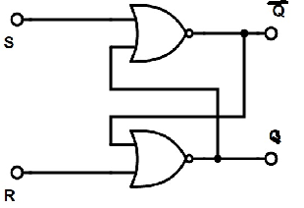
Bistable- Flip Flops made with NORs
There are two outputs, Q and Q’
Complement of each other
Output is fed back to input
S | R | Qn+1 | Qn+1'
0 | 0 | Qn Last | Qn’ State
0 | 1 | 0 Reset | 1 State
1 | 0 | 1 Set | 0 State
1 | 1 | Forbid | den
A | B | Y
0 | 0 | 1
0 | 1 | 0
1 | 0 | 0
1 | 1 | 0

Slide 18



Bistable- Flip Flops made with NANDs
While analyzing this circuit, as soon as one input is a Low or zero (either a direct input or a feedback input) a NAND has High (1) as an output.
On the other hand for NORs if an input is High (1) then the output must be a
Low (0).
S
Q
State Table
S | R | Q | Q'
0 | 1 | 1 | 0
1 | 0 | 0 | 1
0 | 0 | Forbid | Den
1 | 1 | Last | State
Q
R
S ‘sets’ Q HI when it is LO R ‘resets’ Q LO when it is HI
S = R = LO is a ‘disallowed’ state
what happens when S = R = HI?
The last state depends on the previous state, since there are two possible output states - thus sequential logic. What happens if you go from 00 to 11?

Slide 19
Sequential Logic
Operation:
Case I: S = R = 0:
Outputs of gates 3 & 4 will become 1.
Let Q=0 & Q=1 initially, hence both the inputs to gate 1 are 1 & the inputs to gate 2 are (01).
Hence gate-1 output i.e. Q=0 & gate-2 output Q=1.
Thus with S=R=0, there is no change in the state of outputs.
Old TT
S | R | Q | Q'
0 | 1 | 1 | 0
1 | 0 | 0 | 1
0 | 0 | Forbid | Den
1 | 1 | Last | State

Slide 20
Sequential Logic
Case II : S = 1, R = 0:
Since S=1 & R=0, one of the inputs to gate-1 will be 0. This will force Q output to 1.
Hence both the inputs to gate- 2 will be 1. This forces Q to 0.
Hence for S=1, R=0 the outputs are Q=1 & Q=0. This is set state.
Old TT
S | R | Q | Q'
0 | 1 | 1 | 0
1 | 0 | 0 | 1
0 | 0 | Forbid | Den
1 | 1 | Last | State

Slide 21
Sequential Logic
Case III: S = 0, R = 1:
If S=0, R=1 then one of the inputs to gate-1 will be 0. This will force
the Q output to 1.
Hence both the inputs to gate-2 will be 1. This forces Q to 0.
Thus for S=0, R=1, the outputs are Q=0, Q=1. This is the reset state
of clear state.
Old TT
S | R | Q | Q'
0 | 1 | 1 | 0
1 | 0 | 0 | 1
0 | 0 | Forbid | Den
1 | 1 | Last | State

Slide 22
Sequential Logic
Case IV: S = R = 1:
If S=R=1 then outputs of gates-3 and 4 will be zero.
Hence one of the inputs to gate-1 and 2 will be 0.
So outputs Q & Q both will try to become 1. It is not allowed as Q and Q' should be complementary. Hence S=R=1 condition is prohibited.
Old TT
S | R | Q | Q'
0 | 1 | 1 | 0
1 | 0 | 0 | 1
0 | 0 | Forbid | Den
1 | 1 | Last | State

Slide 23
Old TT
New TT
S | R | Q | Q'
0 | 1 | 1 | 0
1 | 0 | 0 | 1
0 | 0 | Forbid | Den
1 | 1 | Last | State
S | R | Q | Q'
0 | 0 | Last | State
1 | 0 | 1 | 0
0 | 1 | 0 | 1
1 | 1 | Forbid | Den

Slide 24
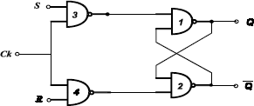
Sequential Logic
Clocked S-R Flip-Flop:
It is required to set or reset the memory cell in synchronous with a train of pulses known as clock (known as CK), & such circuit is referred to as a clocked set-reset (S-R) Flip-Flop.
If CK=1, then it performs the operation exactly the same as that of S- R Flip-Flop, and if CK=0 the gates 3 & 4 are inhibited. i.e. their outputs are 1 irrespective of the values of S or R.
The circuit responds to the inputs S & R only when the clock is present.
Ck | S | R | Q | Q'
1 | 0 | 0 | Last | State
1 | 1 | 0 | 1 | 0
1 | 0 | 1 | 0 | 1
1 | 1 | 1 | Forbid | Den
TT of NAND Gate
A | B | Y
0 | 0 | 1
0 | 1 | 1
1 | 0 | 1
1 | 1 | 0

Slide 25
Sequential Logic
Preset & Clear:
In clocked S-R Flip-Flop, when the power is switched on, the state of the circuit is uncertain. It may come to set (Q=1) of reset (Q=0) state.
In many cases the FF is to be set or reset i.e. the initial state of the FF is to be assigned. This is achieved by asynchronous inputs, referred to as preset (Pr) and Clear (Cr) inputs.
These inputs may be applied at any time between clock pulses and are not in synchronism with the clock.
If Pr=Cr=1 the Ckt operates in accordance with the T.T of S-R FF.
If Pr=0 & Cr=1, the output of G1(Q) will be 1. Thus all the 3 inputs to G2 will be 1 which make Q=0, hence Pr=0 sets the FF.
If Pr=1 & Cr=0, the FF is reset, Once the state of the FF is established asynchronously, the asynchronous inputs Pr & Cr must be connected to logic 1 before the next clock is applied.
The condition Pr=Cr=0 must not be used, since this leads to an uncertain state.
Thus in logic symbol, bubbles are used for Pr & Cr inputs, which means these are active low, i.e. the intended function is performed when the signal applied to Pr & Cr is LOW.

Slide 26
Sequential Logic
Summary of Operation of S-R Flip-Flop:
CK | Inputs Cr | Pr | Output Q | Operation Performed
1 | 1 | 1 | Qn+1 | Normal FF Operation
0 | 0 | 1 | 0 | Clear
0 | 1 | 0 | 1 | Preset
Note: The circuit can be set or reset even in the presence of the clock pulse.

Slide 27
J-K Flip-Flop
J-K FLIP-FLOP:
The uncertainty in the state of an S-R FF, when Sn=Rn=1 can be
eliminated by converting it into a J-K FF.
The data inputs are J & K which are ANDed with Q & Q respectively, to obtain S & R inputs. i.e. S=J.Q & R = K. Q
Truth Table for J-K Flip-Flop:
Inputs Output
Jn | Kn | Qn+1
0 | 0 | Qn
1 | 0 | 1
0 | 1 | 0
1 | 1 | Qn

Slide 28
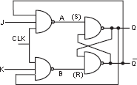
J-K Flip-Flop
Fig. S-R Flip-Flop Converted into J-K Flip-Flop

Slide 29
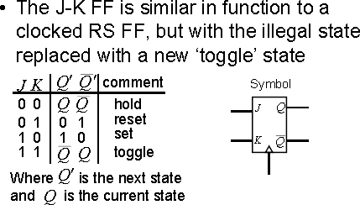
J-K Flip-Flop
Logic Symbols of J-K FF

Slide 30
Sequential Logic
Race- Around Condition:
In J-K Flip-Flop, condition for both the inputs as 1 i.e. S=R=1 is taken into consideration by using the feedback connection from outputs to the inputs of the gates.
In J-K FF, the assumption that the inputs do not change during the clock pulse (CK=1), which is not true because of the feedback connections.
For e.g. the inputs J=K=1 & Q=0 and a pulse is applied at the clock
input.
After a time interval Δt equal to the propagation delay through two NAND gates in series, the output will change to Q=1.
Now J=K=1 & Q=1 and after another time interval of Δt the output will change back to Q=0. Thus for the duration tp of clock pulse, the output will oscillate back and forth between 0 & 1, & at the end of the clock pulse, the value of Q is uncertain. This situation is called as race around condition.
It can be avoided if tp< Δt <T. The best way is to use a master-slave J-K Flip-Flop.

Slide 31
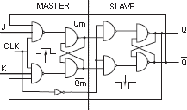
Master-Slave J-K Flip-Flop

Slide 32

Master-Slave Flip-Flop
Y
S
S
S
Q
Master
Slave
Y’
R
R
R
Q’
CP
MASTER-SLAVE FLIP-FLOP

Slide 33
Master-Slave Edge-Triggered Flip-Flop
Can connect two level-sensitive latches in Master-Slave configuration to form edge-triggered flip-flop
Master latch “catches” value of “D” at “Q_{M}” when CLK is low
Slave latch causes “Q” to change only at rising edge of CLK
Master Latch
Q_{M}
Slave Latch
D
Q
CLK CLK
2 x 8 = 16 Transistors
CLK
D Q_{M} Q

Slide 34
D-Type Flip-Flop
It has only one input referred to as D-input or data input.
The output Qn+1 at the end of the clock pulse equals the input Dn
before the clock pulse.
Input data appears at the output at the end of the clock pulse. Thus transfer of data from the input to the output is delayed and hence the name delay (D) FF.
It is either used as a delay device or as a latch to store 1 bit of binary information.
Truth Table: Input
Dn 0
1
Output Qn+1 0
1

Slide 35
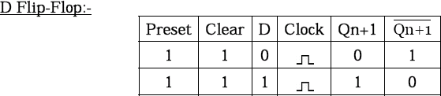
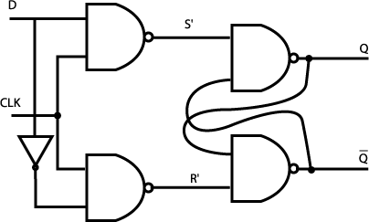
Sequential Logic

Slide 36
Sequential Logic
T- Type Flip-Flop:
In J-K FF, if J=K, the resulting FF is referred to as a T-type FF.
It has only one input, referred to as T-input.
From the truth table of T-type FF, if T=1 it acts as a toggle switch. For every clock pulse, the output Q changes.
An S-R FF cannot be converted into a T-type FF since S=R=1 is not allowed. But its logic symbol can be used as a toggle switch. i.e. the output of Q changes with every clock pulse.
Truth Table:
Input Tn
0
1
Output Qn+1
Qn
Qn

Slide 37
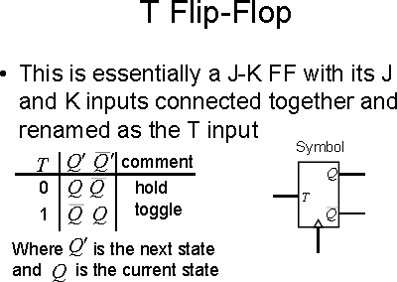
Sequential Logic

Slide 38
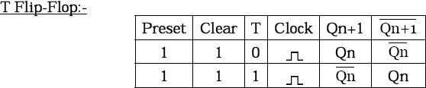
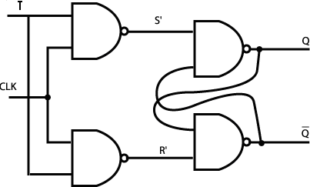
Sequential Logic

Slide 39
S | R | Q | Q'
0 | 0 | Last | State
1 | 0 | 1 | 0
0 | 1 | 0 | 1
1 | 1 | Forbid | Den
J | K | Q | Q'
0 | 0 | Last | State
1 | 0 | 1 | 0
0 | 1 | 0 | 1
1 | 1 | Toggle
D | Q | Q’
0 | 0 | 0
1 | 0 | 1
T | Q | Q’
0 | 0 | LS
1 | 0 | Toggle
T | Q_{n+1} | Q’_{n+1}
0 | 0 | Q_{n}
1 | 0 | Q_{n}’

Slide 40
If Qn = 0
Clock is applied
Desired output should not change
What input must be applied to achieve this?
Ans is
S=0, R=0 or S=0, R=1
S=0 and R can be 0 or 1 ie ‘x’ (don’t care)
S | R | Q | Q'
0 | 0 | Last | State
1 | 0 | 1 | 0
0 | 1 | 0 | 1
1 | 1 | Forbid | Den

Slide 41
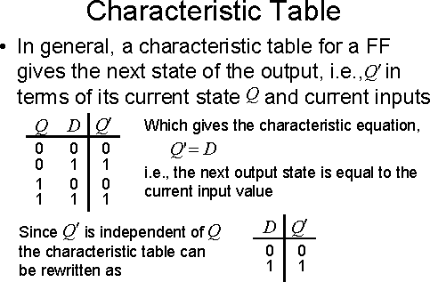
Sequential Logic

Slide 42
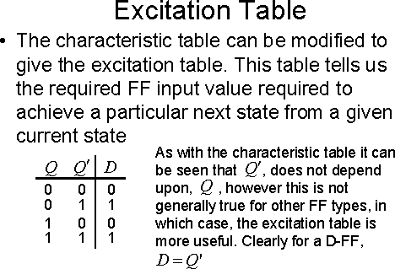
Sequential Logic

Slide 43
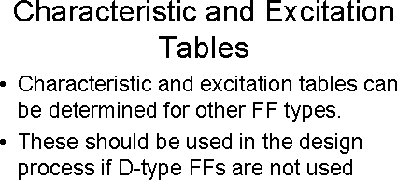
Sequential Logic

Slide 44
Sequential Logic
Excitation Table of Flip-Flop:
The truth table of a FF is referred as the characteristics table &
specifies the operational characteristics of the FF.
To design sequential circuits, it is needed that the input conditions corresponding to present state & next state is specified.
Thus we have to find the input conditions that must prevail to
cause the desired transition of the state.
Present state & Next state means circuit prior to & after the clock pulse applied.

Slide 45
Sequential Logic
Excitation Present State
Table of Fli
Next State
p-Flops:
S-R FF
Sn
T-FF
Tn
J-K FF
Jn
D-FF
Dn
Rn
Kn
0
0
0
x
0
x
0
0
0
1
1
0
1
x
1
1
1
0
0
1
x
1
1
0
1
1
x
0
x
0
0
1

Slide 46
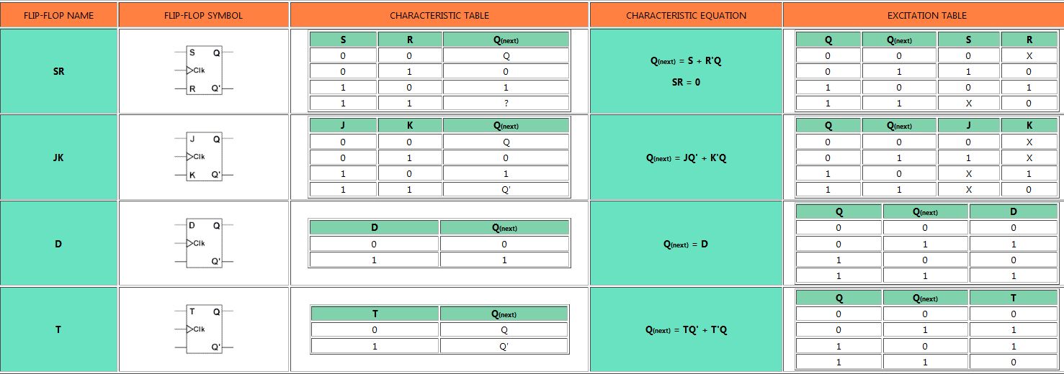
Summary of the Types of Flip-flop Behavior

Slide 47
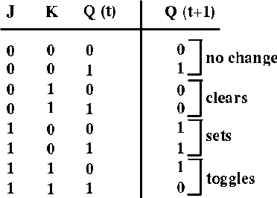
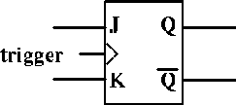
Sequential Logic

Slide 48
Sequential Logic
In general model for conversion from one type of FF to another type, we design the combinational logic decoder (conversion logic) for converting new input definitions into input codes which will cause the given FF to perform as desired.
To design the conversion logic we need to combine the excitation tables for both FF’s & make a truth table with data inputs & Q as the inputs and the inputs of the given FF as the outputs.
FLIP-FLOP
Conversion logic
Given
FLIP-FLOP
Fig. General Model used to convert one type of Flip-Flop to another type

Slide 49
Sequential Logic
Converting One Type of FF to another:
S-R FF to J-K FF:
Steps for Conversion:
Prepare the excitation table
Prepare K-Maps & derive minimized expression.
Draw the logic diagram
Data Inputs Outputs Inputs to S-R FF
Output
Jn | Kn | Qn | Qn | Sn | Rn
0 | 0 | 0 | 1 | 0 | 0 | 0 | Qn
0 | 0 | 1 | 0 | 0 | 0 | 1
1 | 0 | 0 | 1 | 1 | 0 | 1 | 1
1 | 0 | 1 | 0 | 0 | 0 | 1
0 | 1 | 0 | 1 | 0 | 0 | 0 | 0
0 | 1 | 1 | 0 | 0 | 1 | 0
1 | 1 | 0 | 1 | 1 | 0 | 1 | Qn
1 | 1 | 1 | 0 | 0 | 1 | 0

Slide 50
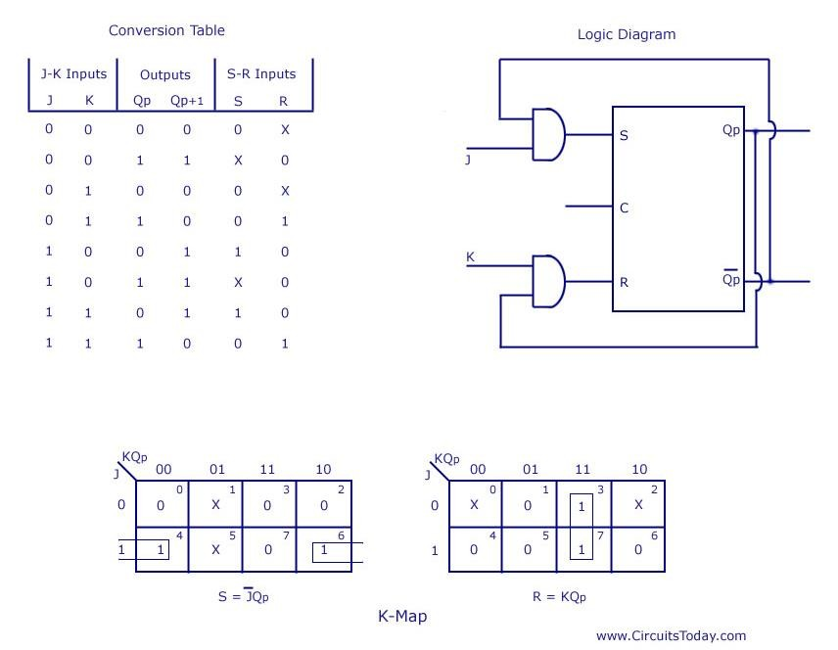
Flip-Flop Conversion
S-R To J-K Flip-Flop

Slide 51
Clock Pulse Definition
Positive Pulse
Negative Pulse
Positive Negative
Edge Edge
Negative Edge
Positive
Edge
Edges can also be referred to as leading and trailing.

Slide 52
Sequential Logic
Flip-Flops
Flip-flops are the fundamental element of sequential circuits
  bistable
  (gates are the fundamental element for combinational circuits)
Flip-flops are essentially 1-bit storage devices
  outputs can be set to store either 0 or 1 depending on the inputs
  even when the inputs are de-asserted, the outputs retain their prescribed value
Flip-flops have (normally) 2 complimentary outputs Q & Q.
Three main types of flip-flop
  R-S J-K D-type

Slide 53
Flip-flop
Flip-flop is also known as the basic digital memory circuit.
It has two stable states, memory logic 1 state & logic 0 state.
We can design it, by using either NOR or NAND gates.
A flip-flop can be designed by using the fundamental circuit which is also called as cross coupled inverter circuit, as the NAND gates in this circuit basically act as inverter.
The cross coupled inverter is capable of clocking or batching the information, & hence this circuit is also called as latch.
The disadvantage of the circuit is that we can’t enter the disturbed digital
signal as data into it.
Latch is a distable element with two stable states.
It has two outputs, Q & Q which are complement of each other.
Latch is a sequential logic circuit which checks all its inputs continuously & will change its output as soon as the input changes without waiting for the clock signal.
Generally an enable signal is provided for a latch when the enable signal is active the output will change as soon as there is a change in input.
S-R (Set-Reset) latch is the simplest type of latch.

Slide 54
Flip-flop
Difference between a latch & a Flip-flop.
Latch & Flip-flop both are basically the bistable elements.
Latch is a dual triggered flip-flop but flip-flop is a sequential circuit which generally samples inputs & changes its outputs only at particular instants of times & not continuously.
Five types of flip-flops are as follows: S-R Flip-flop, J-K Flip-flop, Master Slave J-K Flip-flop, T- Flip-flop, D- Flip- flop
In S-R flip-flop output is uncertain and is not according to assumption when both S & R are equal to 1.
When initial conditions of flip-flops is to be set then we use the preset.
Disadvantages of output being indeterminate for S-R flip-flop is overcome using J-K flip-flop.
In JK ff, for Δt time period which is the propagation delay time of flip-flop, the output fluctuates between 0 and 1 & therefore is not certain. Fluctuation of output reduces life time of IC.
In computer memory master slave principle is used to drive is slave while the other is master.
D- Flip-flop can be used as delay or latch element in the circuit to delay the
output.
T- Flip-flop is used for toggling input. In this case output is always the complement of input.

Slide 55
Sequential Logic
Application of Flip-Flop:
Bounce Elimination Switch
Latch
Registers
Counters
Memory Elements
Bounce Elimination Switch: (Fig 7.23 on Pg.256 R. P. Jain)
In sequential circuit, if a 1 is to be entered through switch, then the
switch is thrown to the corresponding position.
But when the switch is thrown to position 1, the output oscillates between 0 & 1 for some time due to make & break (bouncing) of the switch at the point of contact before coming to rest.
This changes the output of the circuit and creates difficulties in the operation of the system. This problem is eliminated by using bounce-elimination switch.

Slide 56
Sequential Logic
Registers:
It is composed of a group of FF’s to store a group of bits (word).
FF can store 1-bit of digital information & also called as 1-bit register.
The number of FF required is equal to the number of bits in binary
word.
E.g. 8085 have seven 8-bit registers called as general purpose register & five 1-bit register called as flags.
The data can be entered in serial (one bit at a time) or in parallel form (all the bits simultaneously) and can be retrieved in the serial or parallel form.
Data in serial form is also called as temporal code & in parallel form as spacial code.
For serial input/output it requires only one line for data input & one line
for data ouput.
Whereas for parallel input/output it requires lines equal to the number of bits.

Slide 57
Sequential Logic
Registers:
Registers are classified depending upon entered & retrieved.
There are four possible modes of operation:
Serial-In, Serial-Out (SISO)
Serial-In, Parallel-Out (SIPO)
Parallel-In, Serial-Out (PISO)
Parallel-In, Parallel-Out (PIPO)
the way in which data are
Counters:
A circuit used for counting the pulses is known as a counter.
Most widely used sequential circuits are registers & counters.
Counters are composed of Flip-Flops.
E.g. A circuit with n FF’s has 2^{n} possible states. Therefore a 3-bit counter can count from decimal 0 to 7.
Flip-Flop’s are cleared by applying logic 0 at the clear input terminal
momentarily.
For normal counting operation, it is maintained at logic 1.

Slide 58
Basic shift register functions
A register is a digital circuit with basic functions:
  Data storage and Data movement
The storage capacity of a register is the total number of bits it can retain.
Shift registers consists of an arrangement of flips-flops.
Each stage (flip-flop) in a shift register represents one bit of storage
capacity.
The shifting capacity permits the movement of data from stage to stage within the register or into or out of the register upon application of clock pulses.
The basic difference between a register and a counter is that a register has no specified sequence of states, except in certain very specialized applications.
A register is used solely for storing and shifting data.

Slide 59
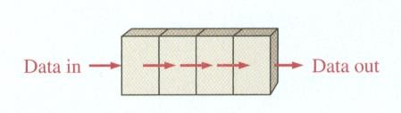

Serial in/serial out shift registers
It accepts data serially, one bit at a time on a single line, and produces the sorted information on its output also in a serial form

Slide 60
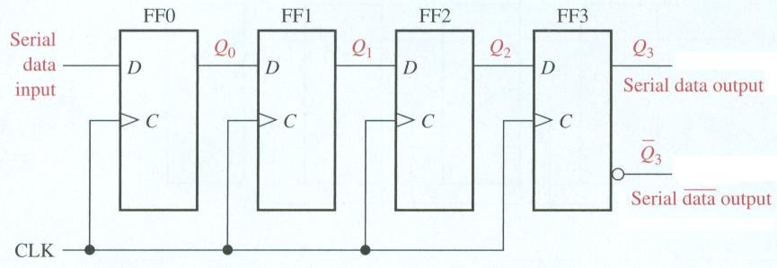

Serial in/serial out shift registers
4 bit register
It needs 4 clock pulses to store 4 bits
Example:
  Illustrate entry of the 4 bits 1010 into the register.
  Illustrate serially shifting the 4 bits out of the register, i.e. clearing the register.

Slide 61
SISO Shift Register
Ck | D | Q
1 | 0 | 0
1 | 0 | 1
Ck | Q2 | Q1 | Q0
0 | 0 | 0 | 0
1
1
1
1
1

Slide 62
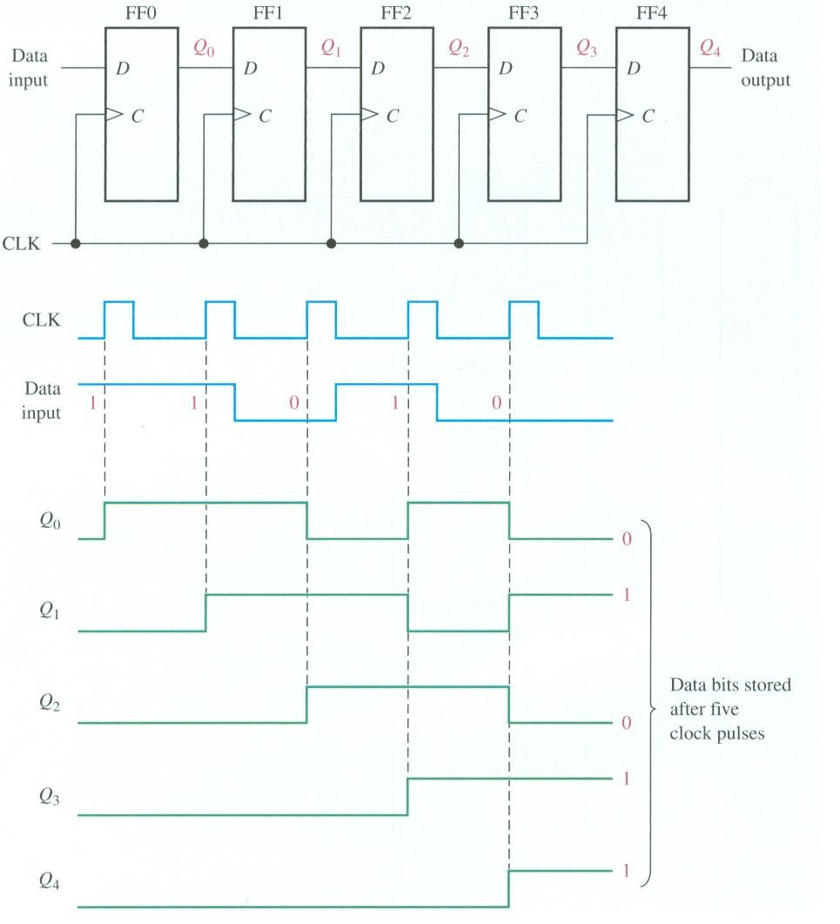

Example: Show the states of the 5-bit shift register for the specified data input and clock waveforms. The register is initially cleared.

Slide 63
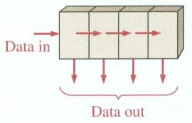

Serial in/parallel out shift registers
Data bits are entered serially as illustrated before
Once the data are stored, the output of each stage is available on its output line.

Slide 64
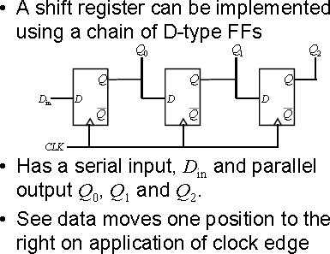
Shift Register

Slide 65
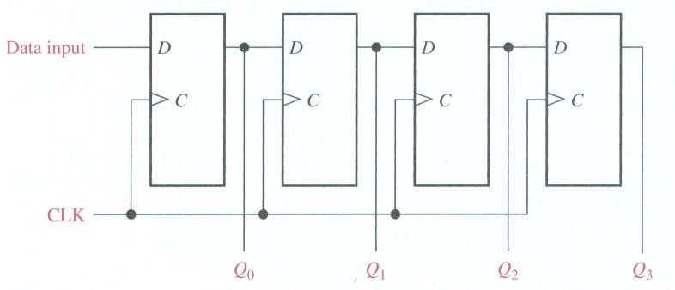

Serial in/parallel out shift registers
4-bit register

Slide 66
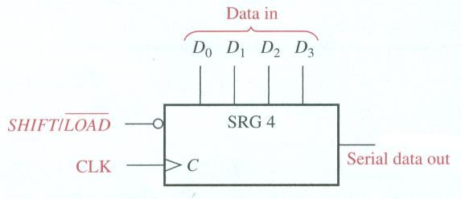

Parallel In/Serial Out Shift
Registers
The bits are entered simultaneously into their respective stages.
The serial output appears bit by bit per clock pulse.
To store 4 bits, we need 1 clock pulse
To shift them out them, we need another 3 clock pulses.
4-bit parallel in/serial out

Slide 67
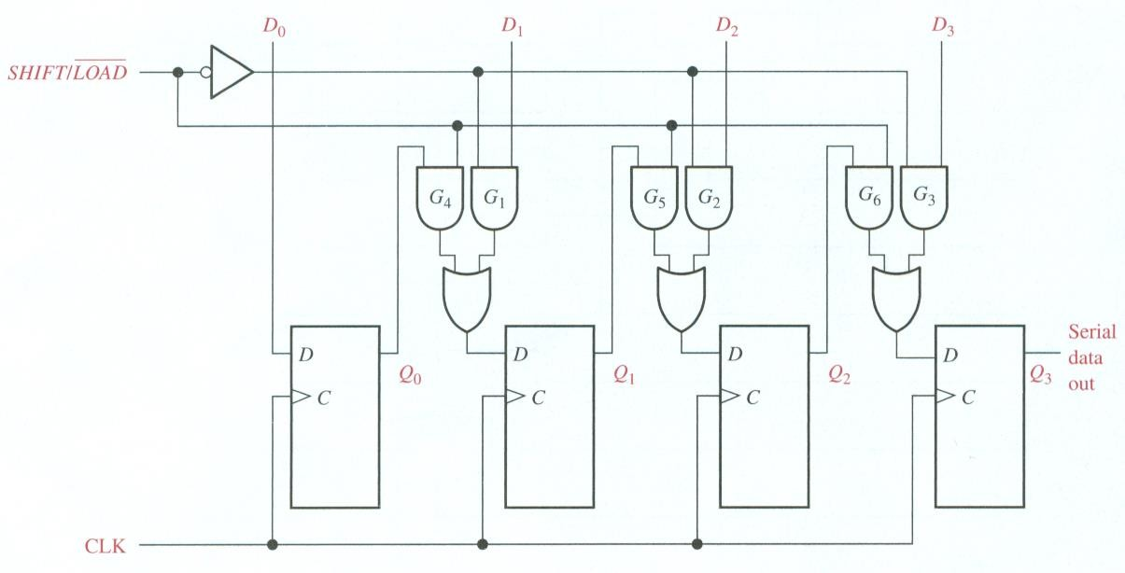

Parallel In/Serial Out Shift Registers
4-bit parallel in/serial out

Slide 68
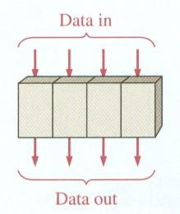

Parallel In/Parallel Out Shift Registers
The bits are entered simultaneously into their respective
stages.
Immediately, the bits appear on the parallel outputs.
4-bit version

Slide 69
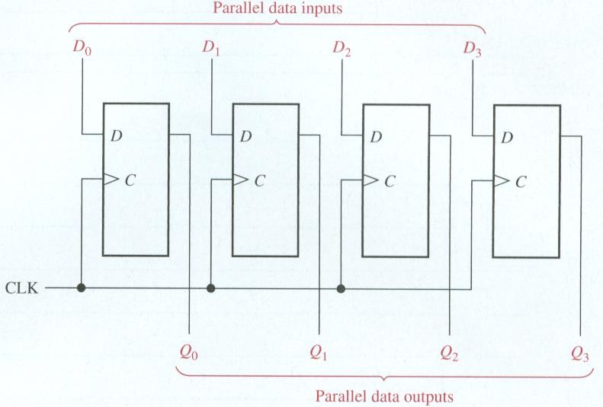

Parallel In/Parallel Out Shift Registers
4-bit version

Slide 70
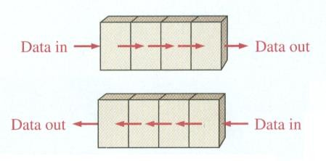

Bidirectional Shift Register
A bidirectional shift register is one in which the data can be shifted either left or right.
4-bit version

Slide 71
Sequential Logic
Applications of Shift Registers:
1. Time Delays:
The time delay can be adjusted by controlling the number of stages
in the register.
By using serial-in & parallel-out registers and by taking the serial output at any one of the intermediate stages, we can delay output by any number of clock pulses.
2. Serial/Parallel Data Conversion:
Data can be available in serial/parallel form.
The transfer of data in parallel is much faster than serial form.
Shift registers are used for converting serial data to parallel form, so
that a serial input can be processed by a parallel system.
A serial-in, serial-out, shift register can be used to perform serial to parallel conversion & a parallel in serial out, shift register can perform parallel-to-serial conversion.

Slide 72
Sequential Logic
3. Ring Counters:
Ring counters are constructed by modifying the serial-in, serial- out, shift registers. There are two types of ring counters- basic ring counter & johnson counter.
The basic ring counter can be obtained from a serial-in, serial-out, shift register by connecting Q output of the last FF to D input of first FF.
The ring counter is the decimal counter. It is divide-by-N counter, where N is the number of stages. The keyboard encoder is an application of a ring counter.
4. UART (Universal Asynchronous Receiver Transmitter):
Computers & microprocessor-based systems often send & receive data in a parallel format.
They frequently communicate with external devices that send
and/or receive serial data.
An interfacing device used to accomplish these conversions is the UART.

Slide 73
A Review
Sequential Logic

Slide 74
Basic RS Flip-Flop (NAND)
1
0
S (set)
S R Q Q’
1
Q
1 | 0 | 0 | 1
1 | 1 | 0 | 1 (after S = 1, R = 0)
0 1 1 1 0 0 |  | 1 0 1 0 (after S = 0, R = 1) 1 1
1
0
R (reset)
2
Q’
’
(a) Logic diagram
(b) Truth table
A flip-flop holds 1 "bit". "Bit" ::= "binary digit."

Slide 75
RS-Latch as Cross-Coupled NOR Gates
R
Q
If R = 1, Q resets to 0
If S = 1, Q sets to 1
If RS = 00, no change
RS = 11 is not allowed because leads to oscillation
S
Q
S R | Q
0 0 | No change
0 1 | 0
1 0 | 1
1 1 | Undefined

Slide 76
Level-Sensitive RS-Latch
“Q” only changes when CLK is high (i.e. level-sensitive)
When CLK is high, behavior same as RS latch
S
Q
CLK
Q
R
CLK | S | R | Q
0 | X | X | No change
1 | 0 | 0 | No change
1 | 0 | 1 | 0
1 | 1 | 0 | 1
1 | 1 | 1 | Undefined

Slide 77
Level-Sensitive D-Latch
D
Q
CLK
Q 18 Transistors
Make level-sensitive D-latch from level- sensitive RS-latch by connecting S = D and R = not D

Slide 78


Master-Slave Edge-Triggered Flip-Flop
Master-Slave configuration
MASTER SLAVE
D
Q
CLK
CLK
36 Transistors

Slide 79
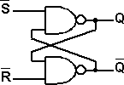
R-S Flip Flop
Logic Symbol
Wiring Diagram
Also called: R-S Latch Set-Reset FF
al
ut
Set
S Q FF R Q | Norm
 | Outp Comp
Input
Reset
lementary
Truth Table
Waveform Diagram
Set | Reset | Hold | Set | Hold
Mode of Operatio n | Input S | Input R | Output Q | Output Q | Effect
Prohibited | 0 | 0 | 1 | 1 | Prohibited Do not use
Set | 0 | 1 | 1 | 0 | For setting Q to 1
Reset | 1 | 0 | 0 | 1 | Resetting Q to 0
Hold | 1 | 1 | Q | Q | Depends Previous State
1
0
Input S
R
1
0
Q
Output _{Q}
1
0
1
0

Slide 80
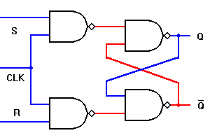
Clocked R-S Flip Flop
Logic Symbol Wiring Diagram
Output FF operates Synchronously
in step with clock.
Input
Set
Clock
Output
al
_{S} FF _{Q} CLK R Q | Norm
 | Comp
Reset
lementary
Truth Table
Waveform Diagram
Mode of Operati on | Input CLK |  | Input S | Input R | Output Q | Output Q | Effect
Hold |  |  | 0 | 0 | 1 | 1 | No Change
Reset |  |  | 0 | 1 | 0 | 1 | Reset or cleared to 0
Set |  |  | 1 | 0 | 1 | 0 | Set to 1
Prohibite d |  |  | 1 | 1 | 1 | 1 | Do not use
CLK
Input
S
1
0
R
1
0
Q
Output _{Q}
1
0
1
0

Slide 81
Questions
Q. What type of waveform is used in flip flops?
A. Square Waves.
Q. What does the RS stand for in the RS Flip Flop?
A. Reset Set.

Slide 82
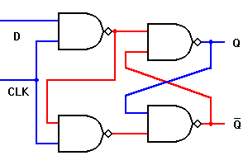
D Flip Flop
Logic Symbol
Also called:
Wiring Diagram
Delay FF
Data FF
D-type Latches ‘Delayed 1
al
ut
Data | D Q FF CLK Q | Norm
nput lock |  | Outp Comp
I
Clock Pulse’
C
lementary
Truth Table
Similar Wiring
Input CLK | Input D | Output _{Q}n+1 | Output Q
 | 0 | 0 | 1
 | 1 | 1 | 0
_{S} FF CLK
D Q
FF
CLK Q
Q
=
R
Q

Slide 83
7474 D Flip Flop
Logic Symbol
Preset
Note: The asynchronous inputs (PS & CLR) Override the synchronous inputs (D & CLK) .
al
ut
lementary
Data | _{D} PS _{Q} | Norm
put | FF | Outp
lock | CLK Q | Comp
 | CLR
I
C
Clear
Truth Table
Mode of Operation | INPUTS |  |  |  | OUTPUTS
 | Asynchronous |  | Synchronous
 | PS | CLR | CLK | D | Q | Q
Asynchronous Set | 0 | 1 | X | X | 1 | 0
Asynchronous Reset | 1 | 0 | X | X | 0 | 1
Prohibited | 0 | 0 | X | X | 1 | 1
Set | 1 | 1 | L to H | 1 | 1 | 0
Reset | 1 | 1 | L to H | 0 | 0 | 1

Slide 84
D (Delay) Flip Flop Uses
Sequential logic devices used in temporary memory devices.
Wired together to form shift registers and storage registers.
Delays data from reaching output Q one clock pulse.

Slide 85
J-K Flip Flop
Logic Symbol
Input
Output
Data | FF _{Q} CLK Q | Norm
Clock |  | Com
Data
al
plementary
Truth Table
Mode of Operatio n | INPUTS |  |  |  |  |  |  | OUTPUTS |  | Effect
 | Input CLK |  |  |  |  | Input J | Input K | Output Q | Output Q
Hold |  |  |  |  |  | 0 | 0 | No Change | No Change | No Change
Reset |  |  |  |  |  | 0 | 1 | 0 | 1 | Reset or cleared to 0
Set |  |  |  |  |  | 1 | 0 | 1 | 0 | Set to 1
Toggle |  |  |  |  |  | 1 | 1 | Toggle | Toggle | Changed to Opposite State

Slide 86
7476 J-K Flip Flop
Logic Symbol
Preset
Note: 7476 uses the entire pulse to transfer data from J & K data inputs
Input Output
Data | _{J} FF _{Q} CLK ^{K} CLR ^{Q} | Norm
lock |  | Comp
Data
al
C
to Q & Q outputs.
lementary
Clear
Truth Table
Mode of Operation | INPUTS |  |  |  |  | OUTPUTS
 | Asynchronous |  | Synchronous
 | PS | CLR | CLK | J | K | Q | Q
Asynchronous Set | 0 | 1 | X | X | X | 1 | 0
Asynchronous Reset | 1 | 0 | X | X | X | 0 | 1
Prohibited | 0 | 0 | X | X | X | 1 | 1
Hold | 1 | 1 |  | 0 | 0 | No Change | No Change
Reset | 1 | 1 |  | 0 | 1 | 0 | 1
Set | 1 | 1 |  | 1 | 0 | 1 | 0
Toggle | 1 | 1 |  | 1 | 1 | Opposite State

Slide 87
J-K Flip Flop Uses
Universal Flip Flop. Has all features of other FF.
When being used only in the toggle mode, commonly called a T Flip Flop.
Most commonly used as counters.

Slide 88

JK Flip-Flop from D-Latch
Same as RS-Latch except “toggle” on 11
J
D
Latch
Q
K
Q
CLK
J Q
JK-FF
K
CLK | J | K | Q
0 | X | X | No change
1 | 0 | 0 | No change
1 | 0 | 1 | 0
1 | 1 | 0 | 1
1 | 1 | 1 | Toggle
CLK

Slide 89
Toggle Flip-Flop from D-Latch
Toggles stored value if T = 1 when CLK is high
D
Latch
Q
T
CLK
T
Q
CLK | T | Q
0 | X | No change
1 | 0 | No change
1 | 1 | Toggle
T-FF
CLK

Slide 90
End of Unit-3

