Slide 1
Unit VI Graphs (06 Hrs)
Graph: Basic Concepts & terminology.
Representation of graphs: Adjacency matrix, Adjacency list.
Operations on graph: Traversing a graph.
Spanning trees: Minimum Spanning tree- Kruskal’s Algorithm, Prim’s Algorithm and Dijkstra’s Shortest Path Algorithm.
1

Slide 2
Data Structures: CO-PO Mapping
 | Course Outcome |  | Blooms Taxonomy Level |  | After successful completion of the course students will be able to |  | Mapping with Syllabus Unit | PO MAPPING
 | CO204184.6 |  | 4 |  | Apply the knowledge of graph for solving the problems of spanning tree and shortest path algorithm. |  | 6 | 1, 2, 3, 4, 5, 9, 12
MAPPING |  | LEVEL |  | JUSTIFICATION |  | Program Outcomes (POs) Engineering knowledge Problem analysis Design/development of solutions Conduct investigations of complex problems Modern tool usage The engineer and society Environment and sustainability Ethics Individual and team work Communication Project management and finance Life-long learning
CO6 –PO1 |  |  |  | Every Program is based on knowledge of
 |  | 2 |  | mathematics, science and engineering
 |  |  |  | fundamentals
CO6 –PO2 |  |  |  | Design and debug the program using proper
 |  | 2 |  | selection of data types and control structure to be carried out to obtain the specified solution with
 |  |  |  | appropriate considerations.
CO6 –PO3 |  |  |  | Selection of proper data structure is done based on
 |  | 3 |  | given problem statement for formulating and
 |  |  |  | analysing CEP.
CO6–PO4 |  |  |  | Selection of proper data structures and algorithm is
 |  | 2 |  | done based on given problem statement for formulating and analysing CEP.
Unit VI Graphs (06 Hrs)
Graph: Basic Concepts & terminology.
Representation of graphs: Adjacency matrix, Adjacency list.
Operations on graph: Traversing a graph. Spanning trees: Minimum Spanning tree- Kruskal’s Algorithm, Prim’s Algorithm and Dijkstra’s Shortest Path Algorithm.
2

Slide 3
Data Structures: Books
TEXT BOOKS
T1: Ellis Horowitz, Sartaj Sahni, “Fundamentals of Data Structures”, Galgotia Books Source. T2: Richard. F. Gilberg, Behrouz A. Forouzan, “Data Structures: A Pseudocode Approach with C,” Cengage Learning, second edition.
REFERENCE BOOKS
R1: Seymour Lipschutz, “Data Structure with C, Schaum’s Outlines”, Tata McGrawHill. R2: E Balgurusamy, “Programming in ANSI C”, Tata McGraw-Hill, Third Edition. R3: Yedidyah Langsam, Moshe J Augenstein, Aaron M Tenenbaum “Data structures using C and C++” PHI Publications, 2nd Edition. R4: Reema Thareja, “Data Structures using C”, Second Edition, Oxford University Press, 2014
ADDITIONAL MATERIAL
MOOC / NPTEL: NPTEL Course “Programming & Data Structure” https://nptel.ac.in/courses/106/105/106105085/ NPTEL Course “Data Structure & Algorithms” https://nptel.ac.in/courses/106/102/106102064/
3

Slide 4
Data Structures: Topic – Book – Pages Mapping
Sr. No. | Topic | Reference / text book with page no.
UNIT VI: Graphs
6.1 | Basic Concepts & terminology Sequential representation of graphs : Adjacency matrix, Linked representation of a graph Operations on graph Traversing a graph | T2(481-490), R1(8.1-8.7,8.17-8.24)
6.2 | Spanning trees; Minimum Spanning tree Kruskal’s Algorithm Prim’s Algorithm Dijkstra's Shortest Path Algorithm | R1(8.47-8.59)-Old Edition
4

Slide 5
Data Structures: Unit 6
Contents
Basic concepts & Terminology
Adjacency matrix, Adjacency lists
Operations on graph, Traversing a graph
Spanning of tree, Minimum Spanning tree
Kruskal’s and Prim’s Algorithm
Dijkstra’s Shortest Path Algorithm
5

Slide 6
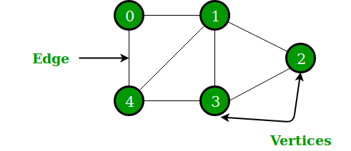

Basic concept
A Graph is a non-linear data structure consisting of nodes and edges.
G = (V, E)
Where V = a set of vertices and E = a set of edges
A Graph consists of a finite set of vertices(or nodes) and set of Edges which connect a pair of node
s.
6

Slide 7
Terminology
Vertex − Each node of the graph is represented as a vertex.
Edge − Edge represents a path between two vertices
Adjacency − Two node or vertices are adjacent if they are connected to each
other through an edge.
Path − Path represents a sequence of edges between the two vertices.
Degree of a Node is the number of edges the node is used to define Can also define in-degree and out-degree
In-degree: Number of edges pointing to a node
Out-degree: Number of edges pointing from a node
7

Slide 8
Terminology
Cycle: a path that starts and ends on the same vertex
Simple path: a path that does not cross itself
Length of a path: Number of edges in the path
An undirected graph is connected if every pair of vertices has a path between it
A directed graph is strongly connected if every pair of vertices has a path between them, in both directions
8

Slide 9
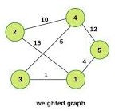
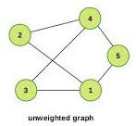
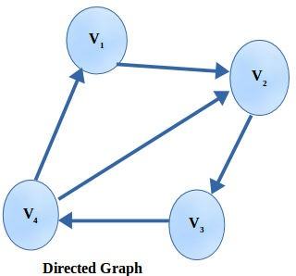
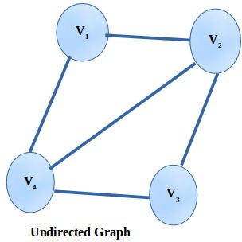
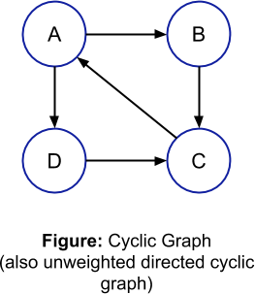
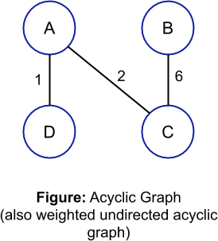
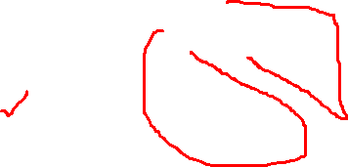
Types of Graphs:
Weighted or unweighted :
Directed or undirected
Cyclic or acyclic
9

Slide 10
Types of Graphs
Weighted graph: edges have a weight
Weight typically shows cost of traversing
Unweighted graph: edges have no weight
Edges simply show connections
Undirected Graphs: each edge can be traversed in either direction
Directed Graphs: each edge can be traversed only in a specified direction
A Cyclic graph contains cycles
An acyclic graph contains no cycles
10

Slide 11
Applications of graphs
To represent networks. The networks may include paths in a city or telephone network or circuit network.
In social networks like linkedIn, Facebook. For example, in Facebook, each person is represented with a vertex(or node). Each node is a structure and contains information like person id, name, gender, etc.
Electrical Engineering − extensively used in designing circuit connections.
Computer Network − The relationships among interconnected computers in the network
follows the principles of graph theory.
Science − The molecular structure and chemical structure of a substance, the DNA structure of
an organism, etc., are represented by graphs.
Linguistics − The parsing tree of a language and grammar of a language uses graphs.
11

Slide 12
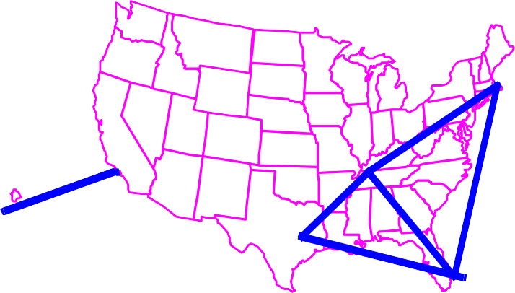
Applications of graphs
Electronic circuits
CS16
Networks (roads, flights, communications)
JFK
LLAAXX
STL DFW
HNL
FTL
12

Slide 13
Representation of Graph in Computer
Adjacency Matrix
Adjacency List

Slide 14
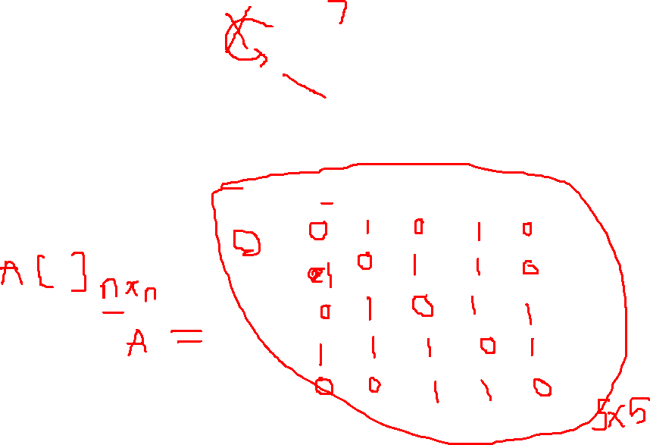
Adjacency Matrix
2
3
1
It is a matrix A[n][n]
Where n is no of vertices
A[i][j] = 1 if i and j are adjacent
= 0 otherwise
4
5
1
2
3
4
5
1
2
3
4
5

Slide 15
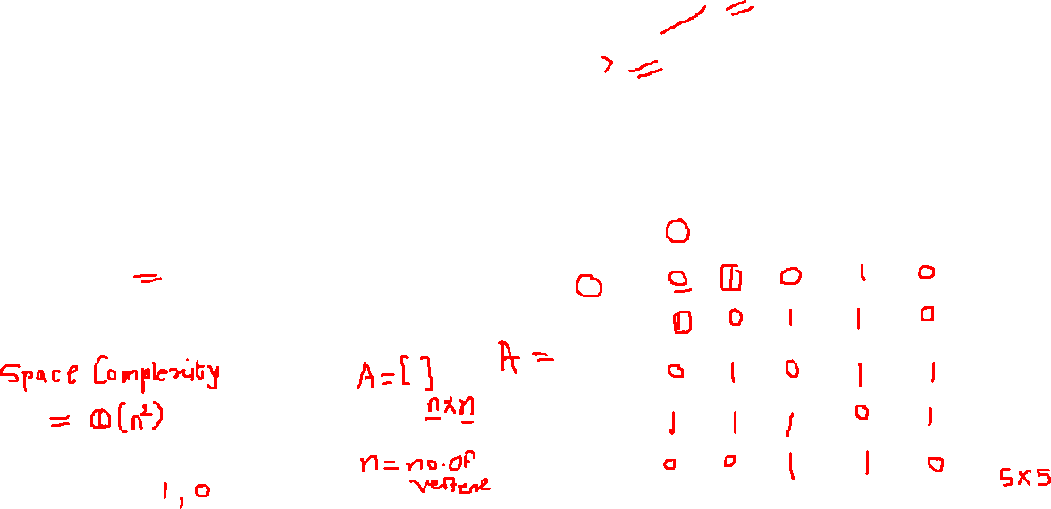
Adjacency Matrix
2
3
1
It is a matrix A[n][n]
Where n is no of vertices
A[i][j] = 1 if i and j are adjacent
= 0 otherwise
4
5
1
2
3
4
5
1
2
3
4
5

Slide 16

Adjacency Matrix
2
3
1
It is a matrix A[n][n]
Where n is no of vertices
A[i][j] = 1 if i and j are adjacent
= 0 otherwise
4
5
1
2
3
4
5
1
2
3
4
5

Slide 17
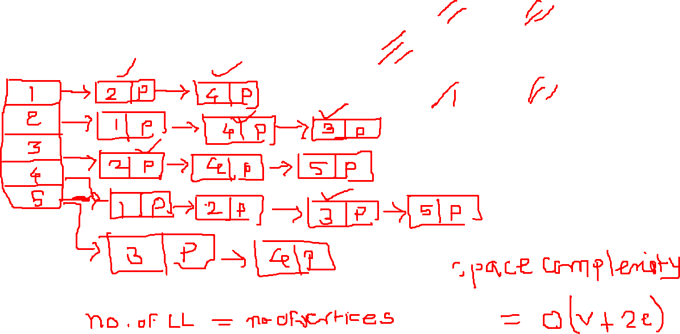
Adjacency List
2
3
1
4
5

Slide 18
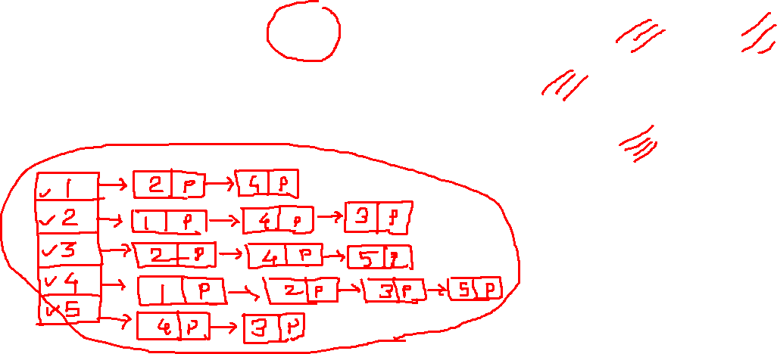
Adjacency List
2
3
1
4
5

Slide 19
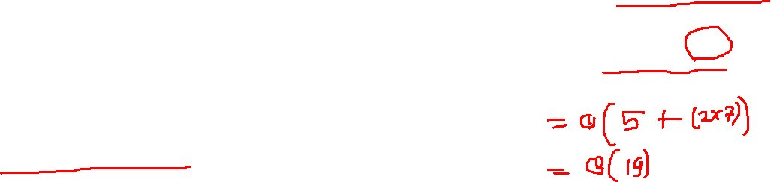
Adjacency List
2
3
1
4
5

Slide 20

Adjacency Matrix
0
0
1
2
1
3
⎡0 1 1 1 ⎤
⎢ 0 1 ⎥
⎢1 1 0 1 ⎥
⎢ ⎥
⎣1 1 1 0⎦
2
⎢₁
₁ ⎥
⎡0
⎢
1 0⎤
₀ ⎥
0
⎢1
⎢⎣0
1 ⎥
0⎥⎦
20

Slide 21
Adjacency Lists
0
1
2
3
1
2
3
0
0
2
3
1
2
0
1
3
0
1
2
3
21

Slide 22
Operations on Graphs:
Add/Remove Vertex :
Add/Remove Edge
Traverse a graph
Insertion and deletion of nodes and edges in a graph is implemented by using adjacency matrix or adjacency list
22

Slide 23
Traversing a graph
Visit the vertices of a graph in some specific order based on the graph's topology
Graph traversal algorithms typically begin with a start vertex and attempt to visit the remaining vertices from there.
Graph traversals must deal with a number of troublesome cases.
It might not be possible to reach all vertices from the start vertex. This occurs when the graph is not connected.
The graph might contain cycles, and we must make sure that cycles do not cause the algorithm to go into an infinite loop.
23

Slide 24
Traversal Methods
Breadth First Search(BFS)
Depth First Search(DFS)
24

Slide 25
Data Structures: CO-PO Mapping
Course Outcome | Blooms Taxonomy Level | After successful completion of the course students will be able to | Mapping with Syllabus Unit | PO MAPPING
CO204184.6 | 4 | Apply the knowledge of graph for solving the problems of spanning tree and shortest path algorithm. | 6 | 1, 2, 3, 4, 5, 9, 12
MAPPING | LEVEL | JUSTIFICATION
CO6 –PO5 | 3 | Modern tools like turbo C, Codeblocks, GCC are used for development of programs.
CO6 –PO9 | 2 | Development of algorithm using proper data structures may be divided into team and after the completion of entire code it could be integrated for the required final output.
CO6 –PO12 | 1 | Integration and implementation of modular programs using proper algorithm and data structures will be useful throughout the life.
Program Outcomes (POs)
Engineering knowledge
Problem analysis
Design/development of solutions
Conduct investigations of complex problems
Modern tool usage
The engineer and society
Environment and sustainability
Ethics
Individual and team work
Communication
Project management and finance
Life-long learning
Unit VI Graphs (06 Hrs)
Graph: Basic Concepts & terminology.
Representation of graphs: Adjacency matrix, Adjacency list.
Operations on graph: Traversing a graph. Spanning trees: Minimum Spanning tree- Kruskal’s Algorithm, Prim’s Algorithm and Dijkstra’s Shortest Path Algorithm.
25

Slide 26
0
1
5
3
2
4
6

Slide 27
Breadth First Search
0
1
Take any node as root node for traversing
If it is not given, take first node as root node
Queue Data Structure used in BFS:- FIFO
For Root
Steps:- 1) Enqueue root node value in the queue
2) Dequeue the element and display in the result
3) Find out and add unvisited adjacent vertices of root node
5
3
2
4
6

Slide 28
Breadth First Search
0
1
For Remaining Vertex Element
Steps:- 1) Dequeue the first element from queue
2) Find out and add unvisited adjacent vertices
of dequeue element
3)display that element in the result
5
3
2
4
6

Slide 29
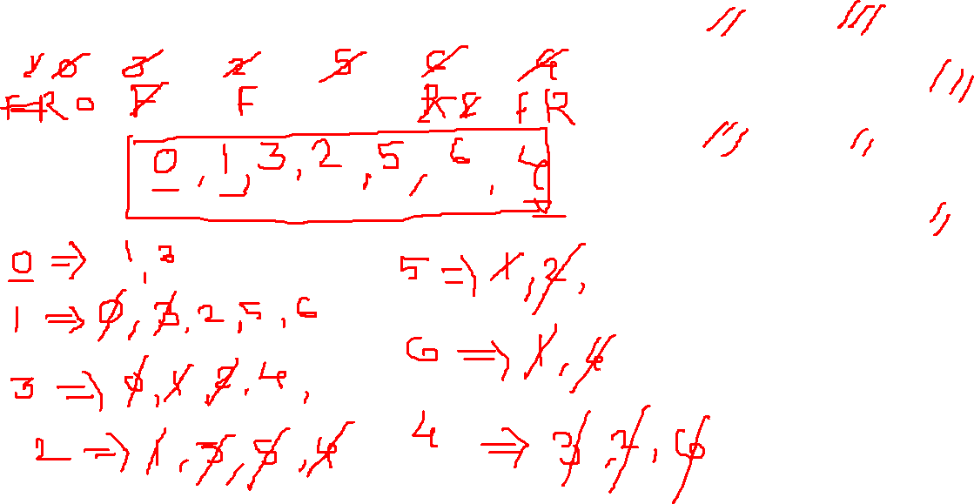
Breadth First Search
0
1
5
3
2
Result :-
4
6

Slide 30
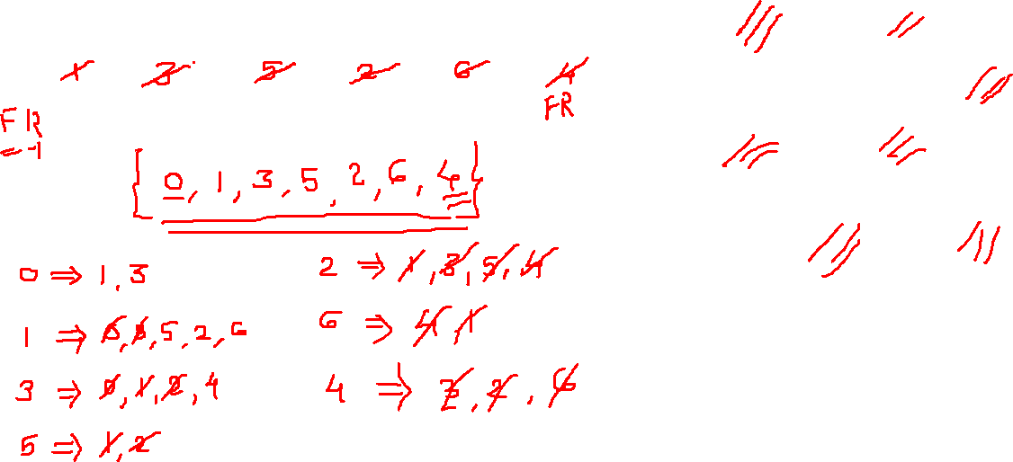
Breadth First Search
0
1
5
3
2
Result :-
4
6

Slide 31
Breadth First Search
0
1
5
3
2
Result :-
4
6

Slide 32

Depth First Search
0
1
Take any node as root node for traversing
If it is not given, take first node as root node
Stack Data Structure used in DFS:- LIFO
Steps:- 1) Push root node value in stack
2) Visit and add only one adjacent vertex near from root
5
3
2
4
6

Slide 33
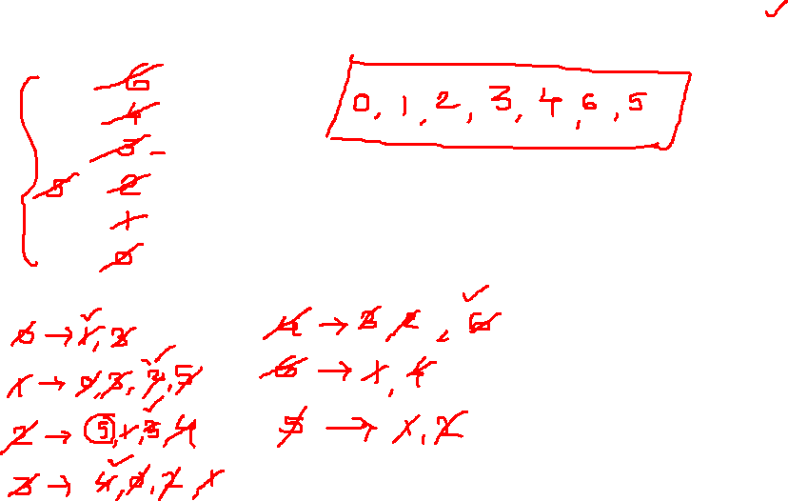
Depth First Search
0
1
5
Result :-
3
2
4
6

Slide 34
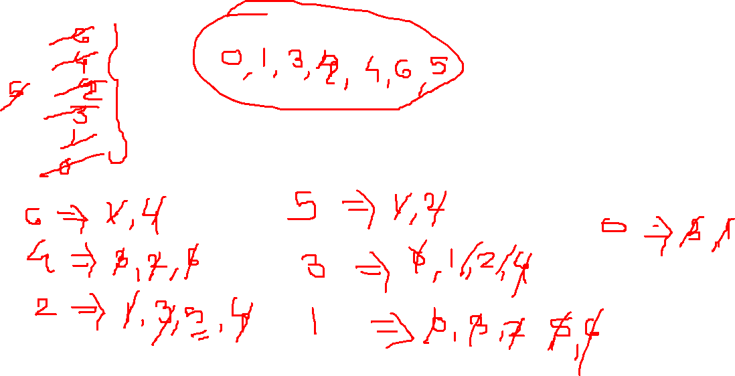
Depth First Search
0
1
5
Result :-
3
2
4
6

Slide 35
Depth First Search
0
1
5
Result :-
3
2
4
6

Slide 36
Depth First Search
0
1
5
Result :-
3
2
4
6

Slide 37

BFS Algorithm Complexity
The time complexity of the BFS algorithm is O(V + E), where V is the number of nodes and E is the number of edges.
The space complexity of the algorithm is O(V).

Slide 38
BFS Algorithm Applications
For GPS navigation
Path finding algorithms
In Ford-Fulkerson algorithm to find maximum flow in a network
Cycle detection in an undirected graph
In minimum spanning tree

Slide 39
Properties of DFS
Property 1 : DFS(G, v) visits all the vertices and edges in the connected component of v
Property 2 : The discovery edges labelled by DFS(G, v) form a spanning tree of the connected component of v

Slide 40
DFS Algorithm (iterative implementation)
Create a stack of nodes and visited array.
Insert the root in the stack.
Run a loop till the stack is not empty.
Pop the element from the stack and print the element.
For every adjacent and unvisited node of current node, mark the node and insert it in the stack.

Slide 41
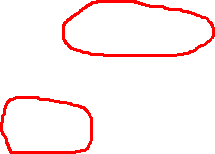
Data Structures: Unit 6
DFS Algorithm Complexity
The time complexity of the DFS algorithm is O(V + E), where V is the number of nodes and E is the number of edges.
The space complexity of the algorithm is O(V).

Slide 42
Data Structures: Unit 6
DFS Algorithm Applications
For finding the path
For finding the strongly connected components of a graph
For detecting cycles in a graph

Slide 43
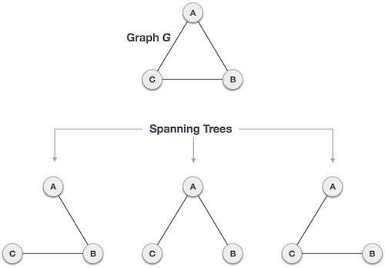

Spanning Tree
A spanning tree is a subset of Graph G, which has all the vertices covered with minimum possible number of edges. Hence, a spanning tree does not have cycles and it cannot be disconnected..

Slide 44
General Properties of Spanning Tree
A connected graph G can have more than one spanning tree.
All possible spanning trees of graph G, have the same number of edges and vertices.
The spanning tree does not have any cycle (loops).
Removing one edge from the spanning tree will make the graph disconnected,
i.e. the spanning tree is minimally connected.
Adding one edge to the spanning tree will create a circuit or loop, i.e. the spanning tree is maximally acyclic.

Slide 45
Mathematical Properties of Spanning Tree
Spanning tree has n-1 edges, where n is the number of nodes (vertices).
A complete graph can have maximum n^{n-2} number of spanning trees.

Slide 46
Application of Spanning Tree
Civil Network Planning
Computer Network Routing Protocol
Cluster Analysis

Slide 47
Minimum Spanning Tree (MST)
In a weighted graph, a minimum spanning tree is a spanning tree that has minimum weight than all other spanning trees of the same graph.
In real-world situations, this weight can be measured as distance, congestion, traffic load or any arbitrary value denoted to the edges.

Slide 48
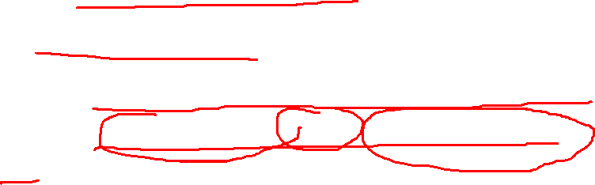
Kruskal’s Algorithm
Edge with minimum weight is selected.
Cycle should not be formed.
Each time the edge of minimum weight has to be selected.
It is not necessary to have edges of minimum weights to be adjacent.

Slide 49
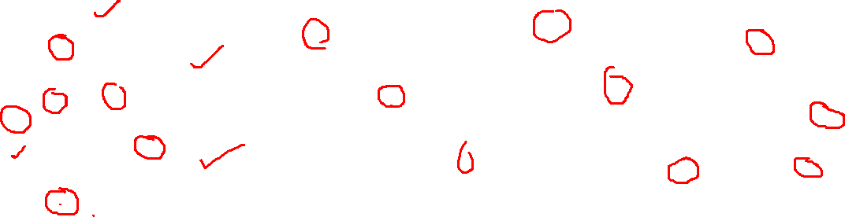
Example of Kruskal’s Algorithm
V₁
V₁
1)
V₁
2)
3)
8
2
1
V₁
V₆
2
1
3
V
1
V₂
1
3
13
2
V
2
7
2
V
12
2
8
2
12
V₃
V₅
V
V₅
V
3
5
V₁
9
4)
10
1
3
V₆
2
V₄
V
2
7
V₃
V₅
V₄

Slide 50
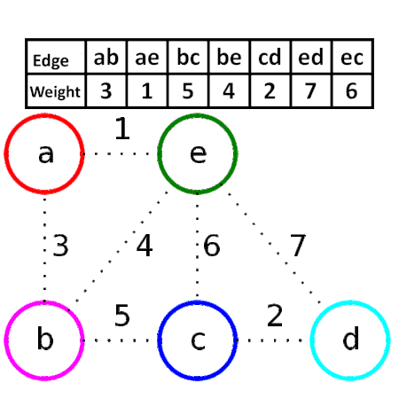
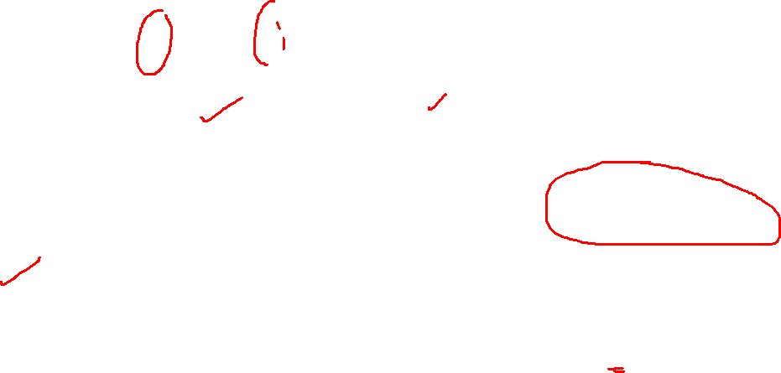
Kruskal’s Algorithm

Slide 51
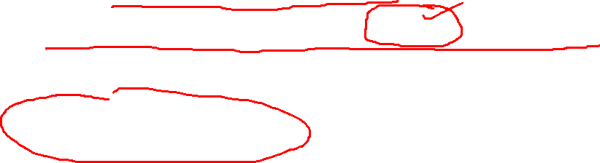
Prim’s Algorithm
Edge with minimum weight is selected
Select edge with minimum weight adjacent to these vertices.
Process will continue till all the vertices are included.
Cycle should not be formed.

Slide 52
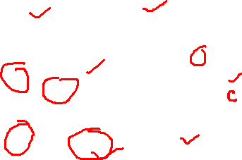
Example:
A 12 B
1)
B B
2)
17
7
1
1
1
F
C 2
C
15
2
19
10
D
6
E
14
D
5)
A
12
B
4)
A
12
B
3)
B
7
1
1
7
1
7
2
C
2
C
2
C
F
F
F
E
14
D
D
D

Slide 53
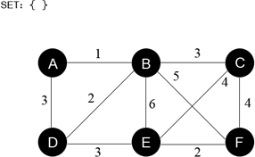
Prim’s Algorithm

Slide 54
Dijkstra Algorithm
Start finding the distances from source node and find all the paths from it to adjacent nodes.
Select minimum distance from paths available.

Slide 55
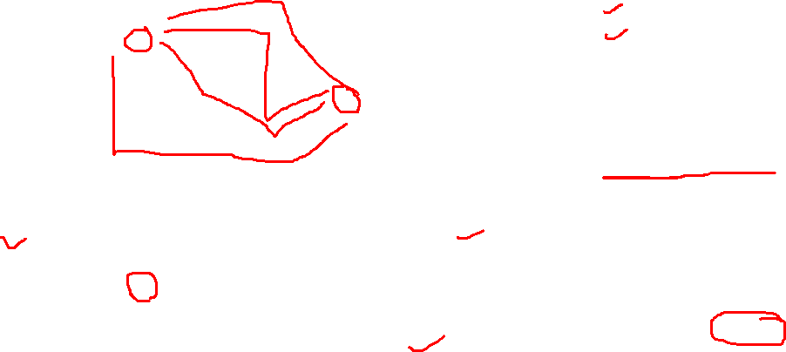
Example:
Find out the shortest path from A to C using Dijkstra algorithm.
Source Node = A Destination Node = C
dist(A,B) =12 dist(A,C) = ∞ dist(A,D)= ∞ dist(A,E) = 15
dist(A,F) = 17
minimum
A
12
B
17
F
19
7
10
1
15
2
C
6
E 14
D
dist(A,C) = min{∞, {d(A,E)+d(E,D)+d(D,C)}}
= min{∞,{15 + 14 + 6}}
=min {∞,35}
dist(A,C) = min{∞, {d(A,B) + d(B,C)}}
= min{∞, (12+1)}
= min{∞,13}
= 13
= 35
dist(A,C) = min{∞, {d(A,F)+d(F,D)+d(Dd,i_{C}st₎(}A},C) =min{∞,{d(A,B)+d(B,D)+d(D,C)}}
= min{∞, {17+10+6}}
= min{∞,33}
= 33
= min{∞,{12+2+6}}
= min{∞,20}
=20

Slide 56
Example:
Among all these paths 13 is minimum distance. So shortest path from A to C is 13 which is shown as follows:
A 12 B
1
C

Slide 57
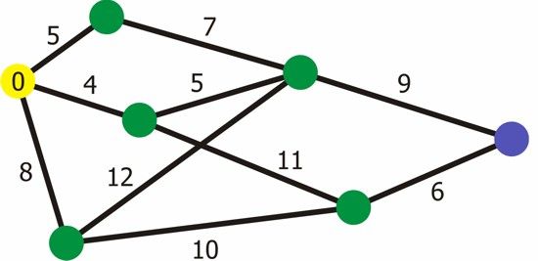
Dijkstra Algorithm
July 7, 2020
48

Slide 58
Questions :
Q. 1. In each of the following examples, please choose the best data structure(s). Options are:
Array, Linked Lists, Stack, Queue, Tree, Graph. Justify your answer.
You have to store social network “feeds”. You do not know the size, and things may need to
be added as and when it is required.
To store the customer order information in a drive-in burger place. (Customers keep on coming and they have to get their correct food at the payment/food collection window.)
To implement back functionality in the internet browser.
To store the possible moves in a chess game.
Q. 2 Can Prim's and Kruskal's algorithm yield different minimum spanning trees? Explain why or why not.

Slide 59
Questions:
Q.3 Consider a simple undirected weighted graph G(V, E) with 10 vertices and 45 edge, assume (u, v) are two vertices weight of a edge is =4lu- vl then the minimum cost of the spanning tree of G_ ?
Answer: The given undirected graph is a complete graph on 10 vertices, so no. of edges in
Minimum spanning tree = 9
An edge is included in MST if it's cost is less than or equal to the weights of the remaining edges and doesn't form a cycle,
Now, the minimum possible weight is 4 because it is a simple graph, so loops are not allowed.
Now, if we consider edges,(1,2),(2,3),(3,4),(4,5),(5,6),(6,7),(7,8),(8,9),(9,10),we obtain the required 9 edges each with a cost of 4
So, Total cost in MST = 9*4 = 36

Slide 60
Questions:
Q.4 Consider an undirected random graph of eight vertices. The probability that there is an edge between a pair of vertices is 1/2. What is the expected number of unordered cycles of length three?
(A) 1/8
1
7
8

Slide 61

Data Structures

