Slide 1
variable precision deep learning (float16 & float32)
CS-597: Reading and Special Problems
Team Members
Nilesh Jorwar (A20405042)
Ashish Ryot (A20405230)

Slide 2
Problem Statement
Performance of CPU with low precision data types, along with data representation techniques (floating point) and the variation of results with adjustments to various parameters of the model needs to be experimented.
Improvisation of the previous project to get better accuracy and lower training time using various techniques:
Implementation of AVX instructions for speeding up runtime (float32)
Multithreading implementation for float32 and float16 data types

Slide 3
Motivation
Need for speedup and performance on larger datasets using low variable precision data types without loss of accuracy, precision and recall.
Deep learning on problems like image recognition is very compute intensive task.

Slide 4
Improvement over past project & current progress
AVX instructions for float32 data types
Parallelization of neural network using thread library for float16 data types
Testing model on more complex datasets
Comparison of C++ model with TensorFlow and Keras in Python
Testing of Keras model with int data type

Slide 5
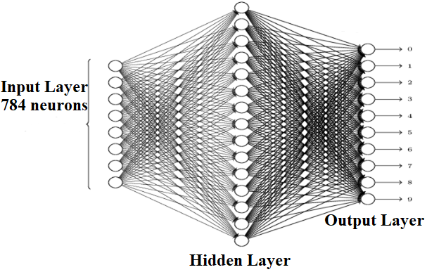
Architectures
cpp Model – Input layer with 784 neurons, hidden layer (variable neurons), and output layer (10 neurons)
Activation Functions: sigmoid
TensorFlow Python Model
Keras Python Model

Slide 6
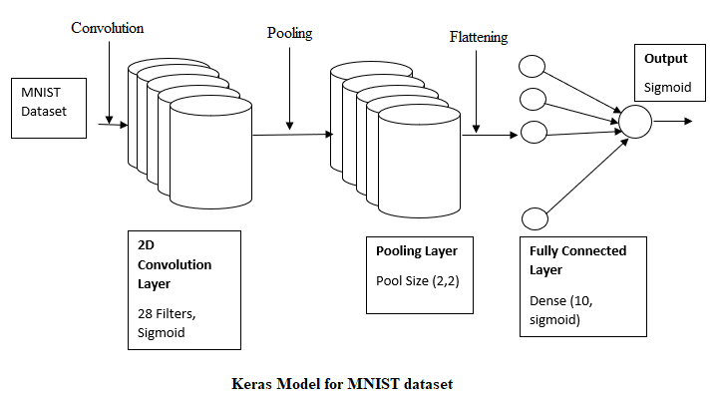
ARCHITECTURE – Keras Model

Slide 7
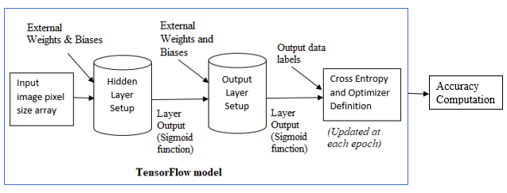
ARCHITECTURE – TensorFlow Model

Slide 8
Testbed requirements
Intel(R) Xeon(R) CPU e5-2667 v3 @ 3.20ghz
CPU 2
Cores 16
Logical Processors 32

Slide 9
Achievements
Successful implementation of multithreading on neural network model
AVX instructions implementation
Improved accuracy, precision and recall
Reduced runtime.
Experiments over different datasets
Evaluation over different platforms and models like Keras, TensorFlow, and CPP

Slide 10
Challenges faced
Implementation of AVX512 instructions for float16 data types.
Implementation using int data types.
Implementation using low precision data types (CLN) [4].
The external library used, rounds the original data into fixed number of real bits , which results in loss of precision.
The precision decreases and number of epochs required to get good accuracy increases.

Slide 11
Performance evaluation
MNIST and Fashion dataset
Float32 and float16 data types
Evaluation using varying number of nodes like 10, 20, 30, 50, 70, 100, and 400 in hidden layer
Accuracy computations for different number of epochs like 10, 20, 30, and 35.

Slide 15
Accuracy and Runtime over different epochs for different models
 |  | cpp Model Float32 (avx) | cpp Model Float16 (multi-threaded) | TensorFlow Model (Keras) Float16
10 Epochs | Accuracy (%) | 96.8 | 95.72 | 98.32
 | Runtime (secs) | 40.51 | 654 | 761
20 Epochs | Accuracy (%) | 97.8 | 97.07 | 98.43
 | Runtime (secs) | 133.50 | 1593 | 1530
30 Epochs | Accuracy (%) | 98.1 | 97.26 | 98.55
 | Runtime (secs) | 205.47 | 2425 | 2276
 |  | cpp Model Float32 | TensorFlow Model Float32
10 Epochs | Accuracy (%) | 96.2 | 95.69
 | Runtime (secs) | 51.33 | 30
20 Epochs | Accuracy (%) | 97.8 | 95.65
 | Runtime (secs) | 152.52 | 60.928
30 Epochs | Accuracy (%) | 97.9 | 95.72
 | Runtime (secs) | 231.37 | 90.88

Slide 17
FUTURE SCOPE
Implementation of VNNI instructions on float16 data types
Conversion of CPP model to work on GPU platform using CUDA
Testing the CPP model on ImageNet

Slide 18
references
[1] https://thinkingandcomputing.com/posts/using-avx-instructions-in-matrix-multiplication.html
[2] https://adventuresinmachinelearning.com/python-tensorflow-tutorial/
[3] https://cognitivedemons.wordpress.com/2017/07/06/a-neural-network-in-10-lines-of-c-code/
[4] https://ginac.de/CLN/cln.html

