Slide 1


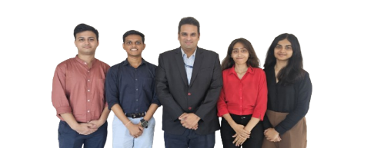
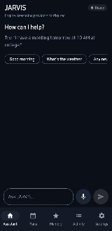
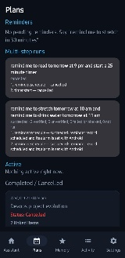
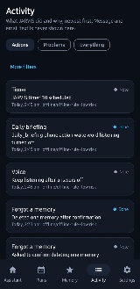
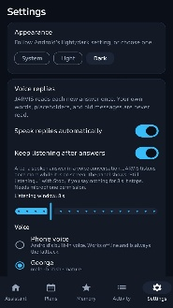
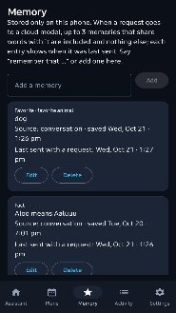
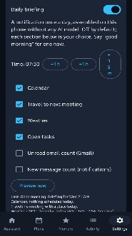
Department : Computer Engineering
Project Title : JARVIS: A Privacy-Aware, Adaptive AI Agent for Android with Persistent Task Execution and Verifiable Tool Use
Domain (Area of Project) : Machine learning, Mobile Computing (Android)
Name of Project Guide : Dr. kavita Shirsat (kavita.shirsat@vit.edu.in))
Name of Students : Hussain Anajwala (hussain.anajwala@vit.edu.in)
Mohammad Equaan Kacchi (equaan.kacchi@vit.edu.in)
Swapnil Supe (swapnil.supe@vit.edu.in)
nilesh patni (nilesh.patni@vit.edu.in)
Brief idea of Project : “JARVIS” is a privacy-aware Android personal assistant that turns typed or spoken requests in English, Hinglish and Hindi into actions the user can inspect, approve and verify. Unlike chat-only assistants that may claim a task is done without checking, JARVIS runs actions through a typed tool registry, asks approval for consequential steps, and reports success only after verifying the result. An adaptive router keeps supported commands on-device and uses cloud AI only when needed and permitted, while a central privacy boundary redacts recognised secrets. Key features include persistent reminders, timers and goals, multi-step Plan–Execute–Verify tasks, contextual memory, calendar and phone actions, a sanitized Activity log, and a Research Dashboard with exportable evidence.
Screenshots of the Project / Photos of Working Model (Min.3):
Applications :
-> Personal productivity: voice and text reminders, timers, goals and calendar events for students and professionals, with every action visible and approved.
-> Privacy-sensitive assistance: local-first processing for users and organisations who don’t want routine requests or secrets sent to cloud AI.
->Multilingual access: an English, Hinglish and Hindi assistant for Indian users who naturally code-mix.
-> Hands-free and accessible use: voice-first control for users who find touchscreen navigation difficult.
Awards/Participation if Any for TPP / Competitions / Paper Publication / Any Other Pls. Specify: --
-> NA

