Slide 1

The Computational Linguistics Summarization Task @ TAC 2014, BIRNDL 2016, SIGIR 2017
Summarization Challenge
3 years, 7 countries, 17 participating teams
Kokil Jaidka¹, Muthu Kumar Chandrasekaran², Min-Yen Kan²,
¹University of Pennsylvania
²National University of Singapore
Notes:
Other than errors, there were some limitations:
1. Focus on research objectives only

Slide 2
Corpus Highlights
Continuing effort to advance scientific document summarization by encouraging the incorporation of semantic and citation information.
Corpus of 30 articles; 500 citing papers
Annotation by 6 paid and trained annotators (Master in Linguistics students) from U-Hyderabad
Sponsorship from Microsoft Research Asia
https://github.com/WING-NUS/scisumm-corpus/
Notes:
Other than errors, there were some limitations:
1. Focus on research objectives only

Slide 3
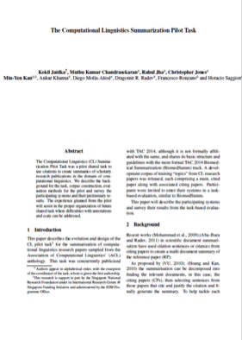
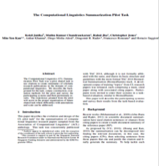
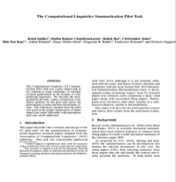
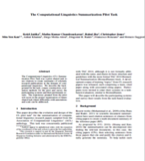
The CL-SciSumm Shared Task
Task 1A:​ I​​dentify the text span in the RP which corresponds to the citances from the CP.
Reference
Paper (RP)
Citing papers
Citing text is called citance
Citing paper (CP)
Task 1A
Match the citing text in the CP to text in the RP

Slide 4
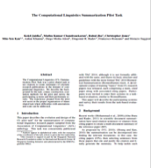
The CL-SciSumm Shared Task
Task 1B: ​Identify the discourse facet for every cited text span from a predefined set of facets.
Reference
Paper (RP)
Citing paper (CP)
CPs
Classify the cited text in RP into one of several facets
Task 1B

Slide 5
Annotating the SciSumm corpus
6 annotators selected from a pool of 25
6 hours of training
Gold standard annotations for Task 1A and 1B, per topic or reference paper
Community and hand-written summaries for Task 2, per topic
Notes:
Other than errors, there were some limitations:
1. Focus on research objectives only

Slide 6


Annotation Pipeline
<xml>
<abstract>
…….
</abstract>……
OCR & Section Parse
CL-SUMM
DOC
<xml>
<abstract>
…….
</abstract>……
CLAIR -Umich’s Python module
Annotation!
Post Processing with U-Colorado’s python scripts
Notes:
Other than errors, there were some limitations:
1. Focus on research objectives only

Slide 7
The CL-SciSumm Shared Task
Task 2: Generate a structured summary of the RP from the cited text spans of the RP. The length of the summary should not exceed 250 words.
Compare with abstractive summary, human summary and community summary
Notes:
Other than errors, there were some limitations:
1. Focus on research objectives only

Slide 8
Evaluation
Task 1A – Exact sentence id match
Task 1B –
conditional on Task 1A
BoW overlap between discourse facets
Task 2 - ROUGE-SU2 and ROUGE-SU4
Notes:
Other than errors, there were some limitations:
1. Focus on research objectives only

Slide 9
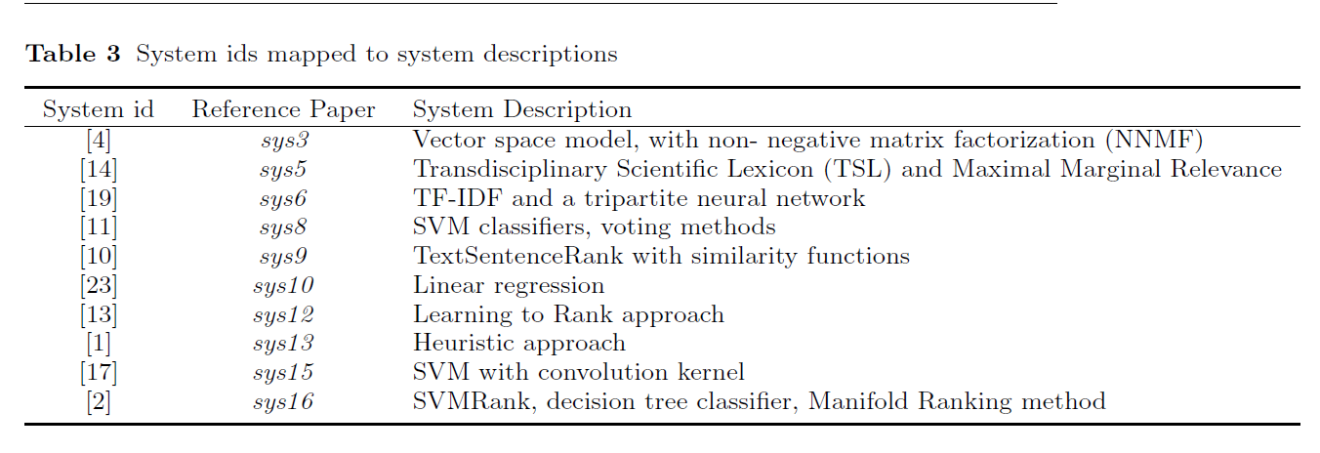
1. Aggarwal, P., Sharma, R.: Lexical and Syntactic cues to identify Reference Scope of Ci-
tance. In: Proc. of the Joint Workshop on Bibliometric-enhanced Information Retrieval
and Natural Language Processing for Digital Libraries (BIRNDL2016), pp. 103{112.
Newark, NJ, USA (2016)
2. Cao, Z., Li, W., Wu, D.: PolyU at CL-SciSumm 2016. In: Proc. of the Joint Workshop
on Bibliometric-enhanced Information Retrieval and Natural Language Processing for
Digital Libraries (BIRNDL2016), pp. 132{138. Newark, NJ, USA (2016)
4. Conroy, J., Davis, S.: Vector space and language models for scientic document sum-
marization. In: NAACL-HLT, pp. 186{191. Association of Computational Linguistics,
Newark, NJ, USA (2015)
10. Klamp, S., Rexha, A., Kern, R.: Identifying Referenced Text in Scientic Publica-
tions by Summarisation and Classication Techniques. In: Proc. of the Joint Workshop
on Bibliometric-enhanced Information Retrieval and Natural Language Processing for
Digital Libraries (BIRNDL2016), pp. 122{131. Newark, NJ, USA (2016)
11. Li, L., Mao, L., Zhang, Y., Chi, J., Huang, T., Cong, X., Peng, H.: CIST System for
CL-SciSumm 2016 Shared Task. In: Proc. of the Joint Workshop on Bibliometric-
enhanced Information Retrieval and Natural Language Processing for Digital Libraries
(BIRNDL2016), pp. 156{167. Newark, NJ, USA (2016)
11. Lu, K., Mao, J., Li, G., Xu, J.: Recognizing reference spans and classifying their dis-
course facets. In: Proc. of the Joint Workshop on Bibliometric-enhanced Information
Retrieval and Natural Language Processing for Digital Libraries (BIRNDL2016), pp.
139{145. Newark, NJ, USA (2016)
14. Malenfant, B., Lapalme, G.: RALI System Description for CL-SciSumm 2016 Shared
Task. In: Proc. of the Joint Workshop on Bibliometric-enhanced Information Retrieval
and Natural Language Processing for Digital Libraries (BIRNDL2016), pp. 146{155.
Newark, NJ, USA (2016)
17. Moraes, L., Baki, S., Verma, R., Lee, D.: University of Houston at CL-SciSumm 2016:
SVMs with tree kernels and Sentence Similarity. In: Proc. of the Joint Workshop
on Bibliometric-enhanced Information Retrieval and Natural Language Processing for
Digital Libraries (BIRNDL2016), pp. 113{121. Newark, NJ, USA (2016)
19. Nomoto, T.: NEAL: A neurally enhanced approach to linking citation and reference. In:
Proc. of the Joint Workshop on Bibliometric-enhanced Information Retrieval and Nat-
ural Language Processing for Digital Libraries (BIRNDL2016), pp. 168{174. Newark,
NJ, USA (2016)
23. Saggion, H., AbuRa'Ed, A., Ronzano, F.: Trainable Citation-enhanced Summarization
of Scientic Articles. In: Proc. of the JointWorkshop on Bibliometric-enhanced Informa-
tion Retrieval and Natural Language Processing for Digital Libraries (BIRNDL2016),
pp. 175{186. Newark, NJ, USA (2016)

Slide 10
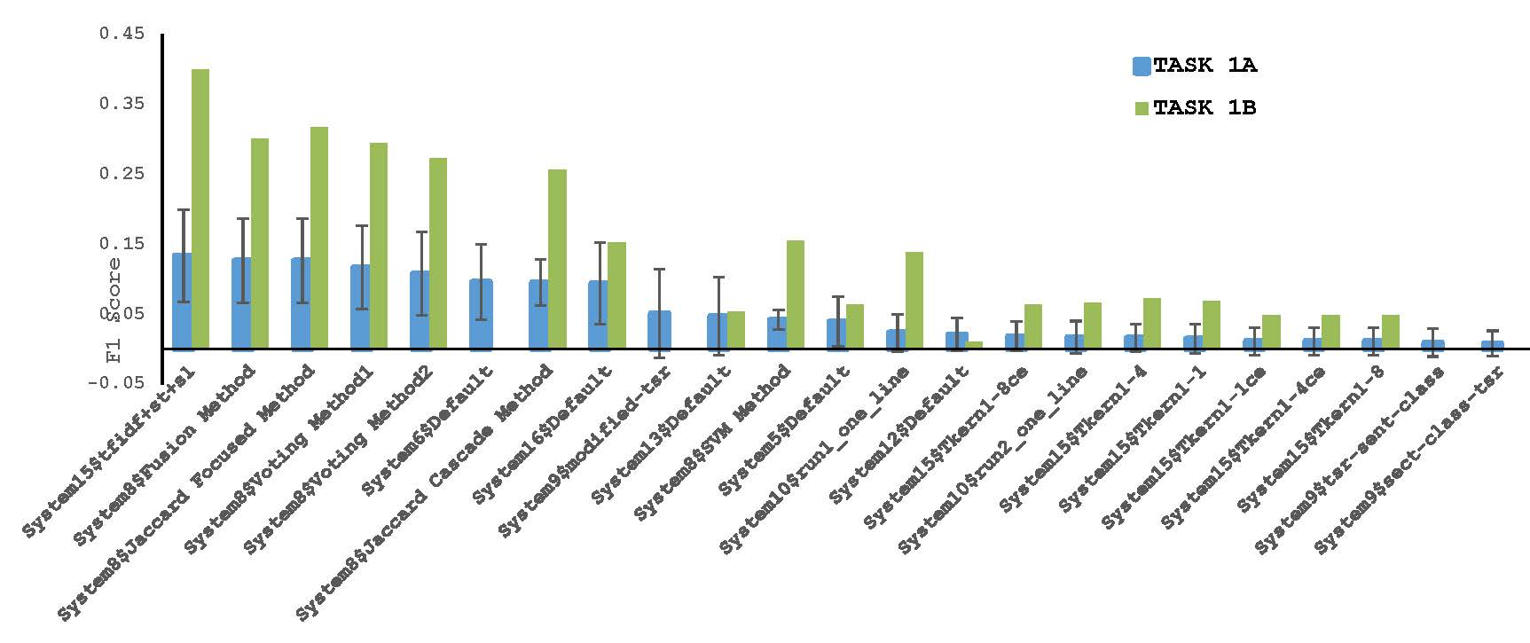
Best Performing Approaches: Task 1
System 15 – Tfidf
System 8 - Combinations of SVM Classifier + term frequencies + surface features
System 6 - Tfidf + embeddings-based neural network
System 16 – SVMRank, decision tree classifier
Notes:
Other than errors, there were some limitations:
1. Focus on research objectives only

Slide 11
Best Performing Approaches (Task 2)
System summaries vs Paper Abstracts
System 8 - SVM classifiers, voting methods
System 3 - Term frequency + NNMF
System 10 - WEKA + feature relevance scores
11
Notes:
ROUGE-L scores here measure overlap over the abstract since we did not have human summaries
Low scores could be due to deviation between summary of citances and the abstract of the paper

Slide 12
Best Performing Approaches (Task 2)
System summaries vs. Human summaries
System 8 - SVM classifiers, voting methods
System 3 - Term frequency + NNMF
System 10 - WEKA + feature relevance scores
12
Notes:
ROUGE-L scores here measure overlap over the abstract since we did not have human summaries
Low scores could be due to deviation between summary of citances and the abstract of the paper

Slide 13
Best Performing Approaches (Task 2)
System summaries vs Community summaries
System 15 - SVM with convolution kernel
System 8 – SVM classifiers, voting methods
System 10 - WEKA + feature relevance scores
13
Notes:
ROUGE-L scores here measure overlap over the abstract since we did not have human summaries
Low scores could be due to deviation between summary of citances and the abstract of the paper

Slide 14
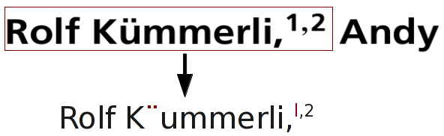
Dataset Limitations
Task 1B: limited number of samples for most (e.g., hypothesis) discourse facets, inconsistent labeling
Preprocessing: OCR + Parsing
Software: Protégé w/ manual alignment and post-processing
Scaling the corpus was difficult: key bottleneck in the corpus development
Notes:
Other than errors, there were some limitations:
1. Focus on research objectives only

Slide 15

Acknowledgements
Chin-Yew Lin (MSRA)
NIST and Hoa Dang
Lucy Vanderwende, MSR
Anita de Ward, Elsevier Data Services
Kevin B. Cohen, Prabha Yadav (U. Colorado, Boulder)
Rahul Jha (Google)
U-Hyderabad Annotators:
Aakansha Gehlot, Ankita Patel, Fathima Vardha, Swastika Bhattacharya and Sweta Kumari
System Paper Reviewers:
Akiko Aizawa, Dain Kaplan, John Lawrence, Lucy Vanderwende, Philipp Mayr, Vasudeva Verma and John Conroy
This task was possible through the generous support of
Notes:
Other than errors, there were some limitations:
1. Focus on research objectives only

Slide 16
Supplemental Analysis
We investigated whether high deviations could be because of the topic sets themselves
Topics with both high and low number of citances have mixed results
No significant patterns of performance against:
Number of citances of the topic set
Age of the paper
Notes:
Other than errors, there were some limitations:
1. Focus on research objectives only

Slide 17
Thank you jaidka@sas.upenn.edu

