Slide 1

A Web Application that Delivers
Household Services using a
Peer-to-Peer Workload System
HOMEAZE
Presented By
Household Services Platform
Nilesh Sharma (2023BTech052)
Prateek Yadav (2023BTech059)
Faculty Guide
Dr. Deepika Prakash
Institute of Engineering and Technology • March 2026

Slide 2




Project Overview
What is Homeaze?
Homeaze is a web-based platform designed to connect people who
need household services with skilled individuals who can provide them.
GOAL
Simplify service access while
creating employment opportunities
Easy Discovery
P2P Ecosystem
Find local service providers instantly
Users can both provide & consume
Digital Booking
Worker Profiles
Seamless online service requests
Manage skills and service listings

Slide 3


Problem Statement
Many people struggle to find trustworthy professionals for home services, as traditional methods rely on local contacts and manual searching. At the same time, many skilled individuals lack opportunities to showcase their services and reach a wider audience.
Discovery Gap
Difficulty finding reliable, nearby service providers
No Structured Platform
Skilled workers lack proper digital presence
Limited Opportunities
Individuals with practical skills can't monetize easily
Inefficient Processes
Booking services is unorganized and time-consuming

Slide 4

Motivation
Why Homeaze?
SKILLED WORKERS
SERVICE SEEKERS
Electrical Work
Plumbing
BRIDGE
Home Maintenance
Cleaning Services
Users find it difficult to locate
reliable service providers quickly.
...but struggle to reach customers

Slide 5

Proposed Solution
Homeaze — How it works
Centralized Platform
Service Booking System
Worker Profile Mgmt
HOMEAZE
Employment Opportunities
Chain-like model where users can both PROVIDE and CONSUME services

Slide 6
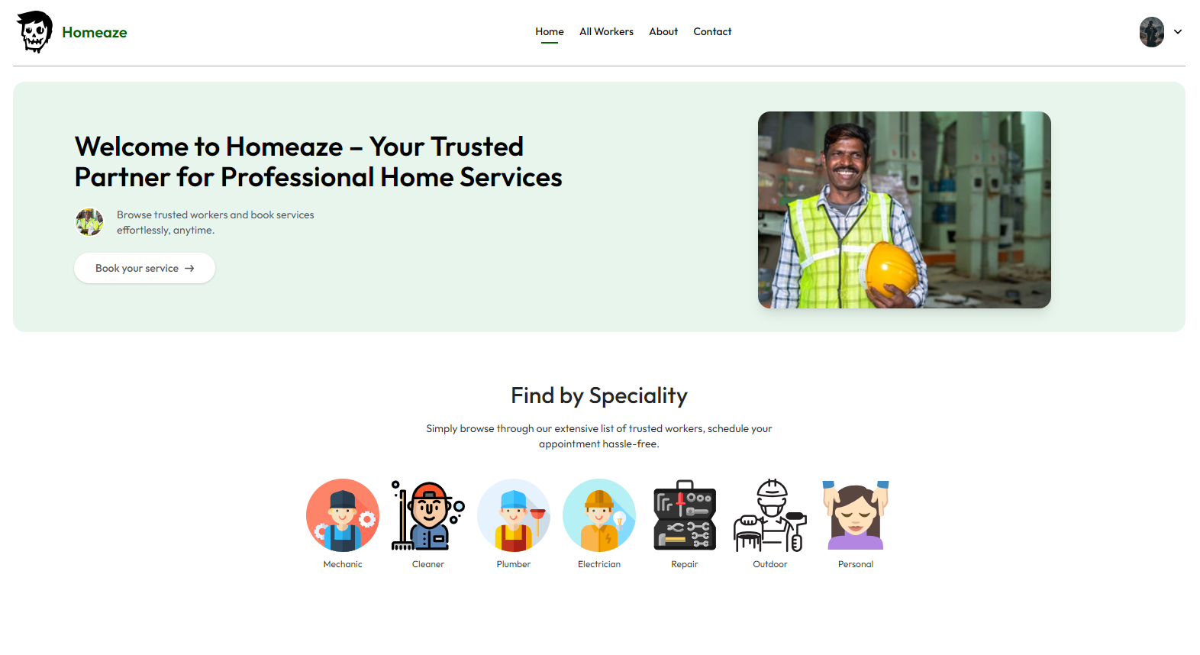
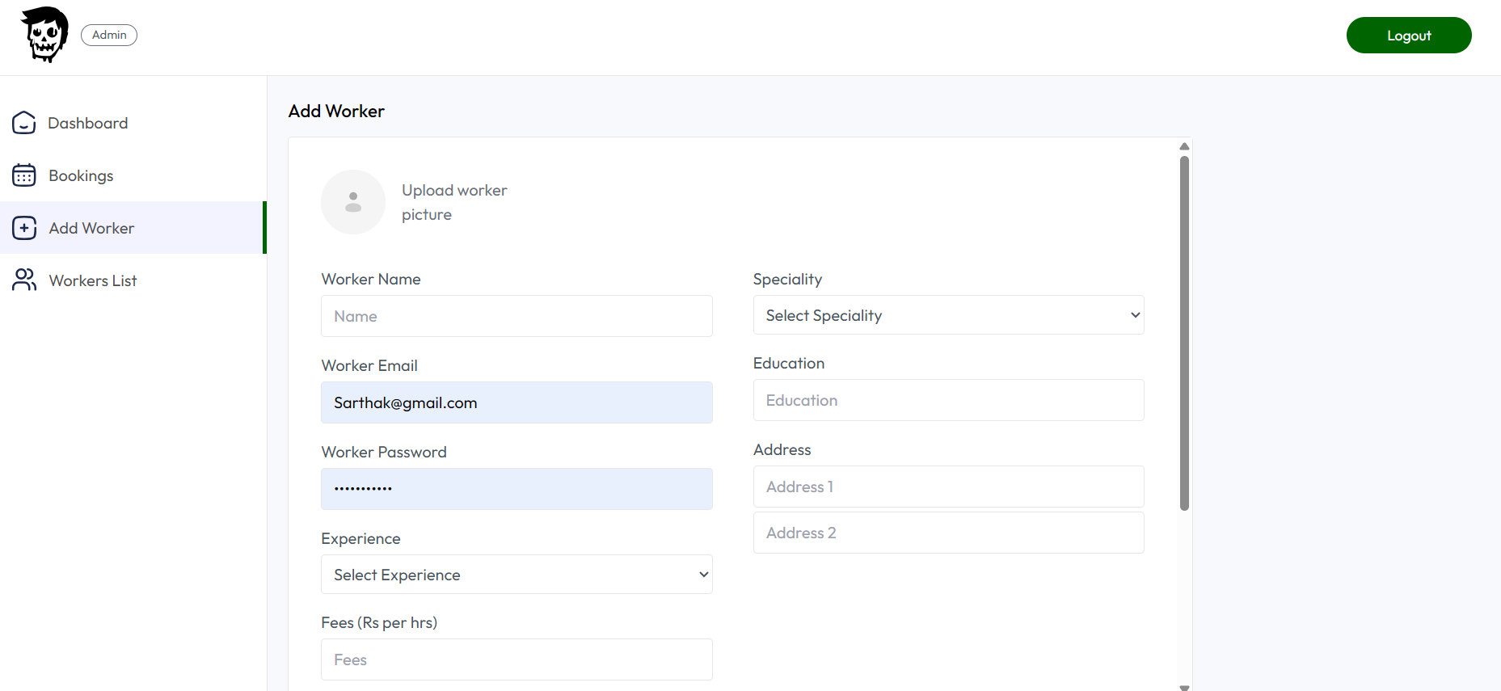
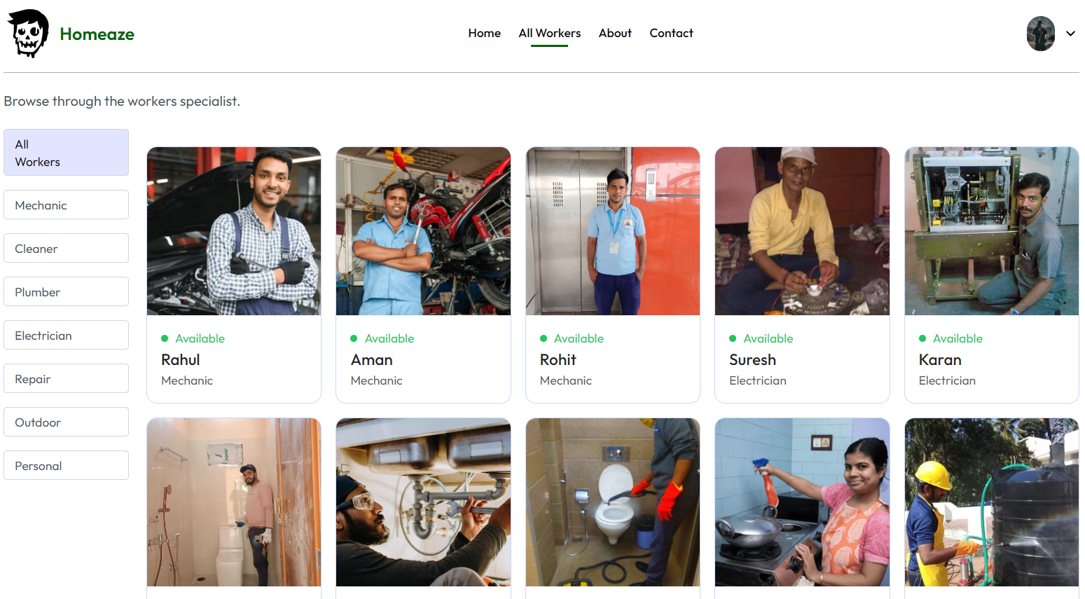
Application Screenshots
UI Previews
[Screenshot]
Landing Page
Worker Listing
Add Worker / Admin

Slide 7





System Architecture
Full-Stack Technical Overview
Cloudinary
Image Storage
& CDN Delivery
USER
FRONTEND
BACKEND
DATABASE
Browser / Mobile
React.js + Tailwind
Node.js + Express
MongoDB + Cloudinary
HTTP Requests
REST API Calls
Queries & Responses

Slide 8
Why Using MERN?
Why not PERN, MEAN or PEAN?
Single Language Across the Stack
Flexible and Scalable Database
MERN uses JavaScript for both frontend and backend, making development faster and easier compared to stacks like PERN or MEAN that introduce additional complexity.
MongoDB provides a NoSQL schema-flexible structure, which is suitable for dynamic applications like service platforms.
Strong Ecosystem and Community
Better for Real-Time Web Applications
React and Node.js have large communities, extensive libraries, and strong industry adoption, which makes development, debugging, and scaling easier.
Widely used for modern web applications and scalable platforms, making it a good choice for building applications like Homeaze.

Slide 9
System Workflow
Step-by-step Request Flow
1
2
3
4
5
Browse
Select
Request
Process
Respond
User visits platform
& browses services
User selects worker
& requests service
Frontend sends
API request
Backend processes
& queries MongoDB
Response returned
to frontend

Slide 10
Work Completed — Backend
APIs, Database & Server Logic
Worker Registration API
Endpoint to onboard new service providers with full profile data
MongoDB Integration
Persistent data storage for workers, services, and users
Cloudinary Image Upload
Secure image hosting and delivery for worker profile photos
API Validation & Error Handling
Robust input validation with meaningful error responses
API Testing via Postman
All endpoints verified and documented through Postman collections

Slide 11
Work Completed — Frontend
UI/UX Implementation
Worker Listing Interface
PAGES DEVELOPED
Browse available workers
🏠 Homepage
Service Browsing System
Discover available services
👷 Worker Listing Page
Responsive UI
Tailwind CSS, mobile-friendly
🔍 Service Viewing Interface
React Context API
Global state management

Slide 12


Future Work
Planned Enhancements
“Worker Panel” Integration
CI/CD Implementation
AI Recommendation System
Worker dashboard (Minimal UI)
GitHub Actions automation
Smart provider suggestions
Connection Data between Workers and users
Docker containerization
Based on history & ratings

Slide 13
Benefits of the System
Who gains value?
USERS
WORKERS
SOCIETY
Easy service discovery
New earning opportunities
Collaborative ecosystem
Convenient booking
Showcase skills digitally
Skill-based employment
Verified providers
Grow customer base
Digital inclusion

Slide 14
Challenges Faced
Learnings during development
Efficient API Structure
Frontend-Backend Data Flow
Designing clean, RESTful endpoints that scale well with complex data relationships
Managing asynchronous requests, state synchronization, and error propagation
Responsive Interface
Multi-Technology Integration
Building a UI that works consistently across devices of varying sizes
Connecting React, Node.js, MongoDB, and Cloudinary in a cohesive system

Slide 15
Conclusion
What we built & where we're headed
Homeaze provides a digital solution for connecting service providers and customers,
simplifying household service access while creating income opportunities for skilled individuals.
Service Access
Economic Impact
Modern Tech Stack
Simplified platform connecting users with skilled workers instantly
Earning opportunities for individuals with practical household skills
Full-stack solution with React, Node.js, MongoDB & Cloudinary
Future enhancements: AI Recommendations • CI/CD Pipelines • More Features

Slide 16
Thank You!
HOMEAZE
We appreciate your time
and attention.
Household Services Platform
Nilesh Sharma • Prateek Yadav
Institute of Engineering & Technology
Questions?
Faculty Guide: Dr. Deepika Prakash

