Slide 1



IPL
View in Power BI
Last data refresh:
12/2/2023 2:12:05 PM UTC
Downloaded at:
12/24/2023 6:35:39 PM UTC

Slide 2
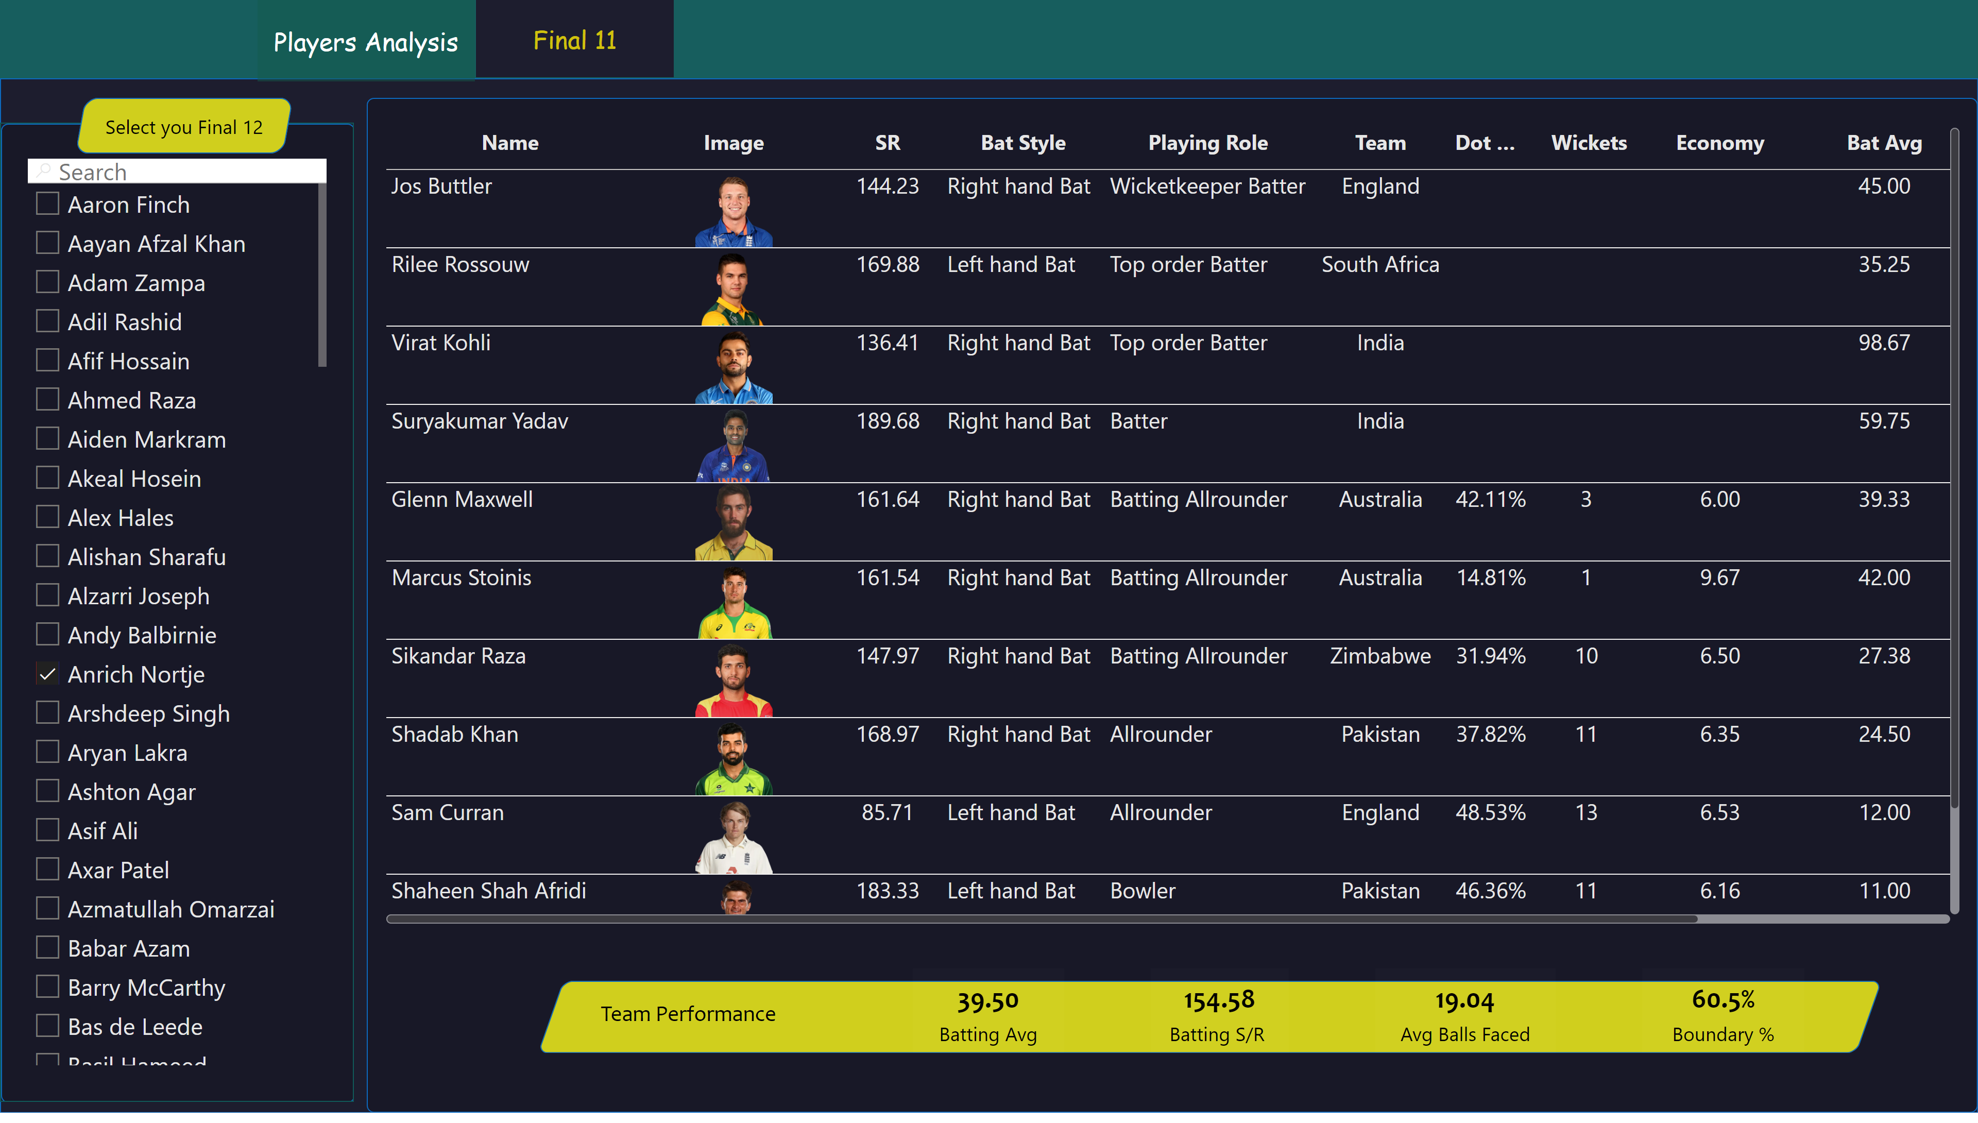
Final 11
Notes:
shape
No alt text provided
shape
No alt text provided
shape
No alt text provided
shape
No alt text provided
slicer
No alt text provided
actionButton
No alt text provided
actionButton
No alt text provided
tableEx
No alt text provided
shape
No alt text provided
shape
No alt text provided
card
No alt text provided
card
No alt text provided
card
No alt text provided
card
No alt text provided

