Slide 1
Nilesh Hampiholi
Robot - Guided Ultrasound Probe Calibration and Volume Scanning

Slide 2
Project Environment
Ultrasound image-guided puncture supported by augmented reality (AR)
Calibration of linear probe to maker/ robot
Augmentation of 2D US images into 3D volume
Derive motion profiles of US probe and patient
3D Rendering of the structures under the skin into AR glasses
Localizing the target using the scan
Needle placement

Slide 3
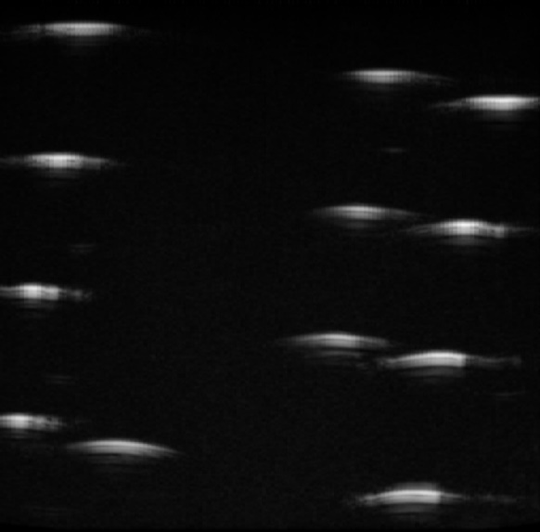
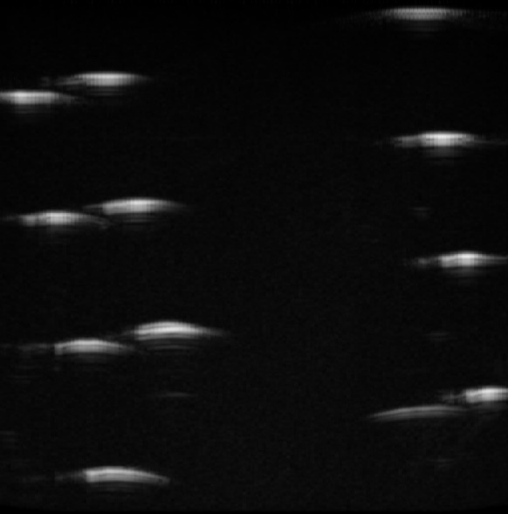
Motivation and Goals
Motivation
Tracked ultrasound imaging is an inexpensive, safe, non-invasive technique for several guided interventions such as needle insertions, biopsies and ablations
Existing solution concentrate on free hand probe calibration using external trackers and camera
Goals
Calibration of linear probe to maker/ robot
To enable assistance, US volume of the patient is needed
To obtain the volume, position of probe has to be determined accurately
Position is computed by calibration
Augmentation of 2D US scans into 3D volume
US Scan from
different angles
Notes:
Not very sure about the motivation.

Slide 4
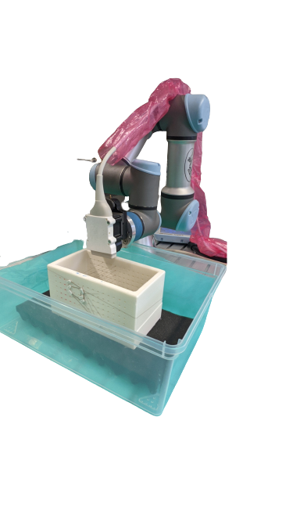
Methodology
Design calibration phantom
Data acquisition
Semantic segmentation
Extraction of centroids from segmented markers
Pose estimation
Solve hand eye problem
Image stitching to obtain 3D US-volume
UR-3 Robot
US Probe
Wire Phantom
Experimental Set-up

Slide 5
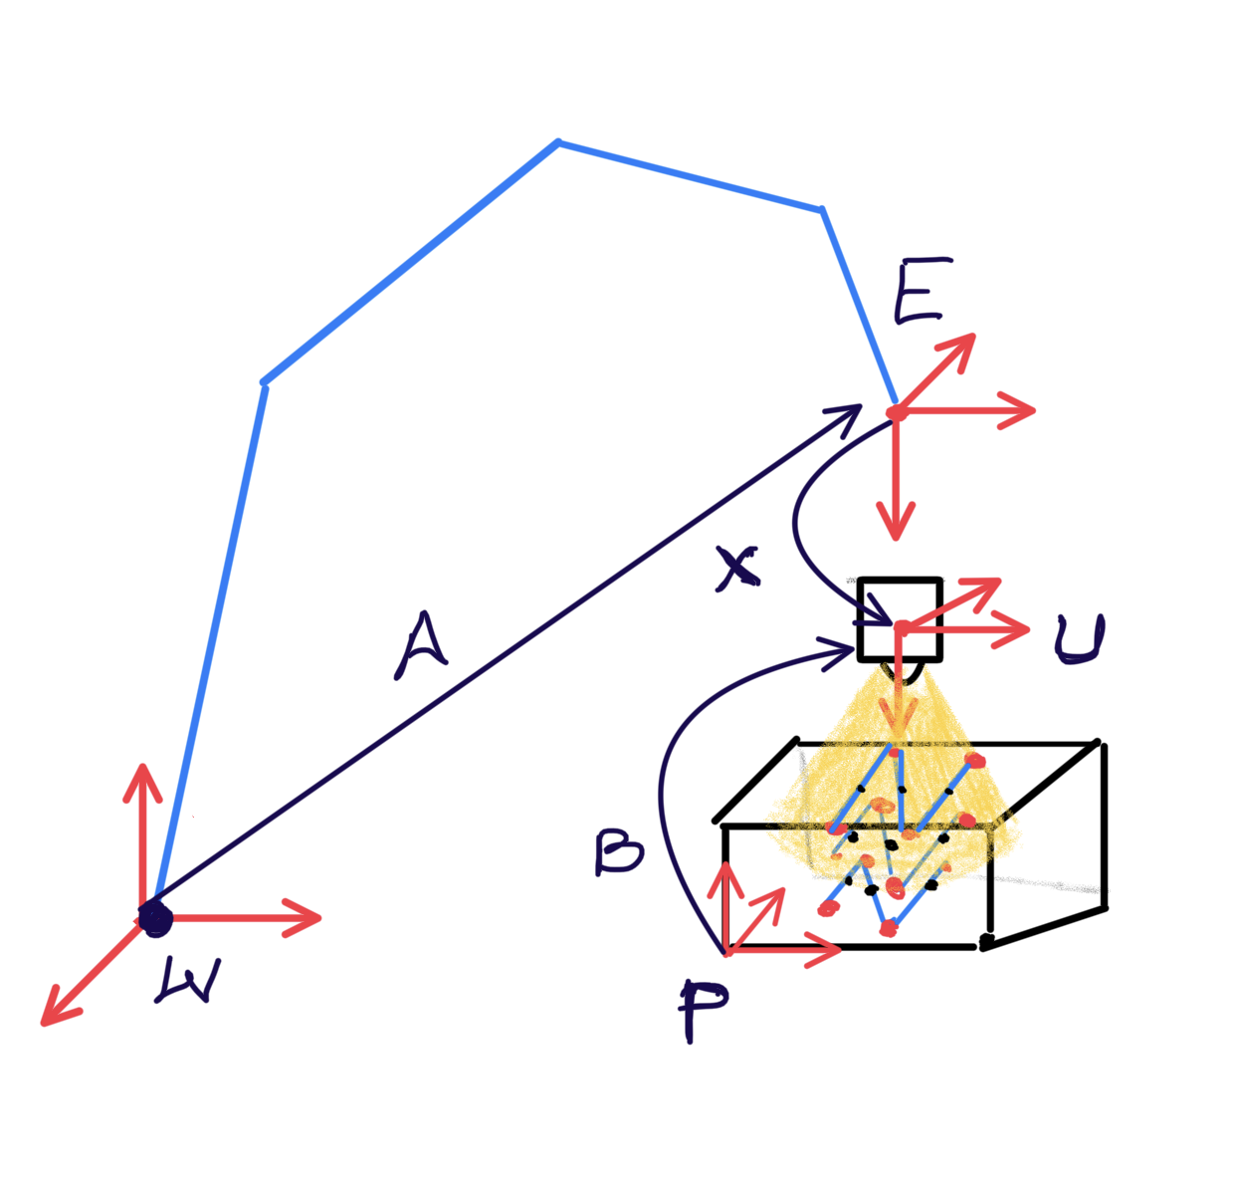
Hand Eye Calibration
Location of probe and scanning object is unknown with respect to robot base or world coordinates
Determining the transformation between robot end-effector and a sensor
Solve AX=XB to obtain pose of phantom in robot base coordinate frame

Slide 6
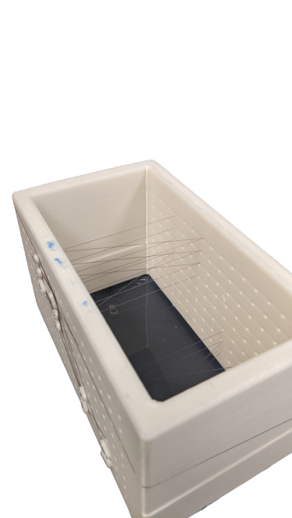
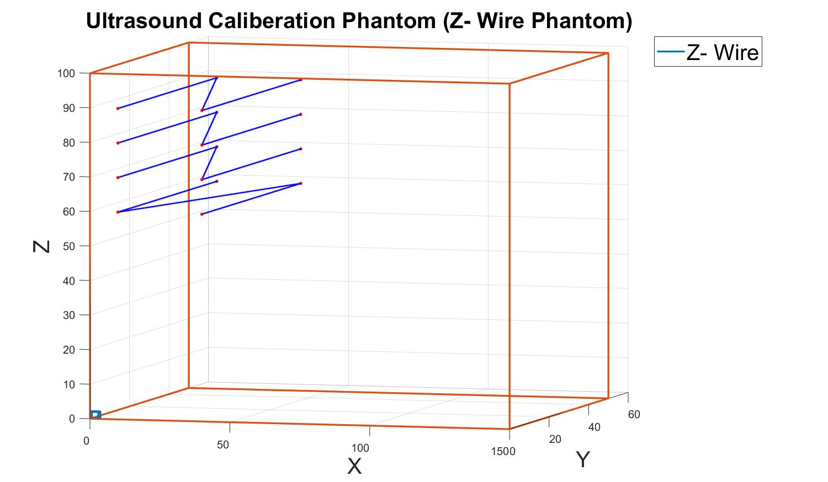
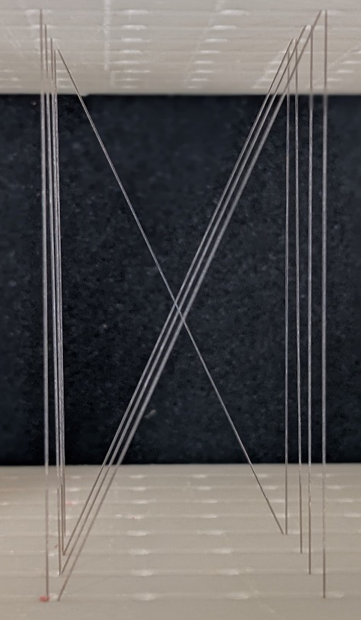
Design of Calibration Phantom
(a) 3D Printed Calibration Phantom 15 x 5 x 10 cm
(b) Fishing Wires arranged in N – shape with 4 layers
(c) Point Cloud model of the Calibration Phantom

Slide 7
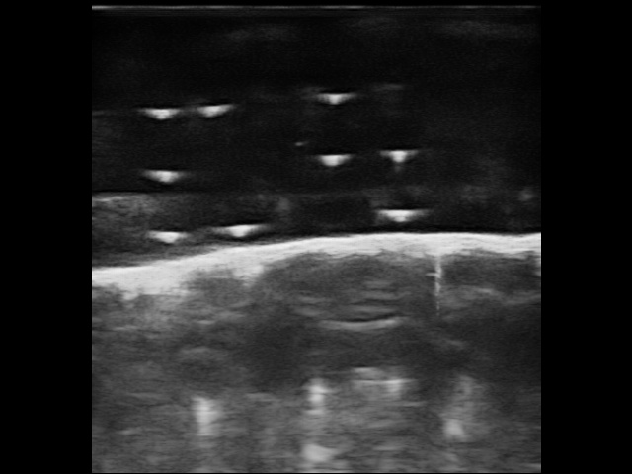
Data Acquisition and Segmentation
Acquiring good ultrasound scans is challenging
Air bubbles
Small dust particles
Sensitive probes
Segmenting markers very close to each other is difficult.
Median filter
Noise removal
Morphological operation
Intersection of Wire with Image Plane
Base of the Phantom
Initial US Scan

Slide 8
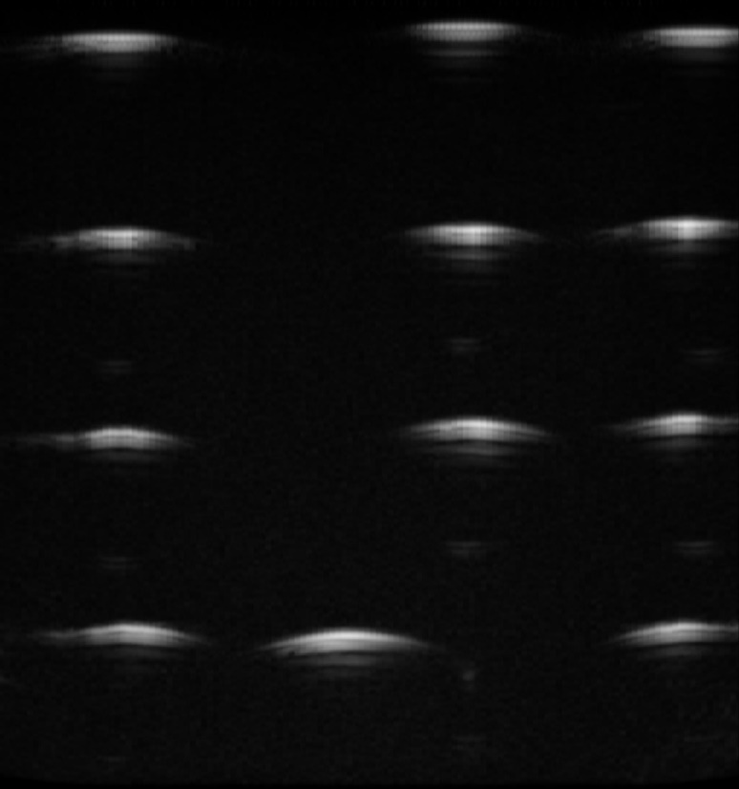
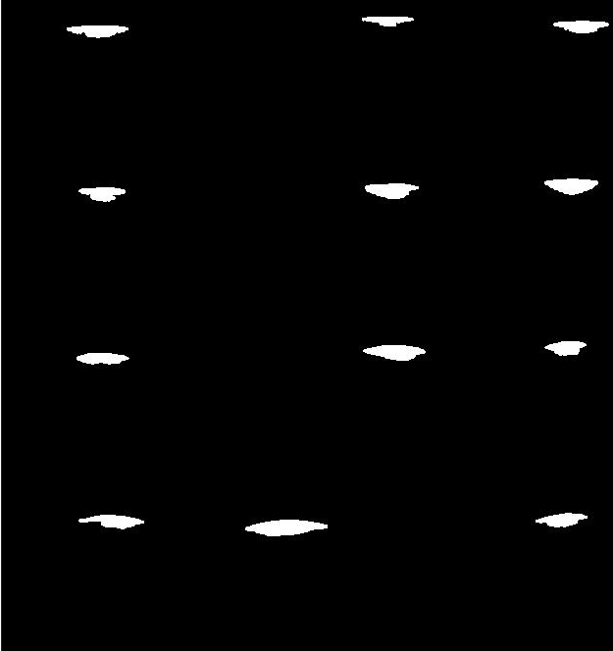
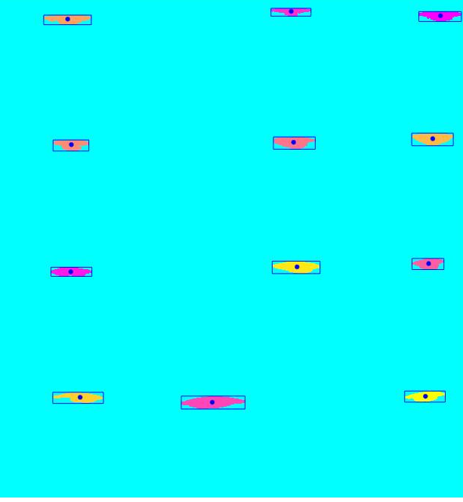
Segmentation Results
Centroids
(a) Acquired Images
(b) Segmentation Results
(c) Extracting centroids from segmented markers

Slide 9
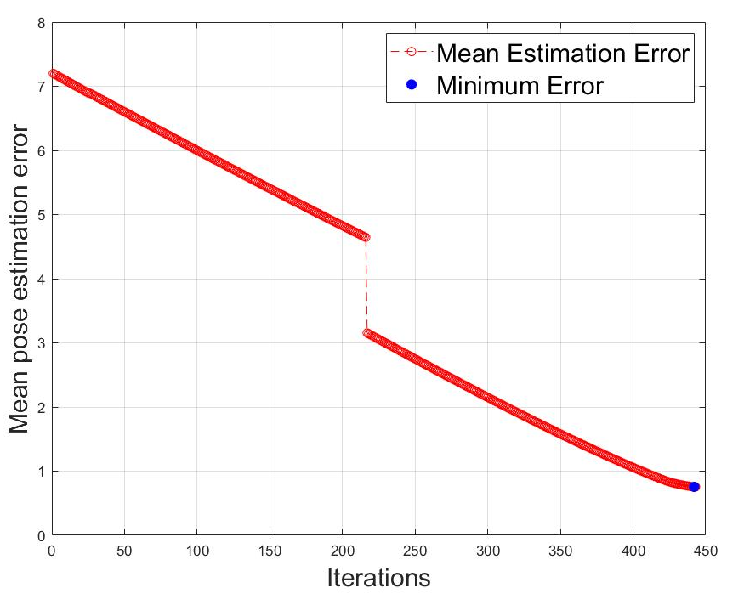
Pose Estimation
Pose estimation is challenging for US scans due to mapping 2D image to 3D phantom
Transformation from phantom coordinate frame to the US probe coordinate frame
Match the segmented markers to the point cloud model of the phantom
Obtain the matching correspondences
Compute the transformation between matched phantom points and marker points
Calculate pose estimation error
Mean pose estimation error = 0.76mm

Slide 10
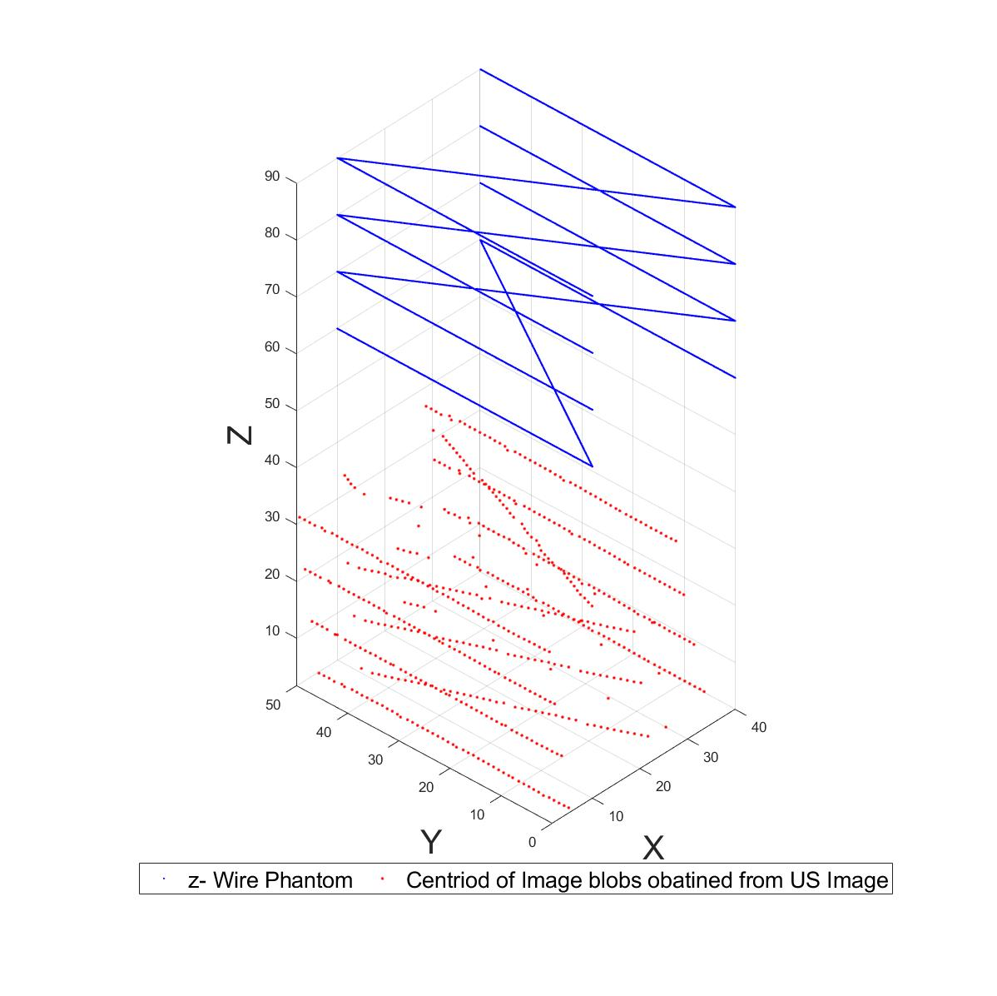
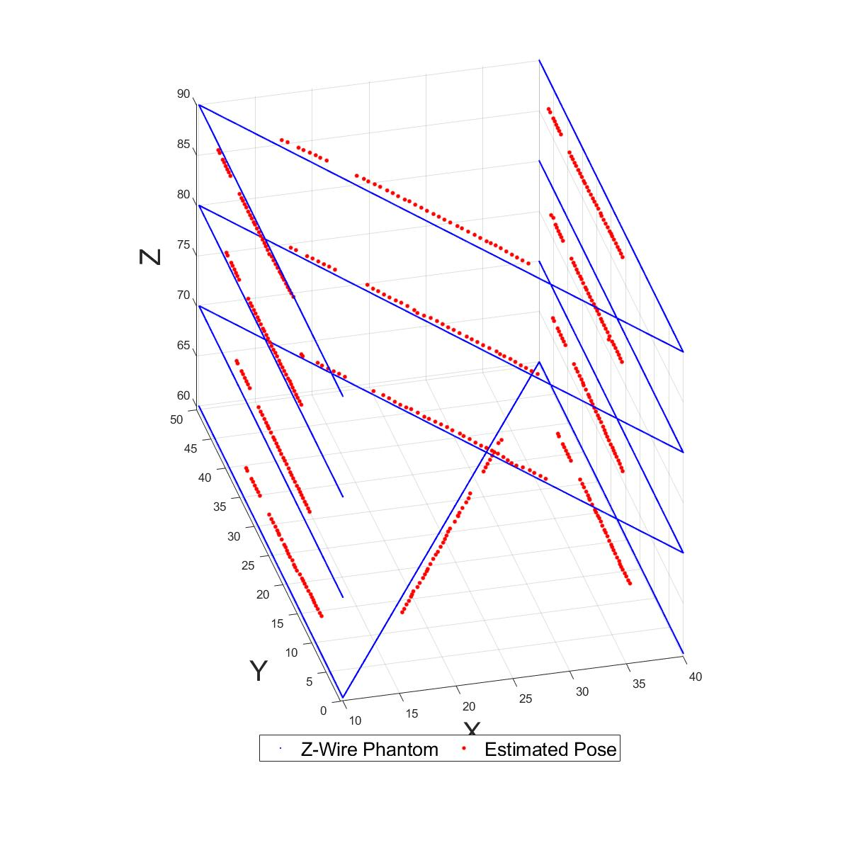
Pose Estimation Results
Initial Data
Transformed Data

Slide 11
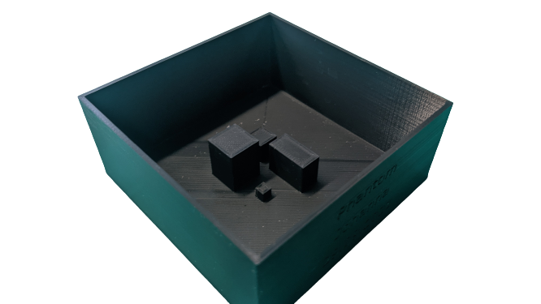
Upcoming Tasks
Solve hand eye calibration
Creating 3D volume using image stitching techniques
Using the calibrated US probe scan the shown objects.
Measure the 3D objects and evaluate the results.
Objects

Slide 12
Thank you

Slide 13
Pose Estimation Plane Wise
Iteratively feed one plane of the phantom
Commute the transformation between segmented markers and static phantom plane
Transform the markers
Compute mean Euclidian distance between markers and correspondence phantom points
Choose the transformation that yields least distance
Pose estimation error = 0.76mm
Limitations :
Case of rotation along X and Z axis is not considered

Slide 14
Pose Estimation using Distance Ratio
Compute the distance ratio of the markers for every layer
Compute the distance ratio for the phantom
Match the distance ratio for every layer separately
This gives the approximate location of the image plane in phantom coordinates
Use ICP to compute the transformation in the small region of the phantom model
Pose estimation error = 1.05mm
Limitation:
Rotation along Z axis is difficult to estimate.
α_1
α_2
d_image = α_1/ α_2

