Slide 1
Life Cycle Assessment(LCA)
Case study – Intermediary presentation
Gasoline vs electric car

Slide 2
Needs and objectives
Context and needs: - Climate change and carbon emissions = large problem
- In 2019 the transportation sector generated 29% of GHG emissions in USA, largest share of emissions (US EPA 2021)
- Over 90 percent of the fuel used for transportation is petroleum based, which includes primarily gasoline and diesel (IPCC 2007)
- Lithium Ion battery production requires mining and extraction of specific metals and minerals, which also has substantial environmental impacts
Objective: Compare the environmental impacts of a gasoline vs an electric car
Study various electricity sources and different distances driven over the car lifetime

Slide 3
Function
PRODUCTS
MAIN FUNCTION
SECONDARY FUNCTION & OTHER PERFORMANCES
Product A
Transportation of people and goods
Impress others, safety,
Product B

Slide 4
Reference flows and key environmental parameters
PRODUCTS OR SYSTEM
FUNCTIONAL UNIT (service offered)
REFERENCE FLOWS (what is purchased)
KEY ENVIRONMENTAL PARAMETERS (linking reference flows to functional unit)
Gasoline car
1/150,000 of a gas car
6.19 kg gas
Fuel efficiency
Total distance driven over lifetime
Car weight and material composition
1 Vehicle km
(V-km)
Electric car
1/225,000 of an electric car
0.26 kWh electricity

Slide 5
Main assumptions and data used
Lifetime distance: - Gasoline car: 150000 km
Electric car: 1.5 x distance of the gasoline car
Gasoline car: input data from ecoinvent documentation: petrol car 2010 x 1.05 for weights, and / 1.05 for consumption and emissions, consumption of 0.065/1.05 kg gasoline/V-km
- Electric car : input data from conference paper Tesla 3.0
- No battery replacement

Slide 6
Process Tree: Gasoline car – summary Neil
alkyd paint, white
2.91E-05 kg
polyethylene, high density, granulate
7.14E-04 kg
aluminum, primary, ingot
3.63E-04 kg
Transportation
Freight Train
3.71E-03 t-km
Transportation
Truck
3.94E-04 t-km
emulsion paint incineration
2.91E-05 kg
polypropylene, granulate
3.43E-04 kg
chromium oxide, flakes
1.68E-05 kg
polyvinylchloride, suspension polymerized
1.12E-04 kg
sheet rolling, copper
1.41E-04 kg
glass incineration 2.11E-04 kg
electronics, for control units 4.08E-05 kg
section bar rolling, steel
1.42E-03 kg
ethylene
1.30E-04 kg
sheet rolling, steel
3.79E-03 kg
Transportation
Oceanic freight
6.93E-02 t-km
1 vehicle km
during 150,000 km lifespan
plastic mixture incineration 4.55E-04 kg
1 Gas Vehicle
ethylene glycol
3.36E-05 kg
steel, low-alloyed, hot rolled 6.93E-03 kg
flat glass, uncoated
2.11E-04 kg
sulfuric acid
5.60E-06 kg
zinc in car shredder residue incineration
4.12E-05 kg
Supply chain petrol, low-sulfur 6.19E-02 kg
heat, natural gas
1.55E-02 MJ
synthetic rubber
3.09E-04 kg
lead
9.10E-05 kg
tap water
2.25E-02 kg
aluminum recycling 3.63E-04 kg
Light fuel oil, burned in furnace 1MW of greenhouse/MJ
4.41E-04 MJ
zinc
4.12E-05 kg
Direct combustion 6.19E-02 kg
nickel
9.80E-06 kg
electricity, medium voltage
4.16E-03 kWh
Note: For direct comparisons, we assume the same weight and distances divided by a different lifespan. The exact numbers calculated will be different for transportation.
Notes:
Note: For direct comparisons, we assume the same weight and distances divided by a different lifespan. The exact numbers calculated will be different for transportation.

Slide 7
Process Tree: Electric car summary Neil
alkyd paint, white
1.85E-05 kg
lubricating oil
1.51E-05 kg
Battery, Li-ion, rechargeable, prismatic
3.64E-04 kg
Metal working, aluminum manufacturing
3.40E-04 kg
Transportation
Freight Train
2.47E-03 t-km
Transportation
Truck
2.63E-04 t-km
Recycling of iron and mixed metal scrap 4.25E-03 kg
glass at landfill 2.18E-04 kg
Copper
1.28E-03 kg
Metal working, steel manufacturing
4.24E-03 kg
electronics, for control units 1.04E-04 kg
Transportation
Oceanic freight
4.24E-02 t-km
1 vehicle km
during 225,000 km lifespan
mineral oil incineration
1.51E-05 kg
Polypropylene, granulate
7.24E-04 kg
1 Electric Vehicle
plastic, mixture at landfill
7.24E-04 kg
ethylene glycol
6.49E-05 kg
Polyurethane, rigid foam
4.04E-05 kg
electricity, medium voltage
0.26 kWh
extruded and thermoformed plastic sheets
7.24E-04 kg
waste polyurethane foam
4.04E-05 kg
steel, low-alloyed, hot rolled 4.24E-03 kg
flat glass, uncoated
2.18E-04 kg
synthetic rubber
2.37E-04 kg
aluminum recycling 3.40E-04 kg
Note: For direct comparisons, we assume the same weight and distances divided by a different lifespan. The exact numbers calculated will be different for transportation.
Notes:
Note: For direct comparisons, we assume the same weight and distances divided by a different lifespan. The exact numbers calculated will be different for transportation.

Slide 8
Energy, CO₂ and CO_{2equ} balance: Gasoline car

Slide 9
Energy, CO₂ and CO_{2equ} balance: Electric car

Slide 10
Comparison of energy and CO2 balance across scenarios

Slide 11
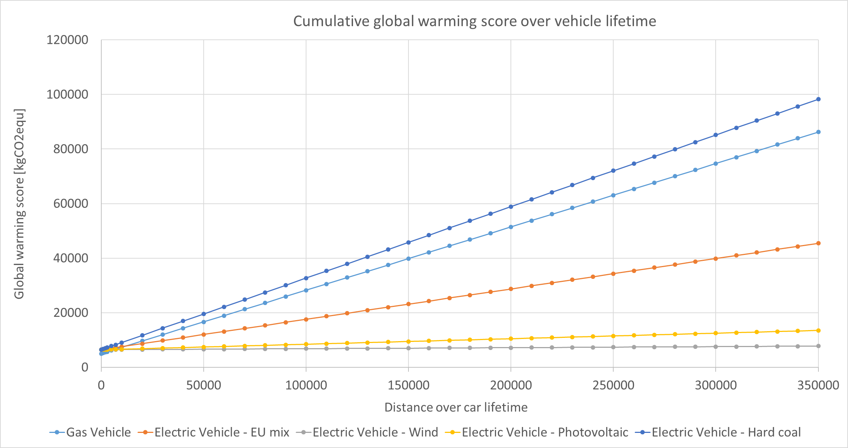
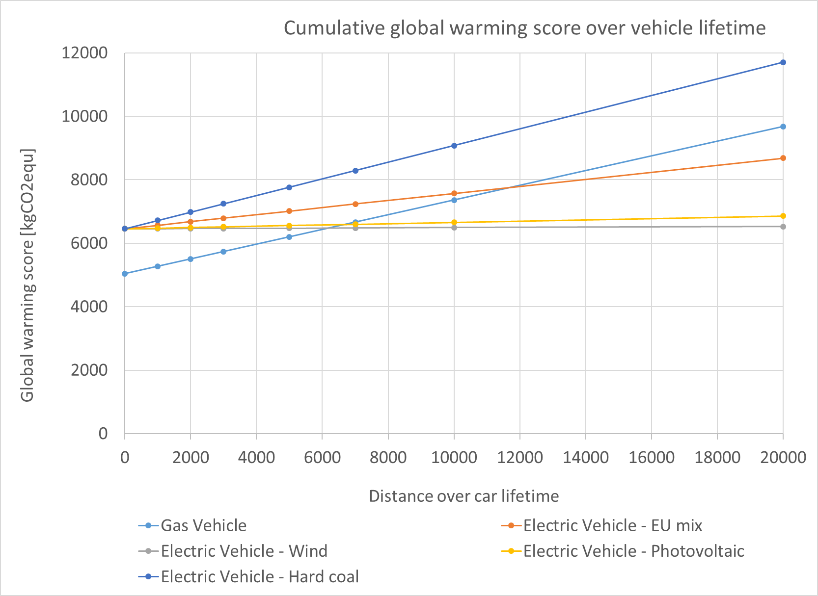
Interpretation – sensitivity study cumulative

Slide 12
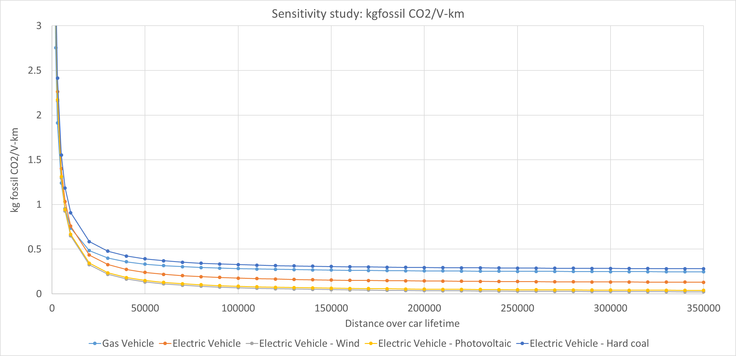
Interpretation – sensitivity study fossil CO2 per V-km

Slide 13
Conclusion and next steps
The gas vehicle scenario generates higher environmental impacts in terms of energy use and carbon footprint compared to the electric vehicle with UCTE electricity, medium voltage production mix.
However, the electric vehicle scenario with hard coal generates higher environmental impacts in terms of carbon footprint compared to the gas vehicle.
The performance of electric vehicles drastically improves with wind or photovoltaic electricity – a key change towards sustainable consumption
Use phase is dominant for the gasoline and the electric car with EU mix, but manufacturing has a substantial contribution with improved photovoltaic and wind electricity

