Slide 1

Analyzing the Impact of Healthcare Expenditure on Life Expectancy across Countries
Name: Kuvalesh Parsad

Slide 2
Introduction
Life expectancy is a key indicator of a country’s overall well-being and quality of life. Understanding the relationship between healthcare expenditure and life expectancy can help policymakers make informed decisions to improve public healthcare. This project aims to analyze if increased healthcare spending leads to longer life expectancy.
Hypothesis
Countries with higher healthcare expenditure per capita have higher life expectancy rates.

Slide 3






Datasets
Healthcare Expenditure per Capita (US$)
Provides data on healthcare spending per capita for various countries.
Life Expectancy at birth (Years)
Provides life expectancy at birth for various countries over several years.

Slide 4
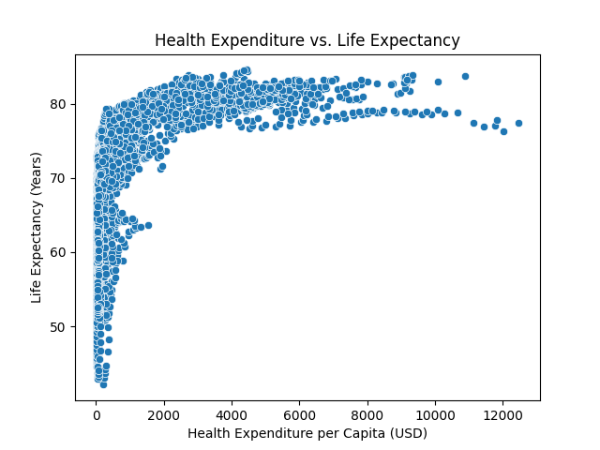
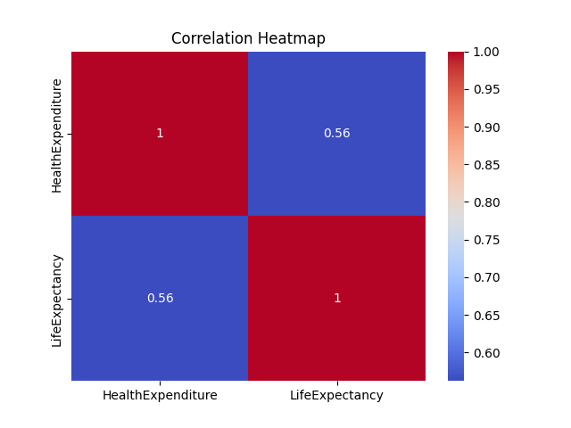
Descriptive Analysis

Slide 5
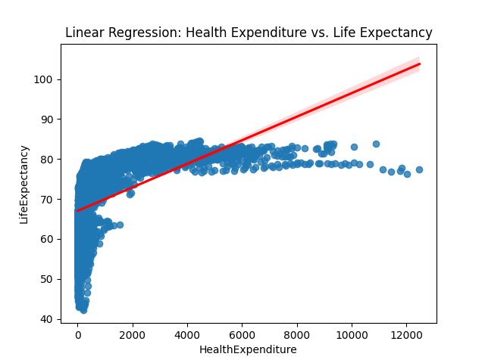
Predictive analysis
Used a linear regression model to predict life expectancy at birth based on healthcare expenditure per capita.
Response variable: Life expectancy at birth (Years)
Predictor variable: Healthcare Expenditure per capita (US$)
After cleaning and merging the data, the model was trained on the combined dataset from multiple years.
R² Score: 0.316
This means that healthcare spending alone explains approximately 31.6% of the variation in life expectancy across countries. While this indicates a positive correlation, it also suggests that other factors (such as education, infrastructure, lifestyle,etc.) significantly influence life expectancy.

Slide 6
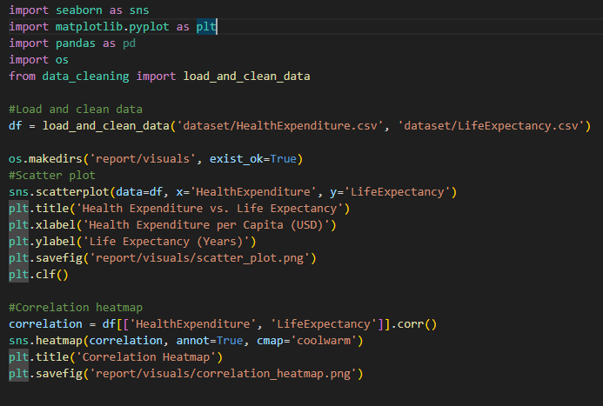
Code explanation
The following code ‘load_and_clean_data()’ merges two datasets, clean column names, filters missing data and combine multiple years into one DataFrame.
‘sns.scatterplot()’ shows the overall relationship and ‘sns.heatmap()’ highlights strength of relationship

Slide 7
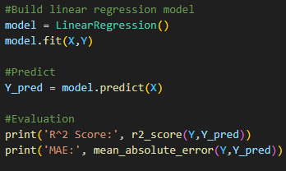
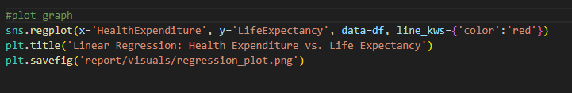
Predicts life expectancy based on spending
R² Score = 0.316 → 31.6% of variation explained
Plots the graph and adds a best-fit line to visualize prediction model

Slide 8
Github Repository Overview
Link: https://github.com/Nileshp1007/Final-Presentation
├── dataset/
│ ├── HealthExpenditure.csv
│ └── LifeExpectancy.csv
├── data_cleaning.py
├── descriptive_analysis.py
├── predictive_model.py
├── report/
│ ├── visuals/
│ ├── scatter_plot.png
│ ├── correlation_heatmap.png
│ └── regression_plot.png
├── FinalPresentation.pptx
├── FinalProjectProposal.pdf
└── README.md

Slide 9
Conclusion
In this project, we explored the relationship between healthcare expenditure per capita and life expectancy at birth across various countries using real-world data. Our descriptive analysis revealed a positive correlation between the two variables, suggesting that countries investing more in healthcare generally see better health outcomes in terms of longevity.
To further evaluate this relationship, we applied a linear regression model, with healthcare expenditure as the predictor and life expectancy as the response variable. The model produced an R² score of 0.316, indicating that while there is some predictive power, healthcare spending alone accounts for only around 31.6% of the variation in life expectancy. This finding implies that other socioeconomic, environmental, and lifestyle factors also significantly influence life expectancy and should be considered in future studies.
Through this analysis, we gained valuable experience in data cleaning, visualization, statistical evaluation, and predictive modeling. Our results demonstrate the complexity of health outcomes and the importance of multidimensional data in understanding them. Future work could improve model accuracy by incorporating additional variables and exploring more advanced machine learning techniques.

