Slide 1
FINAL YEAR PROJECT PRESENTATION
DevTask Hub
Developer Task & Issue Tracking System with GitHub PR Synchronization
STUDENT & PROJECT DETAILS
Student Name: Parmar Nilesh Prakashkumar
Enrollment No: 202206100110113
Semester: 9th Semester
Team Mode: Individual project
MENTORSHIP & AFFILIATION
Internal Guide: Bhavik Sarang
External Guide: Mr. Hardik Patel
Institute: Babu Madhav Institute of Information Technology
University: Uka Tarsadia University

Slide 2
DEVTASK HUB
Project Definition
• Enterprise Task Management: A full-stack, modular web system engineered for software teams to track development workflows and project milestones.
• Deterministic State Machine: Enforces a strict 4-stage lifecycle (ToDo -> InProgress -> InReview -> Done) eliminating skipped testing or review stages.
• Decoupled SPA Architecture: Built with ASP.NET Core Web API (.NET 10) and a React 19 + TypeScript single-page client for instant interactivity.
• Dual Role Governance: Provides segregated workflows for Administrators (organization governance) and Developers (task execution & workload).
• Seamless GitHub Integration: Bridges issue tracking with code repositories by linking public GitHub PRs and caching real-time review/draft statuses.
• Zero-Trust Security Design: Stateless 15-min JWT access tokens with rotating 14-day refresh tokens and automatic reuse theft detection.
Babu Madhav Institute of Information Technology | Uka Tarsadia University

Slide 3
DEVTASK HUB
SRS - Purpose
• Definitive Technical Specification: Specifies the complete architectural invariants, functional capabilities, and security boundaries of DevTask Hub.
• Workflow Enforcement: Eliminates chaotic, ad-hoc task transitions by binding developer activities to a deterministic state machine.
• Traceability & Accountability: Provides an immutable audit trail capturing actor, property diffs, and UTC timestamps for every task modification.
• Developer-Centric Visibility: Combines visual Kanban columns with tabular list views to surface urgent and overdue tasks in real time.
• Continuous Source Traceability: Ensures code contributions are explicitly linked to tracked tasks without leaving the issue management workspace.
• Production-Ready Baseline: Delivers verified enterprise patterns (DTO layers, soft deletes, problem details, PBKDF2 hashing) without framework bloat.
Babu Madhav Institute of Information Technology | Uka Tarsadia University

Slide 4
DEVTASK HUB
SRS - Scope
• Core Identity & Auth: Stateless JWT, HTTP-only refresh rotation, reuse detection, PBKDF2 password hashing.
• Project Administration: Project key validation (2–10 alphanumeric), team member access, lifecycle statuses.
• Task State Machine: Guarded 4-step workflow, assignee membership constraints, priority levels, categories.
• Kanban & List Boards: Interactive drag-and-drop board with optimistic UI plus server-paginated tabular list.
• Role Dashboards: Admin KPI analytics (total counts, activity feed) and Developer workload trackers.
• Public GitHub Link: Public developer profile linking, PR URL regex validation, and state synchronization.
• Private Git Repositories: No private repository OAuth or stored Personal Access Tokens (unauthenticated API only).
• GitHub Webhooks: No asynchronous push webhooks; sync is client-triggered on demand.
• External Email SMTP: No third-party email provider integration; direct credential verification.
• WebSocket Feeds: No full-duplex SignalR streams; client uses HTTP polling and optimistic cache updates.
Babu Madhav Institute of Information Technology | Uka Tarsadia University

Slide 5
DEVTASK HUB
SRS - Identification of Need
• Manual Spreadsheets Lack Control: Teams using Excel/Sheets suffer from accidental status overwrites and unverified task completion.
• Context Switching Overhead: Developers waste hours toggling between external issue trackers and GitHub repositories to inspect PR states.
• Weak Session Hygiene in Generic Apps: Many lightweight trackers store static refresh tokens or plain JWTs in localStorage, vulnerable to XSS.
• Enterprise Bloat & High Cost: Enterprise tools (Jira, Linear) are often cost-prohibitive, complex to configure, and overburdened with unnecessary features.
• Missing Role Clarity: Generic tools often expose administrative toggles to developers or fail to isolate project visibility across teams.
• The Solution – DevTask Hub: A focused, lightning-fast modular tracker enforcing strict domain rules, cryptographic token rotation, and frictionless PR sync.
Babu Madhav Institute of Information Technology | Uka Tarsadia University

Slide 6
DEVTASK HUB
SRS - Technology Used
• Backend Framework: ASP.NET Core Web API on .NET 10 (net10.0) with modular folder layering.
• Database & ORM: SQL Server 2025 Express with EF Core 10.0.13, code-first migrations, and fluent check constraints.
• Authentication & Security: JWT Bearer (HS256, 15m), ASP.NET Identity Core PasswordHasher<User> (PBKDF2), HTTP-only cookies.
• Frontend Client: React 19.3.1 with TypeScript 6.0.3, modern React Hooks, and Context API state management.
• Build Tool & Routing: Vite 8.3.4 for fast compilation and React Router DOM v7.18.4 for declarative client routing.
• External Integration: GitHub REST API v3 (HttpClient factory with custom user-agent and JSON parsing).
Babu Madhav Institute of Information Technology | Uka Tarsadia University

Slide 7
DEVTASK HUB
SRS - Functional Requirements
• FR-01 to FR-03: Identity & Auth: User registration, PBKDF2 credential verification, and 14-day cryptographic refresh token rotation.
• FR-04 to FR-06: Projects & Teams: Uppercase key validation (regex), team membership guards, and deletion block on active tasks.
• FR-07 to FR-08: Task Workflow: Creation with assignee member constraint, and 4-stage state machine transition enforcement.
• FR-09 to FR-10: Audit & Visual Board: Immutable activity logs for all updates, drag-and-drop Kanban board, and paginated list view.
• FR-11 to FR-12: Dashboards & Profiles: Admin KPI summaries, Developer overdue task trackers, and public GitHub profile linkage.
• FR-13 to FR-14: PR Sync & User Admin: Task pull request regex linking, live GitHub status sync, and admin user active/deactivation.
Babu Madhav Institute of Information Technology | Uka Tarsadia University

Slide 8
DEVTASK HUB
SRS - Non-Functional Requirements
• Security (NFR-01): PBKDF2 password hashing, HS256 signed JWTs, SHA-256 hashed refresh tokens, and user-secrets configuration.
• Performance (NFR-02): Sub-100ms API response latency, server-side pagination, and route-level code splitting via React.lazy.
• Usability & Design (NFR-03): Custom CSS tokens, responsive layout (768px mobile drawer), and clear semantic color badges.
• Data Reliability (NFR-04): Foreign key cascading/restrict rules, unique indexes, and EF Core code-first migration integrity.
• Maintainability (NFR-05): Decoupled single-project architecture with strict separation: Controllers -> Services -> DTOs -> DbContext.
• Scalability (NFR-06): Stateless authentication design allows horizontal backend scaling behind a reverse proxy/load balancer.
Babu Madhav Institute of Information Technology | Uka Tarsadia University

Slide 9
DEVTASK HUB
SRS - Modules
• Authentication & Session: AuthController & AuthService handling registration, login, refresh rotation, and logout.
• Project Administration: ProjectsController & ProjectService managing keys, details, members, and status.
• Task & Workflow Management: TasksController & TaskService driving CRUD, Kanban, filters, and state machine validation.
• Activity & Audit Trail: TaskActivityLog tracking chronological actor actions and property mutations.
• Role-Aware Dashboards: DashboardController serving Admin KPI aggregations and Developer personal workloads.
• GitHub & User Management: GitHubController for profile/PR sync, and UsersController for administrative account controls.
Babu Madhav Institute of Information Technology | Uka Tarsadia University

Slide 10
DEVTASK HUB
SRS - User Characteristics
• Administrator Role: Project Managers / Team Leads with full organizational authority.
• Admin Capabilities: Create/archive projects, assign members, inspect organization KPIs, and toggle user active states.
• Developer Role: Software Engineers and QA contributors executing development tasks.
• Developer Capabilities: Create tasks in assigned projects, drag tasks across Kanban columns, link PRs, and track deadlines.
• Strict Authorization Guards: Enforced via ASP.NET Core [Authorize(Roles = 'Admin')] attributes and React RequireRole guards.
• Technical Competency: Both roles possess standard software engineering literacy and familiarity with agile boards.
Babu Madhav Institute of Information Technology | Uka Tarsadia University

Slide 11
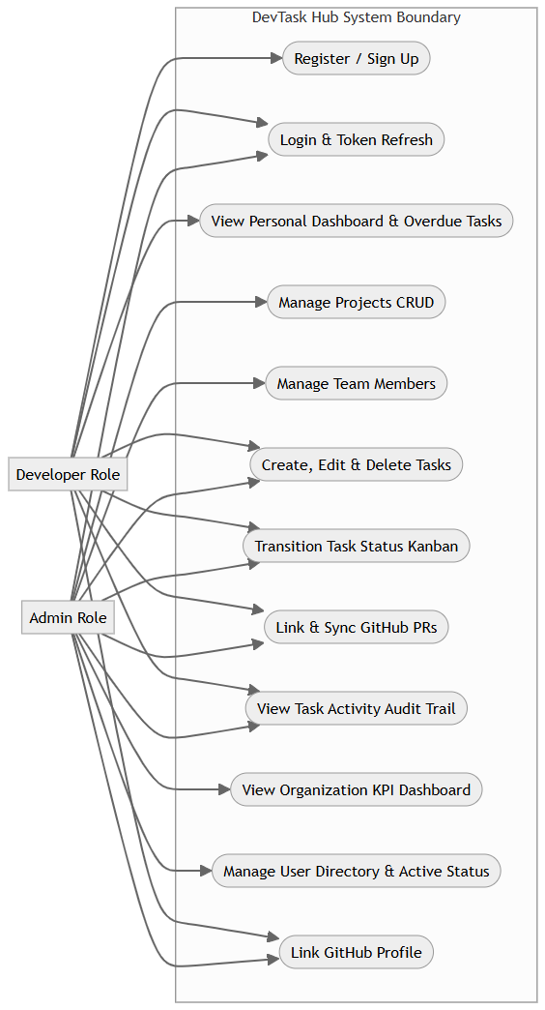
DEVTASK HUB
Use Case Diagram
• Dual Actor Boundary: Distinct use-case mappings for Admin and Developer roles.
• Shared Operations: Both roles authenticate, view tasks, transition Kanban states, and link PRs.
• Admin Exclusive: Project creation, team member management, user directory, and KPI reports.
• Developer Focus: Personal workload inspection, overdue task monitoring, and profile linking.
Babu Madhav Institute of Information Technology | Uka Tarsadia University

Slide 12
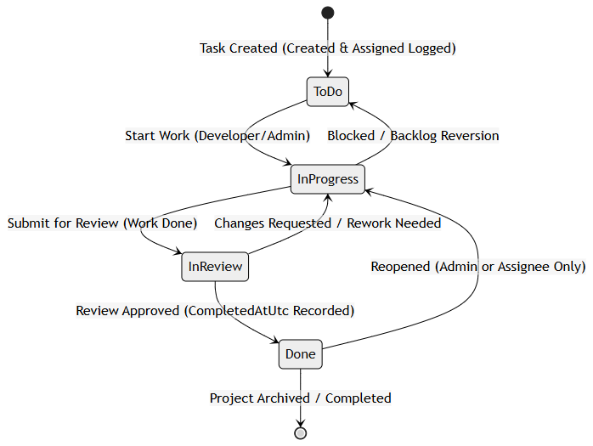
DEVTASK HUB
Activity & State Machine Diagrams
• Deterministic State Machine: Guarantees tasks follow the exact sequence: ToDo -> InProgress -> InReview -> Done.
• Guarded Reverse Flows: InProgress can revert to ToDo; InReview can return to InProgress for requested changes.
• Reopening Constraint: Only Admins or the assigned developer can reopen a completed (Done) task.
• Session Rotation: Background refresh silently rotates tokens with zero user disruption.
• Theft Detection: Replay of revoked tokens immediately invalidates all active sessions for that account.
Babu Madhav Institute of Information Technology | Uka Tarsadia University

Slide 13
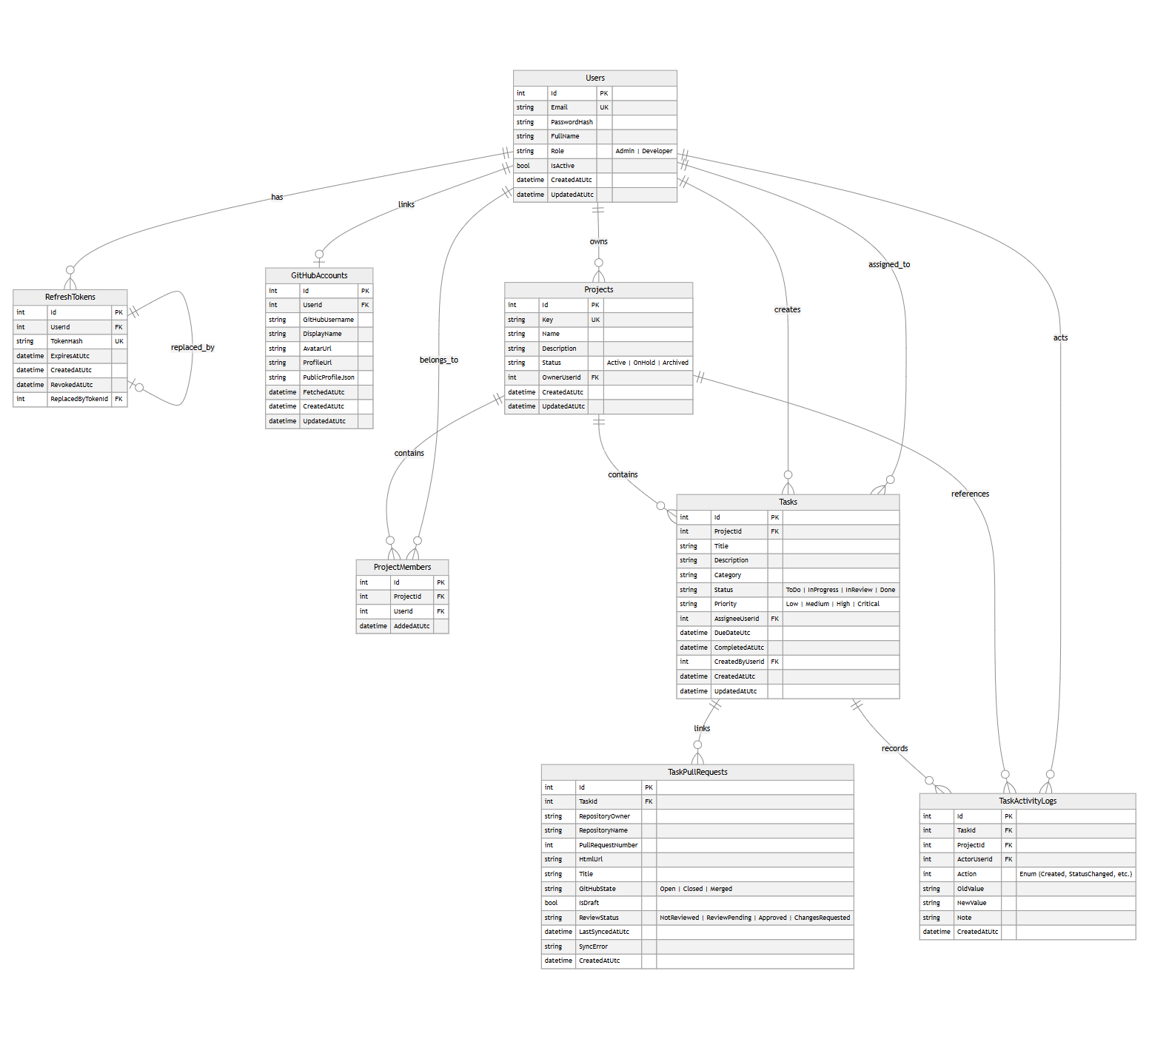
DEVTASK HUB
Data Dictionary & ER Diagram
• 8 Core Entities: Users, Projects, ProjectMembers, Tasks, RefreshTokens, GitHubAccounts, TaskPullRequests, TaskActivityLogs.
• Referential Integrity: Cascade deletes on Tasks & ProjectMembers; Restrict on User relationships to prevent orphaned data.
• Check Constraints: Enforces valid string enums directly in database (Roles, Statuses, Priorities).
• Token Security Table: RefreshTokens stores SHA-256 digests and rotation chains (ReplacedByTokenId).
Babu Madhav Institute of Information Technology | Uka Tarsadia University

Slide 14
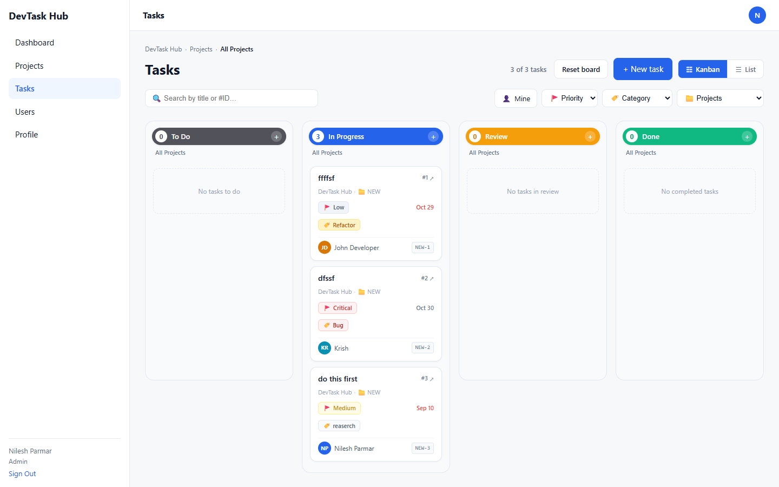
DEVTASK HUB
User Interface Design (Screenshots)
• Interactive Kanban Board: 4-column workflow with drag-and-drop status transitions and optimistic UI updates.
• Card Visual Meta: Shows project key badge, priority pill, category tag, assignee avatar bubble, and due date.
• Overdue Highlights: Tasks past their due date are automatically flagged with vibrant red tags.
• Responsive Multi-View: Instant toggle between Kanban board and multi-filtered tabular list view.
• Minimalist Modern UI: Built with custom CSS variables, 8px radius tokens, and zero heavy UI libraries.
Babu Madhav Institute of Information Technology | Uka Tarsadia University

Slide 15
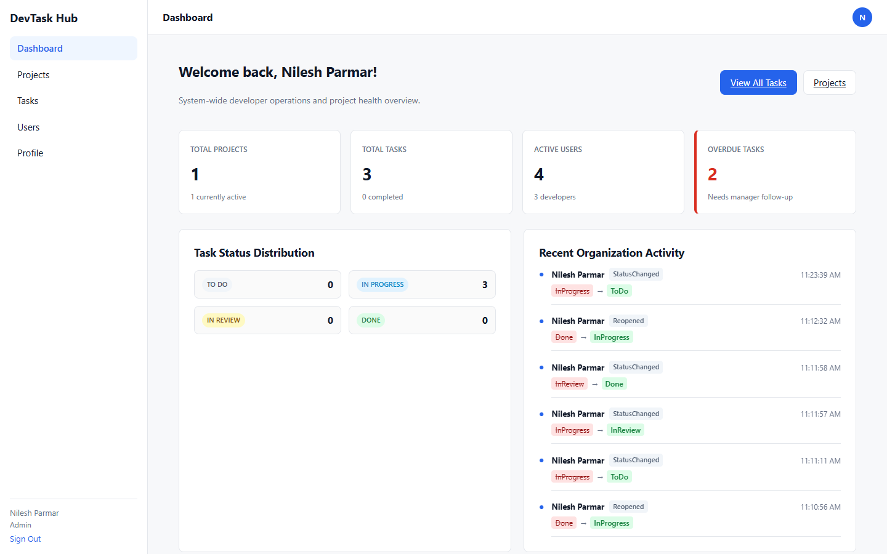
DEVTASK HUB
Reports & Analytics
• Executive KPI Summary: Aggregates total projects, active projects, total tasks, and overdue issue counts.
• Task Distribution Breakdown: Visual distribution breakdown across ToDo, InProgress, InReview, and Done statuses.
• Live Activity Audit Feed: Real-time stream of all user actions with actor name, property diffs, and timestamps.
• Developer Workload Report: Surfaces assigned tasks, urgent overdue alerts, and 7-day upcoming deadlines.
• Project Status Breakdown: Reports member counts and task volumes per active project.
Babu Madhav Institute of Information Technology | Uka Tarsadia University

Slide 16
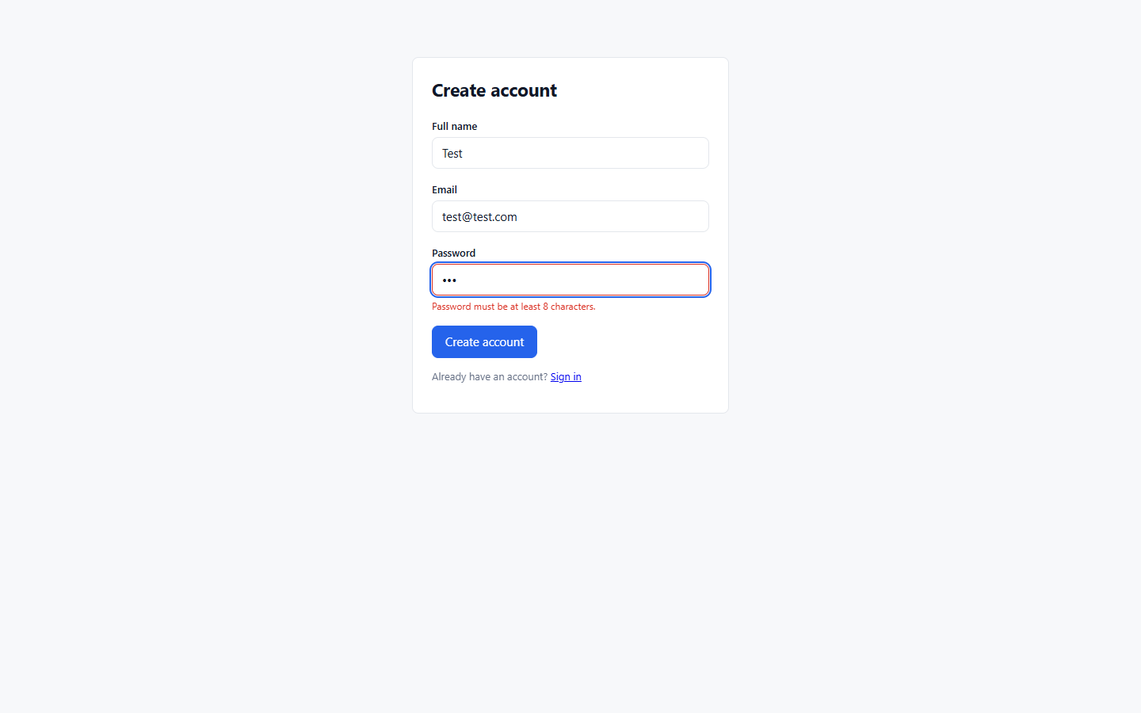
DEVTASK HUB
Snapshot of Validations
• Multi-Layered Validation: Combines real-time client validation with strict ASP.NET Core DataAnnotations.
• Authentication Guards: Validates RFC email regex and minimum 8-character password constraint.
• Project Key Regex: Strictly enforces uppercase alphanumeric format (^[A-Z0-9]{2,10}$) on project creation.
• Assignee Integrity: Server-side check ensures tasks are assigned only to validated project members.
• Duplicate Prevention: Database unique indexes prevent duplicate emails, project keys, and member associations.
Babu Madhav Institute of Information Technology | Uka Tarsadia University

Slide 17
DEVTASK HUB
Test Cases & Live Verification Results
• 24 Automated Tests Executed: 100% verified against live running backend API and SQL Server database.
• Authentication Suite (5 Tests): Verified login, bad credentials (401), registration, duplicate email (400), and token refresh (PASS).
• Project Suite (5 Tests): Verified pagination, key regex validation, member addition, and duplicate member rejection (PASS).
• Task Workflow Suite (5 Tests): Verified creation, legal transitions, illegal jump rejection, and non-member assignment block (PASS).
• Dashboard & Admin (9 Tests): Verified Admin KPIs, Developer workload, RBAC 403 blocks, user toggling, and GitHub sync (PASS).
• Overall Test Result: 24 Tests Passed | 0 Tests Failed | High reliability confirmed across all modules.
Babu Madhav Institute of Information Technology | Uka Tarsadia University

Slide 18
DEVTASK HUB
Extra-Ordinary Features (Beyond CRUD)
• Cryptographic Token Rotation & Theft Detection: Rotating refresh tokens with SHA-256 storage and automated invalidation upon token reuse.
• Deterministic Task State Machine: Rigid 4-stage workflow with business rules preventing out-of-order development progression.
• Public GitHub REST API Integration: Direct synchronization with GitHub pull requests, fetching live states, draft tags, and commit logs.
• Optimistic Drag-and-Drop Kanban: Immediate UI responsiveness with native HTML5 drag events backed by asynchronous API persistence.
• Granular Property Mutation Auditing: Automatic logging of exact before/after diffs on task updates for full compliance traceability.
• Role-Segregated Analytical Dashboards: Context-aware dashboards tailoring operational insights specifically to user permissions.
Babu Madhav Institute of Information Technology | Uka Tarsadia University

Slide 19
DEVTASK HUB
Demonstration Script (Step-by-Step Guide)
• Step 1: Admin Authentication: Navigate to /login, sign in as admin@devtaskhub.com -> Show Admin KPI Dashboard and activity timeline.
• Step 2: Project & Team Setup: Navigate to /projects -> Click 'Create Project' -> Add key 'PRJ' -> Open details and add team members.
• Step 3: Task Creation & Assignment: Navigate to /tasks -> Create task 'Implement OAuth' -> Assign to a team developer with High priority.
• Step 4: Interactive Kanban Flow: Drag task from ToDo to InProgress -> Drag to InReview -> Open details and show automatic activity logs.
• Step 5: GitHub PR Synchronization: In Task Details, paste public GitHub PR link -> Click 'Sync' -> Display live GitHub status badge and commits.
• Step 6: Developer Experience & RBAC: Sign out -> Login as developer -> Show Developer Dashboard (assigned/overdue) -> Try accessing /users -> Show 403 block.
Babu Madhav Institute of Information Technology | Uka Tarsadia University

Slide 20
Thank You!
Questions & Answers (Q&A)
DevTask Hub – Developer Task & Issue Tracking System
Parmar Nilesh Prakashkumar (Enrollment No: 202206100110113)
Babu Madhav Institute of Information Technology | Uka Tarsadia University

